Slide 1
Bangladesh Climate-Resilient Ecosystem Curriculum (BACUM)
Module 2: REDD+ in Climate Change Context

Slide 2
Module 2: REDD+ in Climate Change Context
SECTION IV: DEVELOPING REDD+ STRATEGIES AND ACTION PLANS
4.1. Negotiation in REDD+

Slide 3
REDD+ in Climate Change Context (REDD+)
ENABLING ENVIRONMENT OF REDD+
  1.1. Forests, Forest Carbon and Climate Change
  1.2. Fundamentals of REDD+ and the UNFCCC
  1.3. Stakeholder Engagement
ASSESSING CURRENT CONDITIONS OF REDD+
  2.1. Drivers of Deforestation and Forest Degradation
  2.2. Fundamentals of Forest (Emission) Reference Levels
  2.3. National Forest Monitoring Systems (NFMS) for REDD+
ANALYZING FUTURE OPTIONS FOR REDD+
  3.1. Policies and Measures for REDD+ Implementation
  3.2. REDD+ Safeguards under the UNFCCC
  3.3. The Costs and Benefits of REDD+
DEVELOPING REDD+ STRATEGIES AND ACTION PLANS
  4.1. Negotiation in REDD+
  4.2. National Strategies and Action Plans
  4.3. Approaches for Incentive Allocation System
MONITORING, EVALUATION AND ADAPTATION
  5.1. Establish M&E Framework for REDD+ Action Plan
  5.2. Monitor and Measure Implementation Progress
  5.3. Evaluate, Report and Adapt

Slide 4
Acknowledgements
EXPERT CONTRIBUTORS | SPECIFIC INPUTS
Prof. (Dr.) Manzoor Rashid | Curriculum Development for all topics
Prof. (Dr.) Md. Danesh Miah | REDD+, Forest Carbon
Prof. (Dr.) Md. Jakariya | Community NR Management, Climate Change, Natural Resources Management
UNIVERSITIES
Bangladesh Agricultural University
University of Chittagong
Dhaka University
Independent University, Bangladesh
Khulna University
Noakhali University of Science and Technology
Shahjalal University of Science and Technology
Sher-e-Bangla Agriculture University
North South University
CREL STAFF | CREL STAFF
John A Dorr | Utpal Dutta
Abu Mostafa Kamal Uddin | Ruhul Mohaiman Chowdhury
Kevin T. Kamp | Rahima Khatun
Paul Thompson | Sultana Razia Zummi
Abdul Wahab | Shams Uddin
Shahzia Mohsin Khan
DESIGN, LAYOUT AND CONTENT DEVELOPMENT: Ms. Chi Pham, Curriculum Development Expert, Bangkok, Thailand

Slide 5

Learning Objectives
At the end of this session, students will be able to:
Determine how to reach a consensus agreement on one scenario that is considered to provide the most benefits for the broadest range of stakeholders
Notes:
KEY MESSAGE:
At the end of this presentation students will:
Understand how to reach a consensus agreement on one scenario that is considered to provide the most benefits for the broadest range of stakeholders
During this lecture we will examine:
- What a negotiated process is
- Important principles for a negotiated outcome to be successful
- Understand stakeholder incentives and underlying motivation
- How stakeholders, often with competing or conflicting views can reach an agreement or decision on one particular scenario for the land use plan implementation.

Slide 6
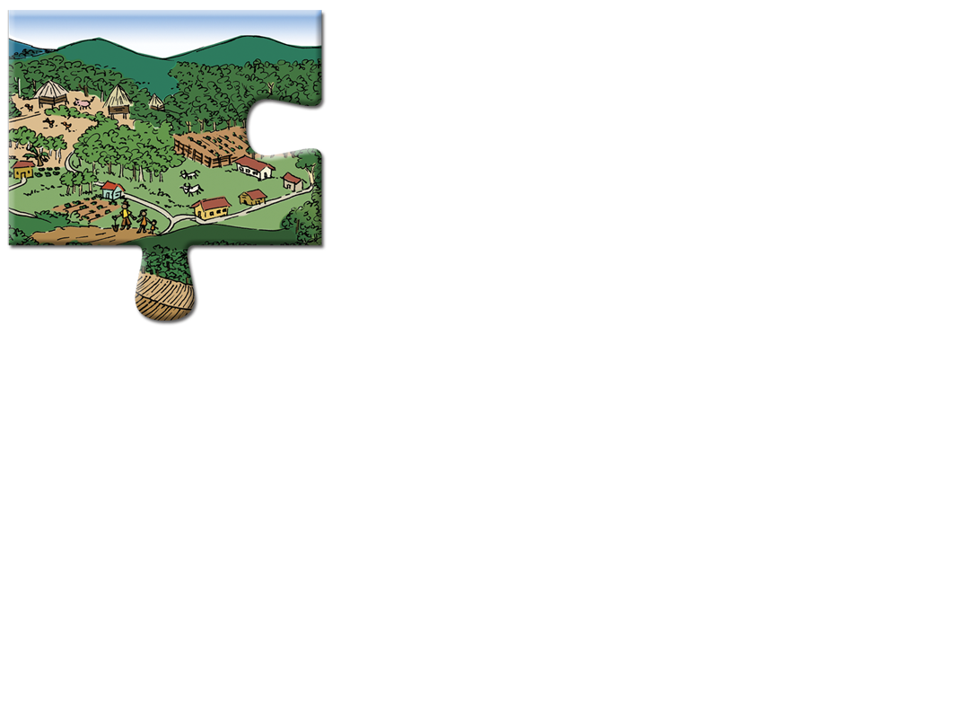
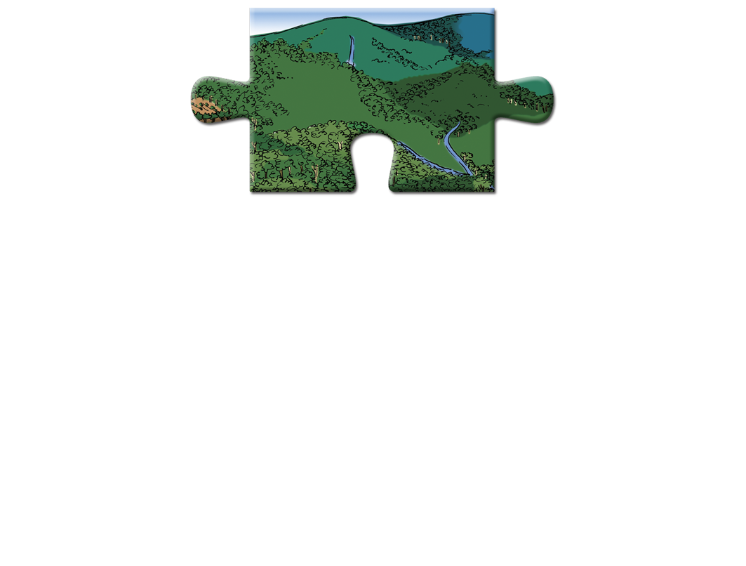
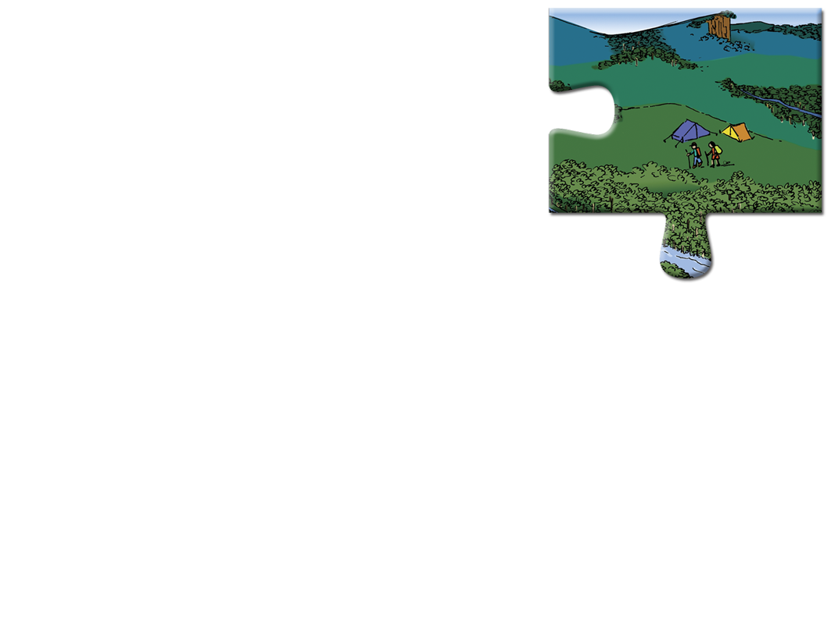

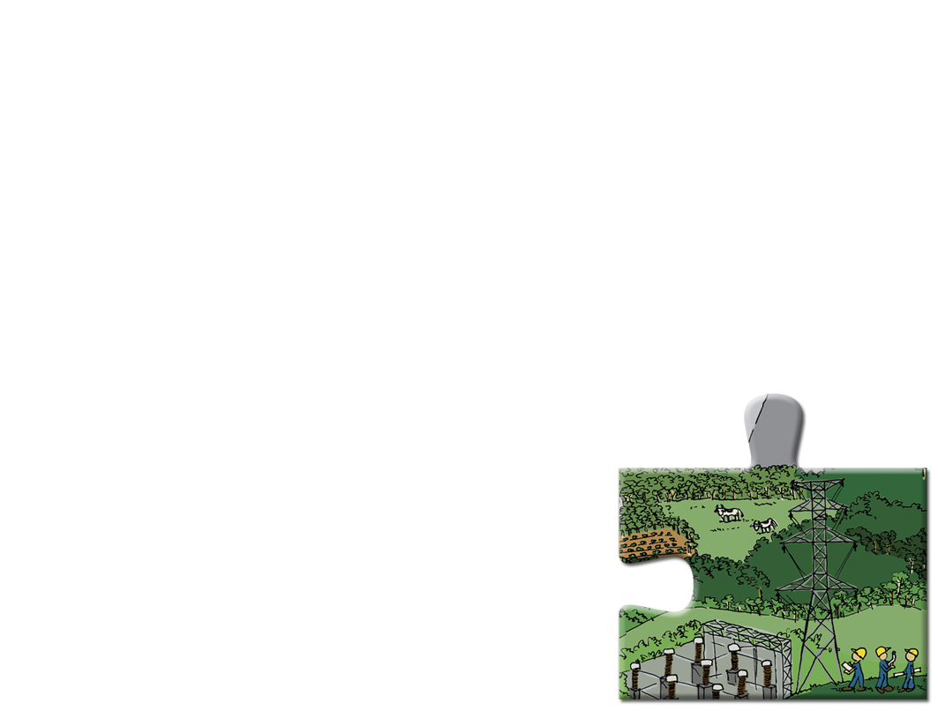
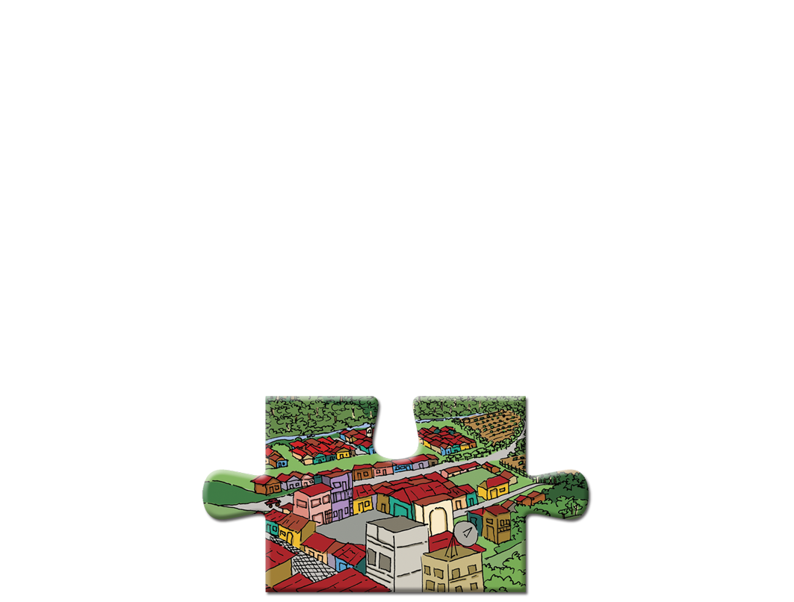
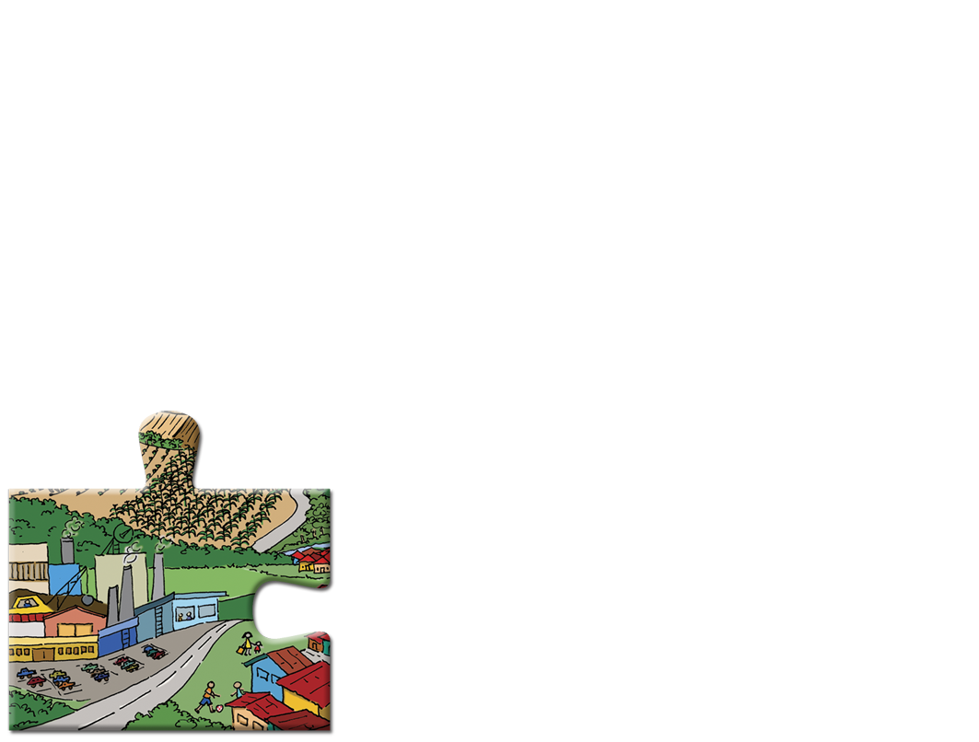
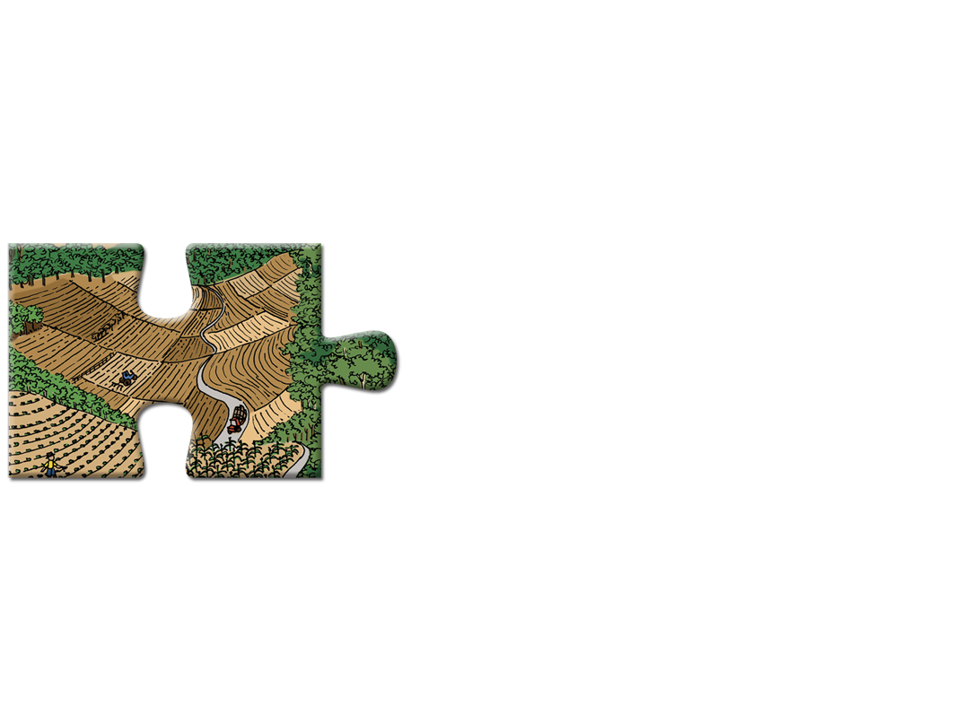

Conflicts and Agreements
Timber
production
Who we are working with?
Hunting & NTFPs
Water
Quantity
Infrastructure development
What are their needs?
Spirit Forests
Conservation
Will there needs be met by the REDD+?
Agriculture Expansion
Climate
change
Notes:
KEY MESSAGE:
Negotiation processes between multiple stakeholders, often with conflicting needs, to reach agreement on forest resources management
Stakeholder always have different needs from forest management. These needs are almost always competing or conflicting.
We need a process to explore these competing needs to see how an agreement can be reached.
Each scenario of forest management planning may be affected by many pressures.
+ Growing population
+ Growing food demand
+ Increased consumption
+ Increased production
+ More competition and
+ Climate change
There are some questions that we need to solve: Which scenario could we choose? And Why?
The critical issue for this module is how to help multiple stakeholders, often with very diverse views, reach is a negotiated agreement on how resources should be used and the benefits from land use distributed equally between stakeholders
How could we seek the agreement on a mutual “best scenario” and sequence implementation needs for REDD+?
References:
USAID. 2015. USAID LEAF‘s Climate Change Curriculum. USAID Lowering Emissions in Asia Forests Program (USAID LEAF). Winrock International and US Forest Service. Bangkok, Thailand.

Slide 7
Example: Negotiations and REDD+
 | Key Assessment Criteria Linked to Objectives
 | Employment | Biodiversity | Forest Cover | Water | GHG Emissions
Scenario 1 | +++ | -- | - | + | --
Scenario 2 | - | - | + | + | -
Scenario 3 | - | ++ | ++ | - | ++
Which scenario is right?
How do we reach agreement on the best one?
Notes:
KEY MESSAGE:
In NRM planning processes there will be a number of options or scenarios to reach the plan’s goals. Stakeholders may not agree on what the best option is. Therefore we need to move through a negotiated process to help stakeholders reach agreement that provides the most benefits to the most stakeholders.
A number of future possible scenarios had been developed and advantages and disadvantages for each of those scenarios had been explored.
But a joint decision between stakeholders as to whether Scenario 1, Scenario 2, Scenario 3 is the best one?
Working through a negotiated process can help stakeholders make an informed decision on which one they think is the best scenario to achieve the goals of the REDD+ action plan.
EXTRA NOTES:
3.42 Prioritization Matrix
Description:
A prioritization matrix is a technique used to achieve consensus within a specific group of participants about an issue. The matrix helps rank problems or issues (usually generated through brainstorming or other techniques) by a particular criterion that is important to the project, as defined by the participants. This allows participants to clearly see which issues are the most important to work on solving first. Prioritization matrices are used to determine what participants consider to be the most pressing issues.
A prioritization matrix can use whatever resources are available to create a table of issues and boxes for participants to cast their ‘votes’. Tools can include whiteboards, computer databases, or twigs and stones in a field trip setting. The important thing is to list all the issues, to determine the frequency with which problems arise in relation to an issue, the importance the people give to this, and to count the votes to determine what is seen by the majority of people as a priority.
References:
USAID. 2015. USAID LEAF‘s Climate Change Curriculum. USAID Lowering Emissions in Asia Forests Program (USAID LEAF). Winrock International and US Forest Service. Bangkok, Thailand.

Slide 8
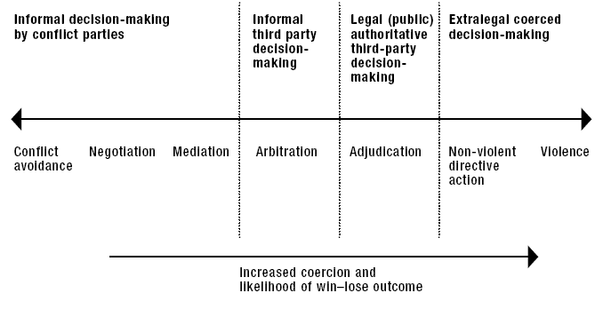
Reaching Agreement: The Options We Have
Notes:
KEY MESSAGE:
1) In reaching agreement there are various ways that agreement can be found.
2) Our lecture will focus on NEGOTIATION
NOTES: Definitions are given, but the lecturer should also provide examples for each of the definitions.
Avoidance: Acting in a way that an agreement can not be reached
Negotiation: a form of decision-making by which two or more parties talk with one another in an effort to resolve their opposing interests.
Mediation: A form of negotiation, but a third party is involved to facilitate the process. BUT the MEDIATOR does not have the authority to impose a solution.
Arbitration: The dispute is presented to a impartial third party, who then makes a decision. But the solution is often non-binding.
Adjudication: The dispute is presented to a judge, the courts or some other administration who then makes a decision. The decision is then binding in which all stakeholders have to agree with.
Direct Action: Protesting.
Coercion: Threatening or using force to impose an agreement.
Source:
FAO (2005) Negotiation and Mediation Techniques for Natural Resource Management, page 42-43

Slide 9
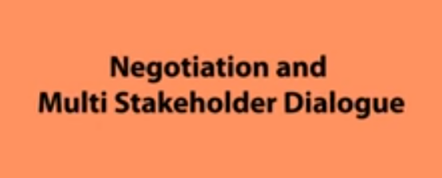
What is a Negotiated Agreement?
https://www.youtube.com/watch?v=1FeM6kp9Q80
Notes:
KEY MESSAGE:
This is a 5 minute video that outlines some of the key principles, issues and steps in a negotiation process.
Many of the key terms, process steps and principles will be further explained during this lecture.
Ask Student:
What do you think a negotiated process is?
Do you think a negotiated process is important to REDD+? Why?
What are some of the main factors needed to make a negotiated process successful?
This video is in English. IF you are teaching in another language this video can be missed as many of the principles, issues and processes shown in this video will be explored during this lecture.
Video Source:
https://www.youtube.com/watch?v=1FeM6kp9Q80

Slide 10
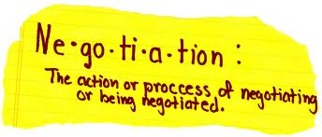
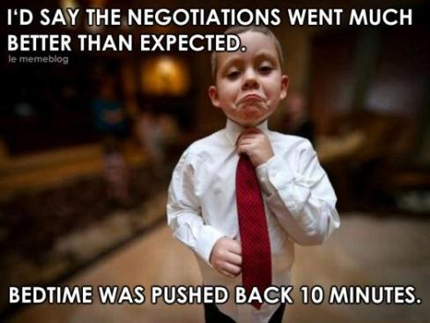

What is a Negotiated Agreement?
Notes:
KEY MESSAGE:
Negotiation is a form of decision-making by which two or more parties talk with one another in an effort to resolve their opposing interests
Negotiating and negotiations are a constant feature of everyday life.
We do it all the time with family, friends and a range of people and organizations.
Give examples on your own daily life:
Negotiating what time your children should go to bed.
Negotiating with your parents what time you will come home.
Negotiating with your husband/wife about going on a holiday.
Negotiation in REDD+ is very important, because it is a process of resolving differences between stakeholders to reach a common agreement.

Slide 11
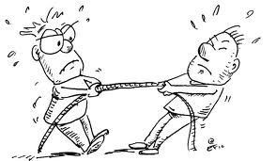
Types of Negotiations
Distributive Negotiations or Confrontational bargaining
  Each side often adopts an extreme position.
  Adversarial. Each side tries to crush the other.
  Win-Lose
Notes:
KEY MESSAGE:
Distributive negotiation sometime is also called hard-bargaining negotiation. In a distributive negotiation, each side often adopt an extreme position, knowing that it will not be accepted.
Distributive negotiation employs a combination of guile, bluffing, and brinksmanship in order to cede as little as possible before reaching a deal.
When each side seeks to prevail over the other (commonly called win–lose or adversarial)
EXAMPLE: Ask your students to give some examples of their communities or Bangladesh.
Reference:
FAO (2005) Negotiation and Mediation Techniques for Natural Resource Management, page 15.
-.

Slide 12

Types of Negotiations
Consensual or Integrative Negotiations
Relatively cooperative.
Principle or interest based
Attempt to improve the quality and likelihood of negotiated agreement.
Notes:
KEY MESSAGE:
Integrative negotiation is set of techniques that attempt to improve the quality and likelihood of negotiated agreement by providing an alternative to traditional distributive negotiation techniques.
Integrative negotiation often attempts to create value in the course of the negotiation. It focuses on the underlying interests of the parties.
Integrative negotiation often involves a higher degree of trust and the forming of a relationship. It can also involve creative problem-solving that aims to achieve mutual gains.
When both sides seek a solution that is mutually beneficial (commonly called principled or interest-based)
When each side seeks to prevail over the other (commonly called win–lose or adversarial)
The negotiation outcomes are Win-Lose; Lose – Lose and WIN –WIN. We can understand this by the two means that are distributive and integrative negotiation
EXAMPLE: Whole protection of natural resource and Ecotourism
Reference:
FAO (2005) Negotiation and Mediation Techniques for Natural Resource Management, page 15.

Slide 13

Objectives of a Consensual Negotiation
GOAL: To reach agreement that is acceptable to all stakeholders with a minimum of compromise and trade-off.
Agreement might not be the ‘best’ or 100% perfect. BUT it is ‘good enough’ for all stakeholders to accept.
Dividing the pie so that everybody gets something
Notes:
KEY MESSAGE:
Consensual Negotiations is the process of seeking agreement where terms acceptable to all parties are elusive or at least not immediately obvious.
Every stakeholder will want a piece of a pie (small pie), and definitely there is not enough pieces for everyone.
The idea is to Increase the size of the pie, so that everyone can enjoy the pie better.
Key issues to also explore:
Develop agreements
Nurture a collaborative, mutually supportive relationship for ongoing problem solving
Find the way for specific interests and underlying needs
Focus on interests over positions
Obtain commitment from the constituents of the groups;
Decide on how to monitor the agreements.
Image source:
http://themedium.blogs.nytimes.com/

Slide 14

Principles of Consensual Negotiations
Separate the people from the problem
Concentrate on interests and not on positions
Develop options that benefit both sides
Use objective criteria for evaluating the options
Notes:
KEY MESSAGE:
Consensual Negotiations are based on 4 very important principles.
1. Separate the people from the problem
In every social conflict there is a factual level and a relational level. Constructive conflict management is only possible if the relational level is taken seriously and it is possible to express feelings, fears, desires, etc. However, this must not be confused with the handling of factual issues. It is easier to work successfully on factual issues when the people issues are treated separately from them. Ideally, people work side by side to attack the problems rather than each other.
2. Concentrate on interests and not on positions:
Participants in negotiations have different perceptions, viewpoints, emotions, likes and dislikes. Taking positions makes things worse because people tend to identify themselves with their positions. The object of negotiations is to satisfy needs and interests.
3. Develop options that benefit both sides:
Negotiation partners should take time to search for a wide range of options before trying to come to an agreement.
4. Insist on using some objective criteria for evaluating the options:
The agreement should reflect fair standards that are shared by the parties.
Reference:
FAO (2005) Negotiation and Mediation Techniques for Natural Resource Management, page 50
http://www.fao.org/docrep/008/a0032e/a0032e00.htm

Slide 15
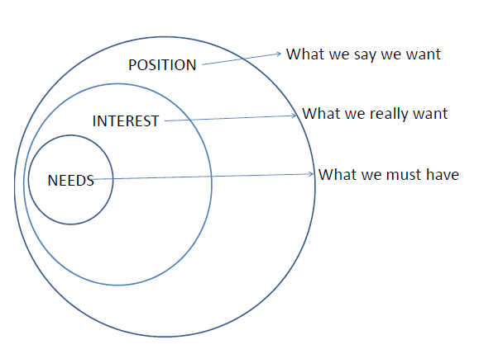
Principles of Consensual Negotiations
Stakeholders will reach agreement if they believe their underlying interests are to be achieved, addressed or satisfied.
Positions
Interests
Needs
Notes:
KEY MESSAGE:
A good negotiation process should help stakeholders move from their position statements to find their common (underlying) needs.
Make sure that examples of Positions and Interests are provided
Positions: - What people say they want in an agreement– the demands they make.
Interests: - What people really want and what motivates them
- Underlying desires and concerns that motivate people to take a position.
Values (Needs):
- Biological and psychological requirements (e.g. needs for shelter, food, security, identity, recognition etc)
EXAMPLES
POSITION: Example: “Local community members must stay outside the national park”
INTEREST: “We are concerned about the impact of subsistence harvesting on the park’s biodiversity
Reference:
FAO (2005) Negotiation and Mediation Techniques for Natural Resource Management, page 50
http://www.fao.org/docrep/008/a0032e/a0032e00.htm

Slide 16

Positions and Interests
Position
Position
Stakeholder A
Stakeholder B
Mutual
interests
Interests
Interests
Notes:
KEY MESSAGE: 1) Consensual negotiation is about helping stakeholders understand where their underlying interests are common.
2) Then using this common understanding to build up an agreement that meets some of the interests of all stakeholders
Notes:
- Focusing on inflexible, immediate and often entrenched positions reduces creativity and narrows agreement possibilities.
- Interests are frequently multiple, and some are likely to be compatible and shared by the groups.
- Once their interests have been articulated and differentiated from their positions, stakeholders have a foundation for entering into consensual, principled or interest-based negotiations.
- Each stakeholder has different position and interests. Negotiation must be seeking to perform mutual interest.
EXAMPLE: - Stakeholder A is timber. He does not care about water resource, environmental pollution.
His interests may be how many woods can he harvest in each year.
- Stakeholder B is Natural park. His interests are increasing forest cover, protection primary forest, sustaining environment.
What mutual interests may be reached on agreement?
Reference:
FAO (2005) Negotiation and Mediation Techniques for Natural Resource Management, page 115
http://www.fao.org/docrep/008/a0032e/a0032e00.htm

Slide 17
When Consensual Negotiations Won’t Work
The intractable nature of some environmental conflicts
Major differences in power among stakeholders
Protracted, deep-rooted structural issues
Notes:
KEY MESSAGE: In Land Use Planning there are circumstances where negotiations will not work and alternative forms of reaching agreement must be found.
Some stakeholders may simply refuse to enter into negotiations.
This undermines the ability of less powerful groups to reach agreement that fully addresses their interests and needs; and
Agreements that require legal, economic, political or social reforms in order to address the conflict adequately.
Reference:
FAO (2005) Negotiation and Mediation Techniques for Natural Resource Management, page 53-56

Slide 18
Power
The ability to get what one wants.
This can occur through:
  Force (sometimes referred to as “power over”) or
  Cooperation (referred to as “power with” or exchange power)
Notes:
KEY MESSAGE: Power is simply the ability to get what one wants

Slide 19
Sources of Power
Resource control
Alliances/
Connections
Coercion
Power
Legitimate
Expert
Charm/
Charisma
Information
Notes:
KEY MESSAGE: There are many sources of power that a stakeholder can use to influence a REDD+ Action Plan
NOTES:
Coercion: physical strength, endurance, capacity for violence; threats, family or political ties, mobilizing of direct action.
Charm or charisma; courage, leadership, commitment, integrity;
Resource control (socio-economic and political strength) ability to access or : control of access to resources, tenure, rights, money, material goods, socio-economic status, political institutions, human resources;
Legitimate: norms and values that establish, justify or reinforce differential roles, rights and responsibilities in society;
Information: control of info, technical, planning, economic, political;
Expert: capacity or skills;
Alliances/connections
Reference:
FAO (2005) Negotiation and Mediation Techniques for Natural Resource Management, page 115
http://www.fao.org/docrep/008/a0032e/a0032e00.htm

Slide 20
Power and Influence
Group 1:
High Importance / Low Influence
Group 2:
High Importance / High Influence
Group 3:
Low Importance / Low Influence
Group 4:
Low Importance / High Influence
Importance
Influence
Notes:
KEY MESSAGE: Stakeholders will have various levels of importance to a negotiated process. But also various levels of power to influence. Understanding how stakeholders use their power to influence a negotiation process is essential.
Class Question: Can students provide an example for each Group?
Group 1 stakeholders are very important to the success of the activity but may have little influence on the process. For example, the success of an electoral project will often
depend on how well women and minorities are able to participate in the elections, but these groups may not have much influence on the design and implementation of the
project or the conduct of the elections. In this case, they are highly important but not very influential. They may require special emphasis to ensure that their interests are
protected and that their voices are heard.
Group 2 stakeholders are central to the planning process as they are both important and influential. These should be key stakeholders for partnership building. For
example, political parties involved in a national elections programme may be both very important (as mobilizers of citizens) and influential (without their support the
programme may not be possible).
Group 3 stakeholders are not the central stakeholders for an initiative and have little influence on its success or failure. They are unlikely to play a major role in the overall
process. One example could be an international observer group that has little influence on elections. Similarly, they are not the intended beneficiaries of, and will not be
impacted by, those elections.
Group 4 stakeholders are not very important to the activity but may exercise significant influence. For example, an informal political leader may not be an important
stakeholder for an elections initiative aimed at increasing voter participation, but she or he could have major influence on the process due to informal relations with power
brokers and the ability to mobilize people or influence public opinion. These stakeholders can sometimes create constraints to programme implementation or may be able to stop
all activities. Even if they are not involved in the planning process, there may need to be a strategy for communicating with these stakeholders and gaining their support.
Reference:
UNDP (2009), Handbook on Planning, Monitoring and Evaluating for Development Results

Slide 21
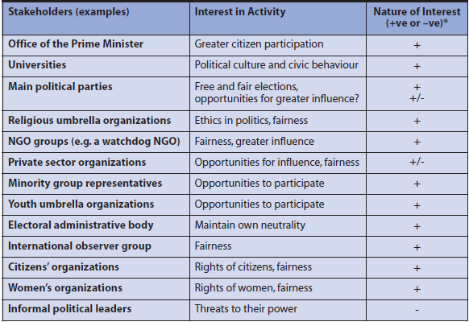
Power and Influence
Notes:
KEY MESSAGE: An example of stakeholders and their interest in a planning process and whether influence may be positive or negative.
Understanding this level of influence, whether this influence is going to be positive or negative is very important in a negotiated process

Slide 22

Power Building Tactics
Strengthen local organizations
Develop common vision and goal
Bring forward “irrefutable" information
Gain broader legitimacy
Introduce new actors (NGOs, media, technical experts)
Build new coalitions
Notes:
KEY MESSAGE:
In a process to negotiate and agreement, understanding what stakeholders have power to influence the agreement is important.
Also understanding what tactics can be used to balance power between stakeholders is also essential

Slide 23

The Role of a Mediator
A Mediator is a…
  Third party who helps the parties in a dispute jointly to develop an acceptable, voluntary and non-coerced solution to their conflict.
Notes:
KEY MESSAGE:
A mediator is a person that can help balance power in a negotiation process
Mediators:
have no power to render a decision
ensure that the different stakeholders agree on the process and logistics, and put forward possible solutions to help the disputing groups consent to negotiations
may put forward their own views on the likely acceptability of solutions to help stakeholders identify mutually acceptable solutions
support the confidential exchange of views and information among the stakeholders
The role of a mediator:
The opener of communication channels, who initiates communication if it breaks down or facilitates better communication if the parties are already talking, including clarifying misunderstandings and avoiding polarization and escalation
The legitimizer, who helps all parties to recognize that the rights of others are part of the negotiations
The process facilitator, who provides procedural assistance to communication, often including formally chairing meetings. When providing procedural assistance, mediators do not involve themselves in the actual issues (the things under dispute) and do not suggest solutions
The problem explorer, who enables people in dispute to examine a problem from a variety of viewpoints
The agent of balance (or reality), who questions and challenges parties with extreme or unrealistic goals, and through this helps build a reasonable, achievable agreement
The networker, who offers procedural assistance and links the conflict parties to outside experts and resources (e.g. technical experts, lawyers, decision-makers) that may enable them to draw up acceptable settlement options.
Reference:
FAO (2005) Negotiation and Mediation Techniques for Natural Resource Management, page 63
http://www.fao.org/docrep/008/a0032e/a0032e00.htm

Slide 24

The Benefits of a Mediator
A good mediator can:
Help balance power
Play an important catalytic role in keeping the process moving
Help stakeholders define the issues and focus on interests over positions
Guide communication
Help stakeholders reach their goals
Notes:
KEY MESSAGE:
A good mediator can have an important role in helping stakeholders reach an agreement
Positive aspects a mediator can play are listed.
Advantages of a mediator: An imbalance of power among stakeholders is one of the most common reasons that unassisted groups fail to begin negotiation or to produce satisfactory results. Using a third party or mediator can help to overcome such imbalances through unbiased, fair handling of the negotiation processes. The role is similar to that of a referee who enforces the rules and ensures fairness in a sports contest. It can provide confidence to weaker stakeholders. A third party is to some extent able to alter power and social relationships by influencing the understanding or behaviour of individual parties, through providing knowledge or information, or introducing a more effective negotiation process. These sometimes help to equalize power relationships (Susskind andCruikshank, 1987). However, the extent to which this is possible is the subject of much debate
BUT A mediator also
Dramatically changes dynamics, resulting in greater formality and posturing
Dispute becomes more public, drawing attention to the conflict so that more people are aware of it
Threatens some parties because they feel it may undermine their power base
May increase disputants’ fears (if the third party is unknown, or is known and seen to be biased)
Disadvantages of a mediator: Some groups feel that involving a third party makes the dispute too public, and are hesitant about becoming involved. Powerful stakeholders, in particular, may also strongly resist the intervention of a third party or mediator. Distrust among the parties may be so great that anyone suggested by one party will be regarded by the others as biased. In such cases it may be helpful to have someone whose formal or informal authority and character are unchallenged by any of the parties.
Need to match need for a mediator to the circumstances and stakeholder needs.
Reference:
FAO (2005) Negotiation and Mediation Techniques for Natural Resource Management, pages 63-64
http://www.fao.org/docrep/008/a0032e/a0032e00.htm

Slide 25
Negotiations & Building Agreements
Set Stage
Roles set
Ground rules set
Provide Space
Stakeholders understand options
Trade-offs understood
Finding Common Ground
Common interests explored
Venue set
Assessing
Options
Reaching Agreement
Goals confirmed
Options expanded
Options explored
Agreement on options
Final agreement reached
Notes:
KEY MESSAGE:
There is no set design or recipe for a negotiation process. Each will be unique.
2) The slide presents 5 generic steps that need to be adapted to each unique situation
The process for each negotiation must meet the needs of the stakeholders and the circumstances of the specific situation.
Reference:
FAO (2005) Negotiation and Mediation Techniques for Natural Resource Management. Chapter 7
http://www.fao.org/docrep/008/a0032e/a0032e00.htm

Slide 26
1. Setting The Stage
Outcomes:
The right stakeholders can attend
A safe & secure venue is agreed upon
Agenda circulated and accepted
Trust is being built in the process
To insert Bangladesh photo
Notes:
KEY MESSAGE:
Stakeholders must be comfortable with the process. Without feeling secure stakeholders may not openly participate.
The right stakeholders are invited and can attend the meeting: Selecting the right participants determines not only if an agreement can be reached, but whether it will be implemented.
A safe a secure venue is agreed: Often in setting up a negotiation process, the venue may actually exclude the right stakeholders from attending. An example is holding a meeting to agree on a Land Use Plan in a capital city. This may exclude community members from attending the meeting.
Agenda circulated and agreed: All the issues must be on the agenda, so that all stakeholders have the opportunity to discuss the issues that they are concerned about.
Trust is built: Because of the potential for conflict and dispute of the allocation of land resources and the confirmation of land access and tenure, tensions leading up to this meeting can be high. Every effort should be made to build trust and reduce tensions.
Reference:
FAO (2005) Negotiation and Mediation Techniques for Natural Resource Management. Chapter 7
http://www.fao.org/docrep/008/a0032e/a0032e00.htm

Slide 27
2. Providing Space
Outcomes:
Roles and responsibilities understood
Time is allowed for those at the negotiation meeting(s) to communicate with their constituents
Paths of communication are opened.
Stakeholders can present their ‘case’
Notes:
KEY MESSAGE:
Roles and responsibilities of all involved must be clearly communicated. This is particularly important if an outside person has been invited in to facilitate or mediate the negotiation process.
Roles and responsibilities are communicated and agreed: Often a facilitator or mediator might be required to help stakeholders reach agreement. Their roles and responsibilities must be communicated to all stakeholders and the stakeholders must agree to their inputs.
Reviewing roles and responsibilities should be done at the start of any meeting to ensure there is agreement. Particularly where an ‘outside’ is involved in facilitating the process.
Opening paths of communication: Good communication means people are actively listening to each other, and everybody has a chance to speak. This is key to creating and maintaining a setting where agreements can be reached. To support good communication, the mediator may need to work out some ground rules with the participants. These rules can be brainstormed by asking the participants how they would like to be treated by others during the negotiations. The mediator needs to explain that it is his/her role to reinforce these rules whenever necessary during the negotiation process. The mediator should make clear that all parties must be heard.
Time is allowed for those at the negotiation meeting(s) to communicate with their constitutes. Because some stakeholders may be at the meeting and representing their community or constitutes, time and a process must be agreed for these representative stakeholders to communicate meeting outcomes and receive direction from their communities or constitutes.
Stakeholders present their case: After the introduction, the second phase in the negotiations starts with the mediator inviting the
parties to state their cases by presenting their interests and views publicly.
the mediator should encourage the stakeholders to:
talk about their own viewpoints, fears and needs, rather than wondering about the viewpoints, interests and needs of others;
focus on finding mutually agreeable outcomes;
repeat back what they have understood from another person’s statement – this helps clear up misunderstandings and forces conflict parties to “put themselves in the shoes of the other”;
rephrase insulting statements in ways that identify key concerns and fears without repeating the insult.
Reference:
FAO (2005) Negotiation and Mediation Techniques for Natural Resource Management. Chapter 7
http://www.fao.org/docrep/008/a0032e/a0032e00.htm

Slide 28
3. Finding Common Ground
Outcomes:
Goals and objectives are reviewed
Conflicting issues/needs are explored
Common ground and goals are defined
To insert Bangladesh photo
Notes:
KEY MESSAGE:
Differences of opinion and conflicts should be explored so that stakeholders are aware of all positions. But common ground must be found for negotiations to move forward.
Goals and objectives are reviewed: This is to ensure that there is still agreement on the goals and objectives of the REDD+ after a full assessment of scenarios and options is presented. It is often during this stage that new technical information is introduced or a new stakeholder enters the process that may require a re-alignment or review of goals and objectives.
Conflicting issues/needs are explored: It is important that differences are understood and expressed.
A successful mediated negotiation will allow stakeholders to express their divergent needs but move forward on a process of identifying and working towards an agreement on joint interests that include reducing emissions of greenhouse gases while maintaining critical ecosystem services and economic growth.
Common ground and goals are defined: It is useful to see if a common goal statement can be written. This common goal statement is based upon stakeholders exploring their common underlying needs and common reasons for developing a REDD+ national strategy or action plan. This can be difficult as stakeholders generally have multiple interests which makes finding common interests upon which consensus can be built difficult.
Reference:
FAO (2005) Negotiation and Mediation Techniques for Natural Resource Management. Chapter 7
http://www.fao.org/docrep/008/a0032e/a0032e00.htm

Slide 29
4. Assessing Options
Outcomes:
Agree on criteria to assess options
Assess all options
Select option(s) that best meet the goal(s) and that all stakeholders can move forward with.
Notes:
KEY MESSAGE:
Stakeholders must agree on criteria used to assess REDD+ options. Then all should be involved in ranking or judging criteria.
Agree on criteria to assess options: Developing and using criteria may help the process of deciding which options are most likely to be satisfactory to all groups. It also ensures that there are fair standards for decision-making. The type of criteria may vary and can include:
general achievability;
cost and inputs;
time scale;
advantages (pros) and disadvantages (cons);
opportunities and risks.
Assess all options: A decision grid can help the analysis and comparison of alternative solutions through the help of indicators.
Select option(s) that best meet the goal(s) and that all stakeholders can move forward with.
The following are some of the possible outcomes of the negotiation process:
Compromise: Parties share the gains and losses in order to reach agreement.
Experimental or trial decisions: Parties are unable to reach a permanent decision and agree to a temporary settlement that will be tested and evaluated at a later date.
Procedural solutions to major issues: Parties agree on a process through which they can obtain a solution to a dispute.
Partial settlement: Parties agree on many issues, but continue to disagree on others.
Continued negotiations: Parties agree to disagree. They want to continue negotiations, sometimes by calling in a third party to help them reach a binding decision.
Reference:
FAO (2005) Negotiation and Mediation Techniques for Natural Resource Management. Chapter 7
http://www.fao.org/docrep/008/a0032e/a0032e00.htm

Slide 30
5. Reaching and Designing Agreement
Outcomes:
Consider implementation challenges
Confirm commitment and mandates to implement
Draft and review agreement
Make agreement public
To insert Bangladesh photo
Notes:
KEY MESSAGE:
Reaching Agreement is important. But documenting, committing and communicating the agreement is just as important.
Consider implementation challenges: What are the challenges:
How will the stakeholders ensure that the agreement will be acted on?
Does the implementation of the agreement require the formal involvement of specialists or groups, such as administrators, leaders of resource user groups, and community political leaders?
How will the parties manage any unexpected results from the agreement?
What monitoring mechanisms will be established to ensure compliance with the agreement?
What is the mediation team’s role in monitoring? Are there local neutral or trusted monitors?
Confirm commitment and mandates: When an agreement has been drafted, the negotiation parties may want to reconfirm its acceptability with their broader constituencies. This is
an important step in reaching broad support and acceptance. Before final agreement, the full support and commitment of all stakeholders must be confirmed. If subgroups that remain apart from the main group have emerged, the document needs to clarify who is, and who is not, party to the agreement.
Draft, review and communicate final agreement: Is the plan honest, acceptable and workable?
A strong agreement is:
Substantive: They define specific exchanges that everyone can touch or see (money, services, labour, etc.) as resulting from negotiations.
Comprehensive: They include the resolution of all the issues in dispute.
Permanent: They resolve for all time the issues in dispute.
Final: They include all the details in their final form. In principle: They include general agreements, but the details remain to be worked out.
Non-conditional: There are no conditions or requirements for future performance.
Binding: They are formal contracts that fix the parties to certain actions (people often stick to the terms of a settlement if they understand the consequences of not doing so).
Make agreement public: A final point of discussion in negotiations is the extent to which the stakeholders want to make their agreement public. Depending on its nature, the final agreement may be enacted through a formal signing in front of witnesses or may require government approval. Alternatively, if the agreement affects many people, they may consider holding a more public forum. Some groups enter their agreements into the legal system in order to bind their decisions formally. Others choose to announce their agreements to the public at local council meetings or through the media.
Reference:
FAO (2005) Negotiation and Mediation Techniques for Natural Resource Management. Chapter 7
http://www.fao.org/docrep/008/a0032e/a0032e00.htm

Slide 31
The Negotiation Process: 3 Critical Elements
Problem
Goals
Issues/problems
Process
Transparent
Fair
People
Right people
Right capacity
Notes:
KEY MESSAGE: In working through the 5 steps the 3 linked elements that must always be considered: The Problem, The Process, The People
People: Their thoughts, emotions and actions.
Process: The way decisions are made and how people react
Problem: The specific issues and differences among people, groups and agencies
People: how people think about and relate to the conflict; their feelings, emotions and perceptions of the problems and of the other people involved; and how these relate to each other and to natural resources in securing livelihoods.
Process: the way decisions are made, and how people feel about this. The decision-making process is often overlooked as a key cause of conflict. However, resentment, feelings of being treated unfairly and a sense of powerlessness are often rooted in this area.
Problems: the specific issues and differences among the people, groups and agencies involved. These often include different values,1 incompatible interests and needs,2 or concrete differences regarding the use, distribution or accessibility of scarce resources. They are often referred to as the “root causes” of conflict, about which people tend to take clear and strong positions.
Reference:
FAO (2005) Negotiation and Mediation Techniques for Natural Resource Management. Page 20
http://www.fao.org/docrep/008/a0032e/a0032e00.htm

Slide 32
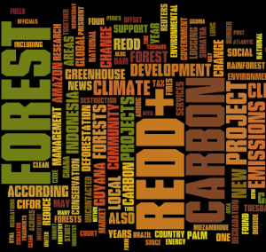
Negotiation Challenges
Complex and difficult – no capacity to support a negotiated process
Influential stakeholders dominate
Power imbalances can not be overcome.
Can be time and resource consuming
Deep rooted and structural problems can not be overcome
Authority for approval and implementation is contradictory & complex.
Notes:
KEY MESSAGE
Key challenge is in moving stakeholders with competing interests to see if they can find common needs.
Negotiating REDD+ decisions are complex and difficult tasks. Powerful stakeholders tend to dominate and actively advocate their interests, often without appreciating risks to vulnerable stakeholders or those excluded from the process.
De facto tenure and resource use rights of local communities are often ignored or extinguished through poorly conceived REDD action plans. Tenure is a complex issue, further compounded by the unregulated or unknown status of carbon rights.
While the authority for approval and implementation of many land use plans is often known, contradictory, complex and confusing policies and regulations often means these authorities and the plan itself is often ignored or status remains uncertain. The classic example is a village or district plan which is ignored during provincial planning processes or where a private investor’s needs (which are often granted) run counter to any agreed REDD+ Action Plan.
A discussion of carbon rights is beyond the scope of this document. The guidance provided here is simply to support a more inclusive and balanced decision REDD+ planning where reducing GHG emissions is a requirement under national or sub-national regulations.

Slide 33
Negotiation Opportunities
There is significant history in negotiating land use agreements across Asia.
Skills and knowledge in REDD+ are emerging
To insert Bangladesh photo
Notes:
KEY MESSAGE:
There is a significant history in facilitating and negotiating REDD+ Action Plan. The lessons learned and establishment of best-practice guidelines easily accommodates the inclusion of an ‘additional’ planning parameter, such as GHG emissions.

Slide 34
Class Exercise
Divide class into three groups of stakeholders:
  Governments
  People living in the hydropower dam area that would be negatively impacted by construction
  Hydropower Company
  Each group to define what they must get from a negotiated process.

Slide 35
Class Exercise
Scenario 1: Historic worst case
Scenario 2: Achieving all the goals fixed without hydroelectric plant
Scenario 3: Achieving all the goals fixed with hydroelectric plant
Notes:
Ask students what scenario they would choose?
How would this impact on their ‘must haves’ from a negotiated process.

Slide 36
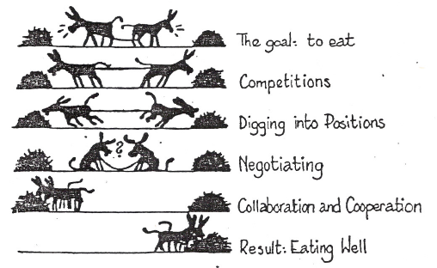
TAKE HOME MESSAGE
Notes:
KEY MESSAGE:
Negotiation is as process.
It is based on stakeholders needs
It aims to find common ground to agree on a preferred land use future.

Slide 37
References
USAID. 2015. USAID LEAF‘s Climate Change Curriculum. USAID Lowering Emissions in Asia Forests Program (USAID LEAF). Winrock International and US Forest Service. Bangkok, Thailand.
Engel, A. and Korf, B. 2005. Negotiation and mediation techniques for natural resource management. FAO Rome
http://www.fao.org/docrep/008/a0032e/a0032e00.htm
UNDP. 2009. Handbook on Planning, Monitoring and Evaluating for Development Results. New York, USA.
http://web.undp.org/evaluation/handbook/
Worah, S. 2008. Participatory Management of Forests & Protected Areas: A Trainers’ Manual. RECOFTC. Bangkok, Thailand
http://www.recoftc.org/site/uploads/content/pdf/Participatory_management_web_58.pdf

Slide 38
References and Resources
The curriculum of USAID’s Climate-Resilient Ecosystems and Livelihoods (CREL) in Bangladesh is a free resource of teaching materials for university professors, teachers and climate change training experts.
Reproduction of CREL’s curriculum materials for educational or other non-commercial purposes is authorized without prior written permission from the copyright holder, provided the source is fully acknowledged.
Suggested citation: Winrock International. 2016. USAID‘s Climate-Resilient Ecosystems and Livelihoods (CREL). Winrock International. Dhaka, Bangladesh.
Disclaimer: The CREL’s curriculum is made possible by the support of the American People through the United States Agency for International Development (USAID). The contents of the curriculum do not necessarily reflect the views of USAID or the US Government.

Slide 39
USAID's Climate-Resilient Ecosystems and Livelihoods (CREL) Project
Winrock International Headquarters
2101 Riverfront Drive, Little Rock
Arkansas 72202-1748 USA
Tel: 1-501-280-3000
Web: www.winrock.org

