Slide 1
Bangladesh Climate-Resilient Ecosystem Curriculum (BACUM)
Module 2: REDD+ in Climate Change Context

Slide 2
Module 2: REDD+ in Climate Change Context
SECTION III: ANALYZING FUTURE OPTIONS FOR REDD+
3.2. REDD+ Safeguards under the UNFCCC

Slide 3
REDD+ in Climate Change Context (REDD+)
ENABLING ENVIRONMENT OF REDD+
1.1. Forests, Forest Carbon and Climate Change
1.2. Fundamentals of REDD+ and the UNFCCC
1.3. Stakeholder Engagement
ASSESSING CURRENT CONDITIONS OF REDD+
2.1. Drivers of Deforestation and Forest Degradation
2.2. Fundamentals of Forest (Emission) Reference Levels
2.3. National Forest Monitoring Systems (NFMS) for REDD+
ANALYZING FUTURE OPTIONS FOR REDD+
3.1. Policies and Measures for REDD+ Implementation
3.2. REDD+ Safeguards under the UNFCCC
3.3. The Costs and Benefits of REDD+
DEVELOPING REDD+ STRATEGIES AND ACTION PLANS
4.1. Negotiation in REDD+
4.2. National Strategies and Action Plans
4.3. Approaches for Incentive Allocation System
MONITORING, EVALUATION AND ADAPTATION
5.1. Establish M&E Framework for REDD+ Action Plan
5.2. Monitor and Measure Implementation Progress
5.3. Evaluate, Report and Adapt

Slide 4
Acknowledgements
EXPERT CONTRIBUTORS | SPECIFIC INPUTS
Prof. (Dr.) Manzoor Rashid | Curriculum Development for all topics
Prof. (Dr.) Md. Danesh Miah | REDD+, Forest Carbon
Prof. (Dr.) Md. Jakariya | Community NR Management, Climate Change, Natural Resources Management
UNIVERSITIES
Bangladesh Agricultural University
University of Chittagong
Dhaka University
Independent University, Bangladesh
Khulna University
Noakhali University of Science and Technology
Shahjalal University of Science and Technology
Sher-e-Bangla Agriculture University
North South University
CREL STAFF | CREL STAFF
John A Dorr | Utpal Dutta
Abu Mostafa Kamal Uddin | Ruhul Mohaiman Chowdhury
Kevin T. Kamp | Rahima Khatun
Paul Thompson | Sultana Razia Zummi
Abdul Wahab | Shams Uddin
Shahzia Mohsin Khan
DESIGN, LAYOUT AND CONTENT DEVELOPMENT: Ms. Chi Pham, Curriculum Development Expert, Bangkok, Thailand

Slide 5
Learning Objectives
By the end of this session, students will be able to:
Understand the need and value of safeguards as applied to REDD+;
Recall the key safeguard requirements for REDD+ under the UNFCCC
List key generic elements of a country approach to safeguards;
Appreciate the crucial link between safeguards and REDD+ actions; and
Know where to go for further support on country approaches to safeguards.

Slide 6
What are safeguards?
A measure taken to protect someone or something or to prevent something undesirable – do no harm
Safeguards have a wide remit and can apply to projects, a set of projects or programmes, as well as act as policies
Safeguards differ from standards, which are ‘objectives to be achieved’
UNFCCC REDD+ safeguards are atypical safeguards as they call for enhancement of benefits – do good

Slide 7
Why apply safeguards to REDD+?
Strengthens the quality and sustainability of REDD+ implementation
Contributes to broader national development goals
Ensures confidence that REDD+ is delivering benefits and avoiding/minimizing risks

Slide 8
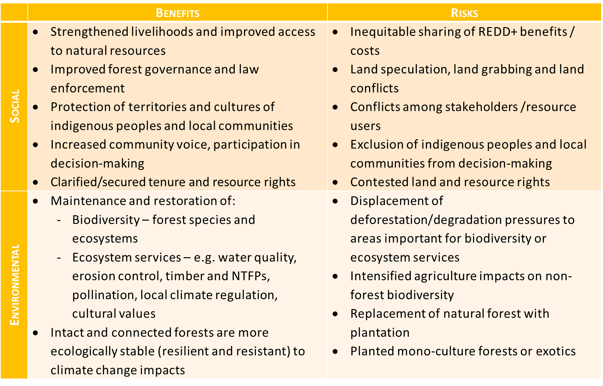
Risks and benefits of REDD+ implementation
Notes:
References:
UNEP. 2014. Forests in a Changing Climate: A Sourcebook for Integrating REDD+ into Academic Programmes. United Nations Environment Programme. Nairobi, Kenya. http://www.unep.org/Training/docs/Forest_in_a_Changing_Climate.pdf
UNEP. 2015. REDD+ Academy Learning Journal. Edition 1. www.un-redd.org/REDDAcademy

Slide 9
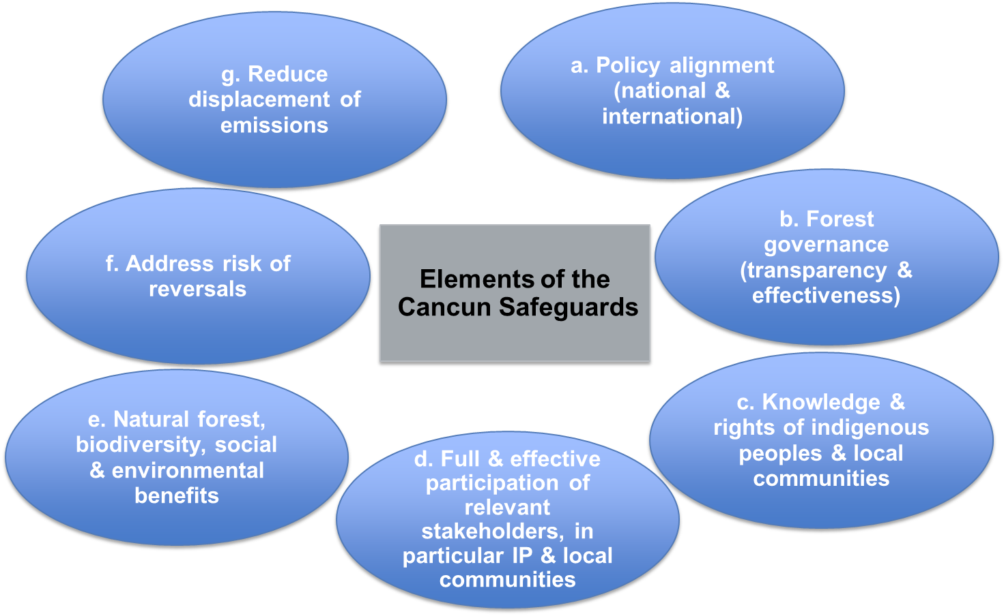
What are the Cancun safeguards?
Notes:
References:
UNEP. 2014. Forests in a Changing Climate: A Sourcebook for Integrating REDD+ into Academic Programmes. United Nations Environment Programme. Nairobi, Kenya. http://www.unep.org/Training/docs/Forest_in_a_Changing_Climate.pdf
UNEP. 2015. REDD+ Academy Learning Journal. Edition 1. www.un-redd.org/REDDAcademy

Slide 10
UNFCCC Safeguards Requirements
Countries should address and respect the Cancun Safeguards throughout REDD+ implementation
2
Summary of information on how the Cancun safeguards are being addressed and respected submitted before results-based payments
Safeguard information system (SIS) to provide information on how the country is addressing and respecting the Cancun safeguards
1
3
Notes:
References:
UNEP. 2014. Forests in a Changing Climate: A Sourcebook for Integrating REDD+ into Academic Programmes. United Nations Environment Programme. Nairobi, Kenya. http://www.unep.org/Training/docs/Forest_in_a_Changing_Climate.pdf
UNEP. 2015. REDD+ Academy Learning Journal. Edition 1. www.un-redd.org/REDDAcademy

Slide 11
Country approaches to safeguards
allows a country to meet international safeguards, in harmony with national policy goals
by building on the existing governance arrangements used to address and respect the Cancun safeguards
‘governance arrangements’ comprise 3 core elements that ensure risks are reduced and benefits are enhanced
policies, laws and regulations (PLRs) which define, on paper, what needs to be done in order to address safeguards
institutions’ mandates, procedures and capacities to ensure the PLRs are being implemented in practice (safeguards respected)
information systems/sources which demonstrate how REDD+ safeguards are being addressed and respected
Notes:
References:
UNEP. 2014. Forests in a Changing Climate: A Sourcebook for Integrating REDD+ into Academic Programmes. United Nations Environment Programme. Nairobi, Kenya. http://www.unep.org/Training/docs/Forest_in_a_Changing_Climate.pdf
UNEP. 2015. REDD+ Academy Learning Journal. Edition 1. www.un-redd.org/REDDAcademy

Slide 12
Assess benefits and risks of PaMs
UNFCCC
Clarify Cancun safeguards in country context
Assess existing policies, laws & regulations (PLRs)
Revise existing (develop new) PLRs
Safeguards addressed
Define safeguard goals & scope
Assess capacity to implement PLRs
Strengthen capacity to implement PLRs
Safeguards respected
Define SIS objectives
Determine information needs and structure
(e.g. indicators)
Assess existing information systems and sources
Safeguards information system
Summary of information
Country approach to safeguards
Notes:
KEY MESSAGES
Define goals = refers to what safeguards frameworks the country chooses to apply for REDD+. Application of (addressing and respecting) the seven Cancun safeguards is a basic requirement to be eligible for results-based payments under the UNFCCC, but a country may also want to consider other bi-/multi-lateral safeguards requirements, e.g. World Bank Operational Policies, as part of the Forest Carbon Partnership Facility (FCPF) Carbon Fund. Consideration may be given to safeguards requirements and expectations of investors in REDD+ activities as well as those of buyers of verified emissions reductions/enhanced removals. Defining safeguards goals also means considering what national sustainable development or green growth policies, for example, could benefit from addressing and respecting REDD+ safeguards. Ultimately, safeguards goals are about the level of a country’s ambition: basic ‘operationalization’ of the Cancun safeguards, or ‘best-in-class’ environmental and social standards, or somewhere in between?
Define scope = is about deciding what activities will be covered by the chosen safeguards frameworks, as per the safeguards goals. Again, basic UNFCCC requirements indicate that safeguards be applied to all REDD+ activities, which could be interpreted to mean all policies and measures (PaMs) indicated in the national strategy/action plan (NS/AP), or possibly only those specific actions implemented with a view to obtaining results-based payments, i.e. the 5 REDD+ activities. A country may wish to integrate REDD+ into wider forestry sector strategies, or even broader, as a cross-sectoral mechanism including agriculture and biomass energy, for example. The underlying drivers of deforestation and forest degradation are unlikely to be confined to the forestry or any single land-use sector. As such, REDD+ safeguards could be applied to a broader scope than just REDD+ actions for results-based payments, e.g. applied to the whole forestry sector as means to attract other sources of foreign investment, and achieve domestic policy goals, in the forestry sector or to all sectors that use forest products.
Assess benefits/risks = foreseeing the potential environmental and social benefits and risks of candidate PaMs comprising the NS/AP, that are proposed to address the drivers of deforestation and forest degradation (as well as barriers to more effective and extensive ‘plus activities’). Benefit/risk assessments are a crucial step to link country safeguards and NS/AP processes. They are essential in focusing the country approach to safeguards on those issues (benefits and risks) most relevant to the country’s NS/AP, rather than trying to consider all possible safeguard issues. An understanding of the potential benefits and risks of candidate PaMs informs both the Cancun safeguards clarification and PLR assessment steps. The Benefits and Risks Tool (BeRT v2.0), Module 2, can be used to help identify the potential risks and benefits of candidate PaMs, or REDD+ actions.
Clarify Cancun = what are the key issues to consider with regard to each Cancun safeguard in relation to the main benefits and risks associated with candidate PaMs? How will the safeguards be applied in the specific country context? This clarification exercise should, ideally, be informed by an expert or participatory benefit and risk assessment of the PaMs being considered for the NS/AP. The breakdown of the broad principles embodied in the Cancun safeguards into country-specific themes can, and has, been used to develop criteria as a means to further structure information in a country’s safeguard information system (SIS). The Cancun safeguards need to be clarified, broken down into country-relevant themes, before assessing PLRs, as the Cancun safeguards themselves are too broad to assess how existing policies, laws and regulations (PLRs) might address each safeguard. Note the double-head arrow between clarify Cancun and assess PLRs; clarifying the safeguards is an iterative process and a country’s clarification of the Cancun safeguards can be revised in explicit terms of their existing PLRs, after the PLR assessment. ‘Interpret’, ‘specify’ and ‘unpack’ are often used synonymously with ‘clarify’ Cancun safeguards.
Assess PLRs = an assessment of how effectively the existing PLRs address, on paper, the benefits and risks of planned REDD+ PaMs can be undertaken by a team of experts, with findings being validated through stakeholder workshops. The assessment should identify any significant weaknesses, gaps and inconsistencies in the PLR framework that may need to be strengthened, filled or resolved in order to better address the Cancun safeguards (and other safeguards frameworks as desired) throughout REDD+ implementation. It will additionally help identify what institutions are mandated to implement these PLRs. BeRT v2.0, Module 3, can be used to identify existing PLRs that address benefits and risks of PaMs, identify gaps in PLR coverage, and whether there are any PLRs that conflict with the country’s clarification of the Cancun safeguards.
Revise PLRs = existing texts of laws might be amended or new provisions drafted in order to strengthen the PLR framework, or new regulations drafted to support the operationalization of PLRs. These processes are often time-consuming, and as such it may be a good idea to build on ongoing reform processes.
Safeguards addressed = identifying, and providing information on, what a country has (or plans to put) in place, in terms of its governance arrangements – its PLRs, institutional arrangements and information systems - which would seek to guarantee the implementation of the safeguards and to meet adopted safeguard requirements/goals. Note that, while the UN-REDD Programme’s understanding is consistent with a general convergence and consensus around the practical meaning of the terms ‘address and respect’, they are not defined in the UNFCCC decisions, and it is ultimately up to the country to decide what these terms mean according to their national circumstances.
Assess capacity to implement PLRs = assessing institutional mandates, procedures and capacities to implement relevant PLRs. Do the PLRs put in place to mitigate, manage or avoid environmental and social risks, and enhance the benefits, actually work in practice? Assessing government institutions’ capacities to implement national and subnational PLRs as well as private sector capacity to implement corporate social and environmental social responsibility policies and industry standards. Could even include assessment of indigenous peoples’ and local communities’ capacity to uphold their own customary norms. As with the PLR assessments, institutional capacity assessments for respecting safeguards might best be done by expert teams, with results being shared and validated through a multi-stakeholder consultation process.
Strengthening capacity = acting to correct weakness in implementation of relevant PLRs identified by the preceding assessment step, which may involve modifying institutional mandates and procedures and investing in increased capacities. Repeated assessment should be able to demonstrate incremental improvements in respecting safeguards, which can help assure those entities making payments for REDD+ results.
Safeguards respected = identifying, and providing information on, how a country has implemented (or plans to implement) its relevant PLRs, together with any relevant industry standards and customary norms (governance arrangements), and the implementation outcomes of the country’s adopted safeguards. Note that, while the UN-REDD Programme’s understanding is consistent with a general convergence and consensus around the practical meaning of the terms ‘address and respect’, they are not defined in the UNFCCC decisions, and it is ultimately up to the country to decide what these terms mean according to their national circumstances.
Define SIS objectives = what are the different domestic and international uses of the information the SIS will provide?
By default, objective would be to meet UNFCCC requirement of providing a summary of information on how the Cancun safeguards are addressed and respected throughout the implementation of REDD+ activities in order to obtain payments for results under REDD+. Information on how environmental and social benefits and risks are being managed in forestry and other land-use sectors could also contribute to a range of other domestic objectives such as:
•Funding accessed – investments in REDD+ activities, particularly from private sector, more accessible due to increased confidence in the enabling environment for REDD+ implementation (i.e. risk reduction, benefits enhanced), and information meets other bi-/multi-lateral safeguards requirements
•Improved NS/AP implementation – through information forming the basis to refine PaMs to address drivers of deforestation, forest degradation and barriers to plus activities (i.e. adaptive management)
•Greater legitimacy of REDD+ - increasing transparency, through stakeholder consultation and participation, and provision of information to domestic stakeholders
•Policies reformed based on evidence – safeguards information used to inform decision-making at country, regional or local levels
Determine information needs = what specific information is needed, in relation to the specific benefits and risks of candidate PaMs, to demonstrate appropriate PLRs are in place (addressing safeguards) and are being adequately implemented, or that capacity exists to implement them (respecting safeguards)? Safeguards information needs will be determined by the benefits and risks of REDD+ actions, together with the PLRs required to mitigate these risks and maximise the benefits, as identified in previous steps. A country need not attempt to collect information on all possible aspects of each safeguard, but can focus efforts on collecting the information most relevant to priority benefits and risks associated with key REDD+ actions comprising the NS/AP.
Determine information structure = how will the necessary information be organised in the SIS? The structuring of information will depend on a many factors including, among other things:
• the goal and scope of safeguard application chosen by the country
• the scale of REDD+ intervention (national, subnational or local);
• the specific objectives of the SIS and the different end users of the information;
• the capacity and resources available to implementing institutions;
• donor and investment requirements.
Two basic structuring options for SISs present themselves:
1.Narrative descriptions of what is in place to address the safeguards, how they have been respected and what are some of the resultant outcomes;
2.Some form of hierarchical categorization as:
• Principles (P) – broad aspirational statements of intent, i.e. statements of objective. A number of countries are choosing to adopt, or adapt and augment the Cancun safeguards as national safeguard principles
• Criteria (C) – more specific statements of thematic content that elaborate the principles. The step of clarifying the Cancun safeguards, in effect, establishes sets of criteria for each safeguard, whether countries choose to acknowledge this explicitly or not
• Indicators (I) – detailed qualitative, quantitative or descriptive attributes that when assessed can demonstrate changes over time.
Wherever, and as much as possible, any identification of indicators should be based on existing sources of information, likely enshrined in the existing PLR framework. Novel indicators can be considered in cases where a distinct information need, important to demonstrate safeguards are being respected, is not met by existing sources.
Assess existing information systems/sources = to make best use of existing country processes and maximize resource sustainability, countries should build on existing systems to the extent possible to meet their SIS information needs. Existing sources and systems of information (as well as any new systems in development) can be assessed to determine their possible contribution to the SIS and whether modifying prioritized information systems to accommodate new information (e.g. indicators, collected by adding questions to existing field forms) is sufficient to close any information gaps. As identified in step Assessing PLRs, institutional mandates and reporting requirements, e.g. to international conventions, can help identify relevant information systems/sources.
Examples of information systems and sources that may provide relevant contributions to an SIS include, but are no means limited to:
• components of the country’s national forest monitoring system - satellite land monitoring systems (SLMS), national forest inventories (NFI) and greenhouse has inventories (GHG-I)
• national population censuses
• systems supporting national implementation of other international conventions, e.g. National Biodiversity Strategies & Action Plans (NBSAPs) under the Convention on Biological Diversity (CBD)
• Living Standards Measurement Studies
• Forest Law Enforcement, Governance and Trade (FLEGT) Voluntary Partnership Agreements (VPA) Timber Legality Assurance Systems (TLAS), etc.
• grievance redress mechanisms
• cadastral databases
• sustainable forestry and agricultural commodity standards (including auditing reports)
One key evolving information system in particular warrants specific attention during the assessment of existing/emerging systems that could contribute to a SIS: the national forest monitoring system (NFMS), another key UNFCCC requirement and pillar of the Warsaw Framework for REDD+. The three main components of an NFMS – satellite land monitoring systems, national forest inventories and greenhouse gas inventories - may provide information relevant to safeguards (f) and (g), and their potential information contributions should be assessed on a case-by-case basis.
Safeguard information system =an articulation of existing national (subnational as desired) systems and sources of information on how all of the Cancun safeguards are addressed and respected throughout the implementation of REDD+.
Summary of information = a summary of information on how all the Cancun safeguards, are being addressed and respected throughout the implementation of REDD+ PaMs for international applications. Note that the summary of information is implied, but not explicitly stated in any UNFCCC decision text, to be a product of the SIS.
References:
UNEP. 2014. Forests in a Changing Climate: A Sourcebook for Integrating REDD+ into Academic Programmes. United Nations Environment Programme. Nairobi, Kenya. http://www.unep.org/Training/docs/Forest_in_a_Changing_Climate.pdf
UNEP. 2015. REDD+ Academy Learning Journal. Edition 1. www.un-redd.org/REDDAcademy

Slide 13
Assess benefits & risks of PAMs
UNFCCC
1
Identify, assess & strengthen
policies, laws & regulations (PLRs)
Safeguards addressed
Define safeguards goals & scope
Identify, assess & strengthen
institutional capacity to implement PLRs
Safeguards respected
2
Identify, assess & strengthen
systems and sources of information
Safeguards information system
Summaries of information
3
Country approach to safeguards
Notes:
KEY MESSAGES
Determine drivers (& barriers) = identifying and understanding the main forces, and underlying causes, driving deforestation and forest degradation, as well as the barriers impeding more effective or extensive implmentation of ‘plus activities’, i.e. (conservation of forest carbon stocks, sustainable management of forests and enhancement of forest carbon stocks).
Identify policies and measures (PaMs) = proposing interventions at the national/subnational policy level, or site-based activity level, to tackle the underlying causes of drivers of deforestation and forest degradation and barriers to plus activities. BeRT v2.0, Module 1, can be used to help document REDD+ PaMs that are anticipated in the country (or if this is not clear yet, REDD+ PaMs that might be feasible) and how these fall under the five REDD+ activities agreed under the UNFCCC.
Assess benefits/risks = foreseeing the potential environmental and social benefits and risks of candidate PaMs comprising the NS/AP, that are proposed to address the drivers of deforestation and forest degradation (as well as barriers to more effective and extensive ‘plus activities’). Benefit/risk assessments are a crucial step to link country safeguards and NS/AP processes. They are essential in focusing the country approach to safeguards on those issues (benefits and risks) most relevant to the country’s NS/AP, rather than trying to consider all possible safeguard issues. An understanding of the potential benefits and risks of candidate PaMs informs both Cancun clarification and PLR assessment steps. Note the double-head arrow between identify PaMs and assess benefits/risks; identifying PaMs is an iterative process, whereby the PaMs proposed to tackle drivers and barriers can be refined, to be more environmentally sustainable and socially equitable, based on outcomes of the benefit risk assessment. BeRT v2.0, Module 2, can be used to help identify the potential risks and benefits of REDD+ PaMs.
Plan for managing benefits and risks of PaMs = incorporation of specific procedural measures, with dedicated (financial, human and time) resources, to manage any residual environmental and social risk, as well as enhance any potential benefits. Such measures should be an integral part of any NS/AP (as well as any subnational plan to operationalise the strategy), in addition to the broad enabling environment for addressing and respecting safeguards, which builds upon existing governance arrangements (PLRs, institutional capacities and information systems), as advocated by the country approach (see previous slide).
National strategy/action plan (NS/AP) = central pillar of the Warsaw framework for REDD+ and formal articualtion of the national REDD+ programme, as endorsed by national government. At the heart of the NS/AP is a description of how emissions will be reduced and/or how forest carbon stocks will be enhanced, conserved and/or sustainably managed, i.e. the PaMs tackle the underlying causes of drivers of deforestation and forest degradation and barriers to plus activities.
References:
UNEP. 2014. Forests in a Changing Climate: A Sourcebook for Integrating REDD+ into Academic Programmes. United Nations Environment Programme. Nairobi, Kenya. http://www.unep.org/Training/docs/Forest_in_a_Changing_Climate.pdf
UNEP. 2015. REDD+ Academy Learning Journal. Edition 1. www.un-redd.org/REDDAcademy

Slide 14
Developing Country Approach
No fixed, linear path to meet UNFCCC requirements on safeguards
Taking into consideration:
Step-wise, iterative approach
Existing policies, laws, regulations, institutions, information systems, etc.
Consultation/participation with stakeholders throughout the process
Notes:
References:
UNEP. 2014. Forests in a Changing Climate: A Sourcebook for Integrating REDD+ into Academic Programmes. United Nations Environment Programme. Nairobi, Kenya. http://www.unep.org/Training/docs/Forest_in_a_Changing_Climate.pdf
UNEP. 2015. REDD+ Academy Learning Journal. Edition 1. www.un-redd.org/REDDAcademy

Slide 15
Determine drivers
(& barriers)
Identify policies and measures (PaMs)
Assess benefits and risks of PaMs
Plan for managing benefits and risks of PaMs
UNFCCC
National strategy/ action plan (NS/AP)
Clarify Cancun safeguards in country context
Assess existing policies, laws and regulations (PLRs)
Revise existing (develop new) PLRs
Safeguards addressed
Define safeguard goals and scope
Assess capacity to implement PLRs
Strengthen capacity to implement PLRs
Safeguards respected
Define SIS objectives
Determine information needs and structure
(e.g. indicators)
Assess existing information systems & sources
Safeguards information system
Country approach to safeguards
showing links with national strategy/action plan process
Summary of information
Notes:
Determine drivers (& barriers) = identifying and understanding the main forces, and underlying causes, driving deforestation and forest degradation, as well as the barriers impeding more effective or extensive implmentation of ‘plus activities’, i.e. (conservation of forest carbon stocks, sustainable management of forests and enhancement of forest carbon stocks).
Identify policies and measures (PaMs) = proposing interventions at the national/subnational policy level, or site-based activity level, to tackle the underlying causes of drivers of deforestation and forest degradation and barriers to plus activities. BeRT v2.0, Module 1, can be used to help document REDD+ PaMs that are anticipated in the country (or if this is not clear yet, REDD+ PaMs that might be feasible) and how these fall under the five REDD+ activities agreed under the UNFCCC.
Assess benefits/risks = foreseeing the potential environmental and social benefits and risks of candidate PaMs comprising the NS/AP, that are proposed to address the drivers of deforestation and forest degradation (as well as barriers to more effective and extensive ‘plus activities’). Benefit/risk assessments are a crucial step to link country safeguards and NS/AP processes. They are essential in focusing the country approach to safeguards on those issues (benefits and risks) most relevant to the country’s NS/AP, rather than trying to consider all possible safeguard issues. An understanding of the potential benefits and risks of candidate PaMs informs both Cancun clarification and PLR assessment steps. Note the double-head arrow between identify PaMs and assess benefits/risks; identifying PaMs is an iterative process, whereby the PaMs proposed to tackle drivers and barriers can be refined, to be more environmentally sustainable and socially equitable, based on outcomes of the benefit risk assessment. BeRT v2.0, Module 2, can be used to help identify the potential risks and benefits of REDD+ PaMs.
Plan for managing benefits and risks of PaMs = incorporation of specific procedural measures, with dedicated (financial, human and time) resources, to manage any residual environmental and social risk, as well as enhance any potential benefits. Such measures should be an integral part of any NS/AP (as well as any subnational plan to operationalise the strategy), in addition to the broad enabling environment for addressing and respecting safeguards, which builds upon existing governance arrangements (PLRs, institutional capacities and information systems), as advocated by the country approach (see previous slide).
National strategy/action plan (NS/AP) = central pillar of the Warsaw framework for REDD+ and formal articualtion of the national REDD+ programme, as endorsed by national government. At the heart of the NS/AP is a description of how emissions will be reduced and/or how forest carbon stocks will be enhanced, conserved and/or sustainably managed, i.e. the PaMs tackle the underlying causes of drivers of deforestation and forest degradation and barriers to plus activities.
References:
UNEP. 2014. Forests in a Changing Climate: A Sourcebook for Integrating REDD+ into Academic Programmes. United Nations Environment Programme. Nairobi, Kenya. http://www.unep.org/Training/docs/Forest_in_a_Changing_Climate.pdf
UNEP. 2015. REDD+ Academy Learning Journal. Edition 1. www.un-redd.org/REDDAcademy

Slide 16
Determine drivers / barriers
Identify PAMs
Assess benefits & risks of PAMs
Plan for managing benefits & risks of PAMs
UNFCCC
NS/AP
Identify, assess & strengthen
policies, laws & regulations (PLRs)
Safeguards addressed
Define safeguards goals & scope
Identify, assess & strengthen
institutional capacity to implement PLRs
Safeguards respected
Identify, assess & strengthen
systems and sources of information
Safeguard information system
Country approach to safeguards
showing links with national strategy/action plan process
Summary of information
Notes:
Determine drivers (& barriers) = identifying and understanding the main forces, and underlying causes, driving deforestation and forest degradation, as well as the barriers impeding more effective or extensive implmentation of ‘plus activities’, i.e. (conservation of forest carbon stocks, sustainable management of forests and enhancement of forest carbon stocks).
Identify policies and measures (PaMs) = proposing interventions at the national/subnational policy level, or site-based activity level, to tackle the underlying causes of drivers of deforestation and forest degradation and barriers to plus activities. BeRT v2.0, Module 1, can be used to help document REDD+ PaMs that are anticipated in the country (or if this is not clear yet, REDD+ PaMs that might be feasible) and how these fall under the five REDD+ activities agreed under the UNFCCC.
Assess benefits/risks = foreseeing the potential environmental and social benefits and risks of candidate PaMs comprising the NS/AP, that are proposed to address the drivers of deforestation and forest degradation (as well as barriers to more effective and extensive ‘plus activities’). Benefit/risk assessments are a crucial step to link country safeguards and NS/AP processes. They are essential in focusing the country approach to safeguards on those issues (benefits and risks) most relevant to the country’s NS/AP, rather than trying to consider all possible safeguard issues. An understanding of the potential benefits and risks of candidate PaMs informs both Cancun clarification and PLR assessment steps. Note the double-head arrow between identify PaMs and assess benefits/risks; identifying PaMs is an iterative process, whereby the PaMs proposed to tackle drivers and barriers can be refined, to be more environmentally sustainable and socially equitable, based on outcomes of the benefit risk assessment. BeRT v2.0, Module 2, can be used to help identify the potential risks and benefits of REDD+ PaMs.
Plan for managing benefits and risks of PaMs = incorporation of specific procedural measures, with dedicated (financial, human and time) resources, to manage any residual environmental and social risk, as well as enhance any potential benefits. Such measures should be an integral part of any NS/AP (as well as any subnational plan to operationalise the strategy), in addition to the broad enabling environment for addressing and respecting safeguards, which builds upon existing governance arrangements (PLRs, institutional capacities and information systems), as advocated by the country approach (see previous slide).
National strategy/action plan (NS/AP) = central pillar of the Warsaw framework for REDD+ and formal articualtion of the national REDD+ programme, as endorsed by national government. At the heart of the NS/AP is a description of how emissions will be reduced and/or how forest carbon stocks will be enhanced, conserved and/or sustainably managed, i.e. the PaMs tackle the underlying causes of drivers of deforestation and forest degradation and barriers to plus activities.
References:
UNEP. 2014. Forests in a Changing Climate: A Sourcebook for Integrating REDD+ into Academic Programmes. United Nations Environment Programme. Nairobi, Kenya. http://www.unep.org/Training/docs/Forest_in_a_Changing_Climate.pdf
UNEP. 2015. REDD+ Academy Learning Journal. Edition 1. www.un-redd.org/REDDAcademy

Slide 17
UN-REDD safeguards products
Country Approach to Safeguards Tool (CAST)
Benefits and Risks Tool (BeRT)
Country Approaches to Safeguards: Global Review of Initial Experiences and Emerging Lessons (paper & brief)
Safeguards Information Systems: Practical Design Considerations (resource doc. & brief)
safeguards@un-redd.org
Notes:
References:
UNEP. 2014. Forests in a Changing Climate: A Sourcebook for Integrating REDD+ into Academic Programmes. United Nations Environment Programme. Nairobi, Kenya. http://www.unep.org/Training/docs/Forest_in_a_Changing_Climate.pdf
UNEP. 2015. REDD+ Academy Learning Journal. Edition 1. www.un-redd.org/REDDAcademy

Slide 18
TAKE HOME MESSAGES
Safeguards are measures designed to help avoid doing harm to people or the environment.
The Cancun safeguards are a generic set safeguards aimed at supporting REDD+ implementation.
Each country needs to develop its own approach to safeguards.
A country approach to safeguards can build on, and strengthen, existing governance arrangements.
Various tools/products are available to help develop and implement a country approach to safeguards.

Slide 19
SESA
ESMF
UNFCCC
Determine drivers
(& barriers)
Identify policies and measures (PaMs)
Assess benefits and risks of PaMs
Plan for managing benefits and risks of PaMs
National strategy/action plan (NS/AP)
Clarify Cancun safeguards in country context
Assess existing policies, laws and regulations (PLRs)
Revise existing (develop new) PLRs
Safeguards addressed
Define safeguard goals and scope
Assess capacity to implement PLRs
Strengthen capacity to implement PLRs
Safeguards respected
Define SIS objectives
Determine information needs and structure
(e.g. indicators)
Assess existing information systems & sources
Safeguard Information System
Country approach to safeguards
showing links with SESA/ESMF
Summary of information
Notes:
References:
UNEP. 2014. Forests in a Changing Climate: A Sourcebook for Integrating REDD+ into Academic Programmes. United Nations Environment Programme. Nairobi, Kenya. http://www.unep.org/Training/docs/Forest_in_a_Changing_Climate.pdf
UNEP. 2015. REDD+ Academy Learning Journal. Edition 1. www.un-redd.org/REDDAcademy

Slide 20
Notes:
References:
UNEP. 2014. Forests in a Changing Climate: A Sourcebook for Integrating REDD+ into Academic Programmes. United Nations Environment Programme. Nairobi, Kenya. http://www.unep.org/Training/docs/Forest_in_a_Changing_Climate.pdf
UNEP. 2015. REDD+ Academy Learning Journal. Edition 1. www.un-redd.org/REDDAcademy

Slide 21
References
UNEP. 2014. Forests in a Changing Climate: A Sourcebook for Integrating REDD+ into Academic Programmes. United Nations Environment Programme. Nairobi, Kenya. http://www.unep.org/Training/docs/Forest_in_a_Changing_Climate.pdf
UNEP. 2015. REDD+ Academy Learning Journal. Edition 1. www.un-redd.org/REDDAcademy

Slide 22
References and Resources
The curriculum of USAID’s Climate-Resilient Ecosystems and Livelihoods (CREL) in Bangladesh is a free resource of teaching materials for university professors, teachers and climate change training experts.
Reproduction of CREL’s curriculum materials for educational or other non-commercial purposes is authorized without prior written permission from the copyright holder, provided the source is fully acknowledged.
Suggested citation: Winrock International. 2016. USAID‘s Climate-Resilient Ecosystems and Livelihoods (CREL). Winrock International. Dhaka, Bangladesh.
Disclaimer: The CREL’s curriculum is made possible by the support of the American People through the United States Agency for International Development (USAID). The contents of the curriculum do not necessarily reflect the views of USAID or the US Government.

Slide 23
USAID's Climate-Resilient Ecosystems and Livelihoods (CREL) Project Winrock International Headquarters 2101 Riverfront Drive, Little Rock Arkansas 72202-1748 USA Tel: 1-501-280-3000 Web: www.winrock.org

