Slide 1
Bangladesh Climate-Resilient Ecosystem Curriculum (BACUM)
Module 2: REDD+ in Climate Change Context

Slide 2
Module 2: REDD+ in Climate Change Context
SECTION II: ASSESSING CURRENT CONDITIONS OF REDD+
2.3. National Forest Monitoring Systems (NFMS) for REDD+

Slide 3
REDD+ in Climate Change Context (REDD+)
ENABLING ENVIRONMENT OF REDD+
  1.1. Forests, Forest Carbon and Climate Change
  1.2. Fundamentals of REDD+ and the UNFCCC
  1.3. Stakeholder Engagement
ASSESSING CURRENT CONDITIONS OF REDD+
  2.1. Drivers of Deforestation and Forest Degradation
  2.2. Fundamentals of Forest (Emission) Reference Levels
  2.3. National Forest Monitoring Systems (NFMS) for REDD+
ANALYZING FUTURE OPTIONS FOR REDD+
  3.1. Policies and Measures for REDD+ Implementation
  3.2. REDD+ Safeguards under the UNFCCC
  3.3. The Costs and Benefits of REDD+
DEVELOPING REDD+ STRATEGIES AND ACTION PLANS
  4.1. Negotiation in REDD+
  4.2. National Strategies and Action Plans
  4.3. Approaches for Incentive Allocation System
MONITORING, EVALUATION AND ADAPTATION
  5.1. Establish M&E Framework for REDD+ Action Plan
  5.2. Monitor and Measure Implementation Progress
  5.3. Evaluate, Report and Adapt

Slide 4
Acknowledgements
EXPERT CONTRIBUTORS | SPECIFIC INPUTS
Prof. (Dr.) Manzoor Rashid | Curriculum Development for all topics
Prof. (Dr.) Md. Danesh Miah | REDD+, Forest Carbon
Prof. (Dr.) Md. Jakariya | Community NR Management, Climate Change, Natural Resources Management
UNIVERSITIES
Bangladesh Agricultural University
University of Chittagong
Dhaka University
Independent University, Bangladesh
Khulna University
Noakhali University of Science and Technology
Shahjalal University of Science and Technology
Sher-e-Bangla Agriculture University
North South University
CREL STAFF | CREL STAFF
John A Dorr | Utpal Dutta
Abu Mostafa Kamal Uddin | Ruhul Mohaiman Chowdhury
Kevin T. Kamp | Rahima Khatun
Paul Thompson | Sultana Razia Zummi
Abdul Wahab | Shams Uddin
Shahzia Mohsin Khan
DESIGN, LAYOUT AND CONTENT DEVELOPMENT: Ms. Chi Pham, Curriculum Development Expert, Bangkok, Thailand

Slide 5
Learning Objectives
By the end of this session, students will be able to:
Define a National Forest Monitoring System;
Describe the process and functions of developing a National Forest Monitoring System;
Identify tools available in developing a National Forestry Monitoring System;
Describe the Measurement, Reporting and Verification process for REDD+.

Slide 6
Key Concepts
Measurement
Concerned mostly with the estimation of Ads and EFs
Reporting
To the UNFCCC on progress with REDD+ through NC and Biennial Update Reports (BURs)
Verification
Done by Independent Experts (3rd Party) contained in UNFCCC Roster
Activity data
Data on magnitude of human activity resulting in emissions during a given period of time
Emission factor
Coefficient that relates activity data to the amount of GHGs released
Removal factor
Rate at which carbon is taken up from the atmosphere by a terrestrial system and sequestered in biomass and soil
Tier
Source of data used in calculation of emissions when reporting
IPCC Land Representation
Six land use categories (Forest Land, Crop land, Grassland, Wetland, Settlement, Other Land)
Notes:
References:
UNEP. 2014. Forests in a Changing Climate: A Sourcebook for Integrating REDD+ into Academic Programmes. United Nations Environment Programme. Nairobi, Kenya.
http://www.unep.org/Training/docs/Forest_in_a_Changing_Climate.pdf
UNEP. 2015. REDD+ Academy Learning Journal. Edition 1.
www.un-redd.org/REDDAcademy

Slide 7
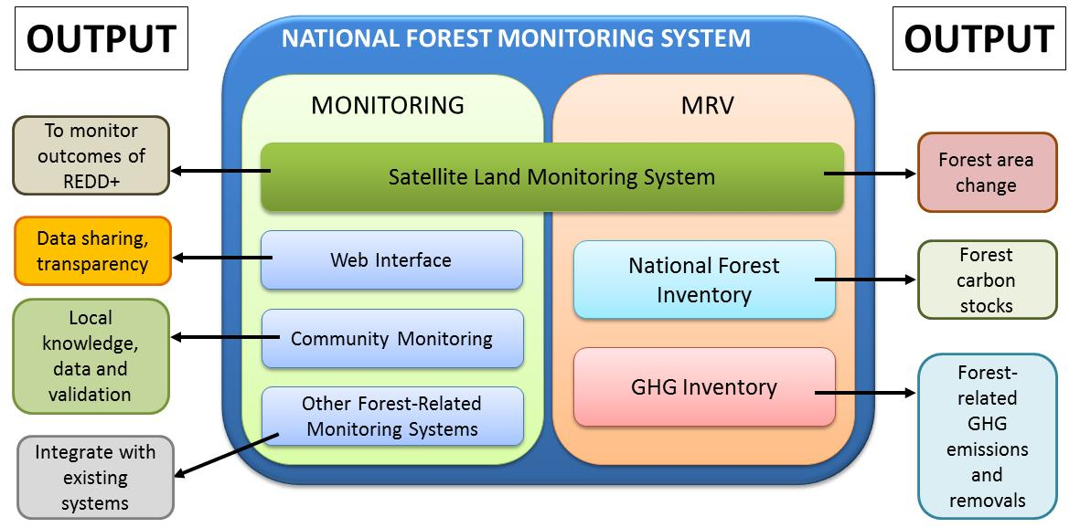
What is an NFMS?
Notes:
KEY MESSAGES:
System for measuring and monitoring how land is used in a country and for estimating forest-related GHG emissions and removals
Ultimate aim is to make reliable GHG emission estimates
Composed of two functions: the MRV (Measurement, Reporting & Verification) function and the Monitoring function
References:
UNEP. 2014. Forests in a Changing Climate: A Sourcebook for Integrating REDD+ into Academic Programmes. United Nations Environment Programme. Nairobi, Kenya.
http://www.unep.org/Training/docs/Forest_in_a_Changing_Climate.pdf
UNEP. 2015. REDD+ Academy Learning Journal. Edition 1.
www.un-redd.org/REDDAcademy

Slide 8
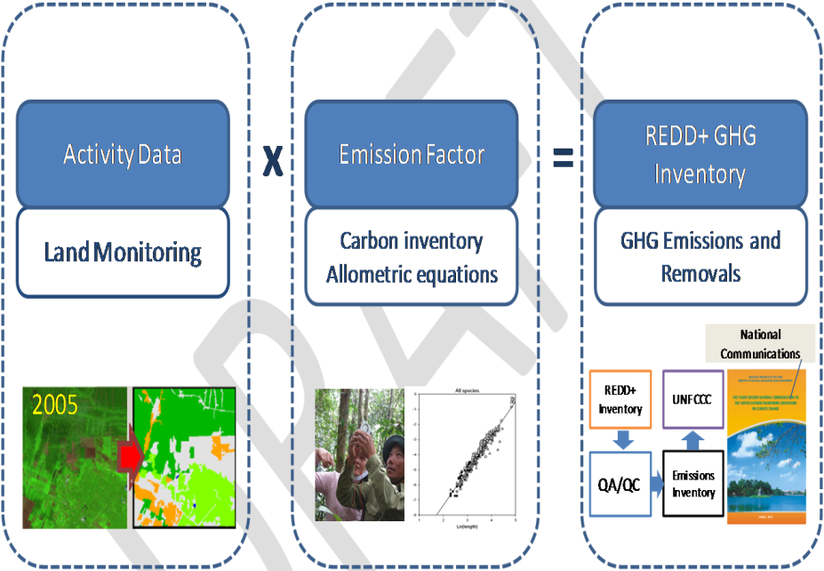
The MRV Function
Notes:
KEY MESSAGES:
The MRV function is supported by 3 technical “pillars “ or building blocks:
Satellite Land Monitoring System (SLMS) for collection and assessment of data on land use/land use change (Activity Data)
P2: National Inventory (NFI) for collection of information on forest carbon stocks and stock changes, needed to estimate emission factors
P3: A National GHG Inventory used as tool for reporting anthropogenic forest-related GHG emissions by sources and removals by sinks to the UNFCCC Secretariat
References:
UNEP. 2014. Forests in a Changing Climate: A Sourcebook for Integrating REDD+ into Academic Programmes. United Nations Environment Programme. Nairobi, Kenya.
http://www.unep.org/Training/docs/Forest_in_a_Changing_Climate.pdf
UNEP. 2015. REDD+ Academy Learning Journal. Edition 1.
www.un-redd.org/REDDAcademy

Slide 9
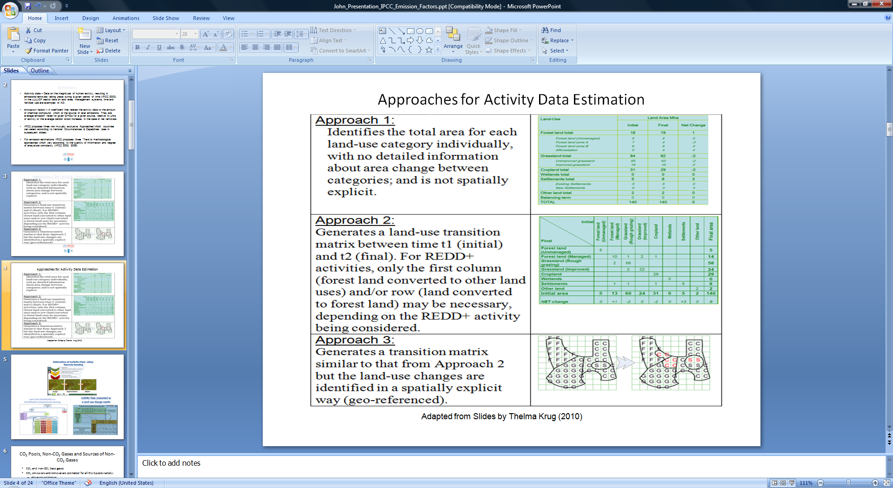
Assessment Area Change:
Activity Data & Approaches
Notes:
References:
UNEP. 2014. Forests in a Changing Climate: A Sourcebook for Integrating REDD+ into Academic Programmes. United Nations Environment Programme. Nairobi, Kenya.
http://www.unep.org/Training/docs/Forest_in_a_Changing_Climate.pdf
UNEP. 2015. REDD+ Academy Learning Journal. Edition 1.
www.un-redd.org/REDDAcademy

Slide 10
REDD+ MRV: Emission Factors (EF)
The “Tiers” system represent different levels of methodological complexities, and vary from Tiers 1 to Tiers 3.
  Tier 1 is basic and is used as s default EF data, provided by IPCC Guidelines & Guidance, and can also be obtained from the Emissions factor Database (EMFDB). It is appropriate for countries where national data is scarce or absent and hence default values have to be used.
  Tier 2 is intermediate but uses EFs that are country- or region-specific for the most important or “Key Carbon Pools”.
  Tier 3 uses higher order methods , including models and inventory measurement systems tailored to address national circumstances.
  Tier 2 & 3 are sometimes referred to as higher order tier methods and provide more accurate estimates of greater certainty than Tier 1.
Notes:
References:
UNEP. 2014. Forests in a Changing Climate: A Sourcebook for Integrating REDD+ into Academic Programmes. United Nations Environment Programme. Nairobi, Kenya.
http://www.unep.org/Training/docs/Forest_in_a_Changing_Climate.pdf
UNEP. 2015. REDD+ Academy Learning Journal. Edition 1.
www.un-redd.org/REDDAcademy

Slide 11
REDD+ MRV: GHG‐Inventory
With the full development and operation of the two elements (AD and EF) of the MRV system a country can generate its REDD+ related National GHG‐I, for reporting to the UNFCCC (in Phase III of REDD+).
The National GHG‐I for REDD+ is incorporated into the National GHG‐I, which will be submitted every four years as its National Communication (NC) to UNFCCC.
Under Articles 4 and 12 of the UNFCCC, all Parties are required to prepare NCs.
Information reported in GHG‐I represents an essential link between science and policy, and provides the means by which the Conference of Parties (COP) can monitor progress made by Parties in meeting their commitments and in achieving the Convention's ultimate objectives
Notes:
References:
UNEP. 2014. Forests in a Changing Climate: A Sourcebook for Integrating REDD+ into Academic Programmes. United Nations Environment Programme. Nairobi, Kenya.
http://www.unep.org/Training/docs/Forest_in_a_Changing_Climate.pdf
UNEP. 2015. REDD+ Academy Learning Journal. Edition 1.
www.un-redd.org/REDDAcademy

Slide 12
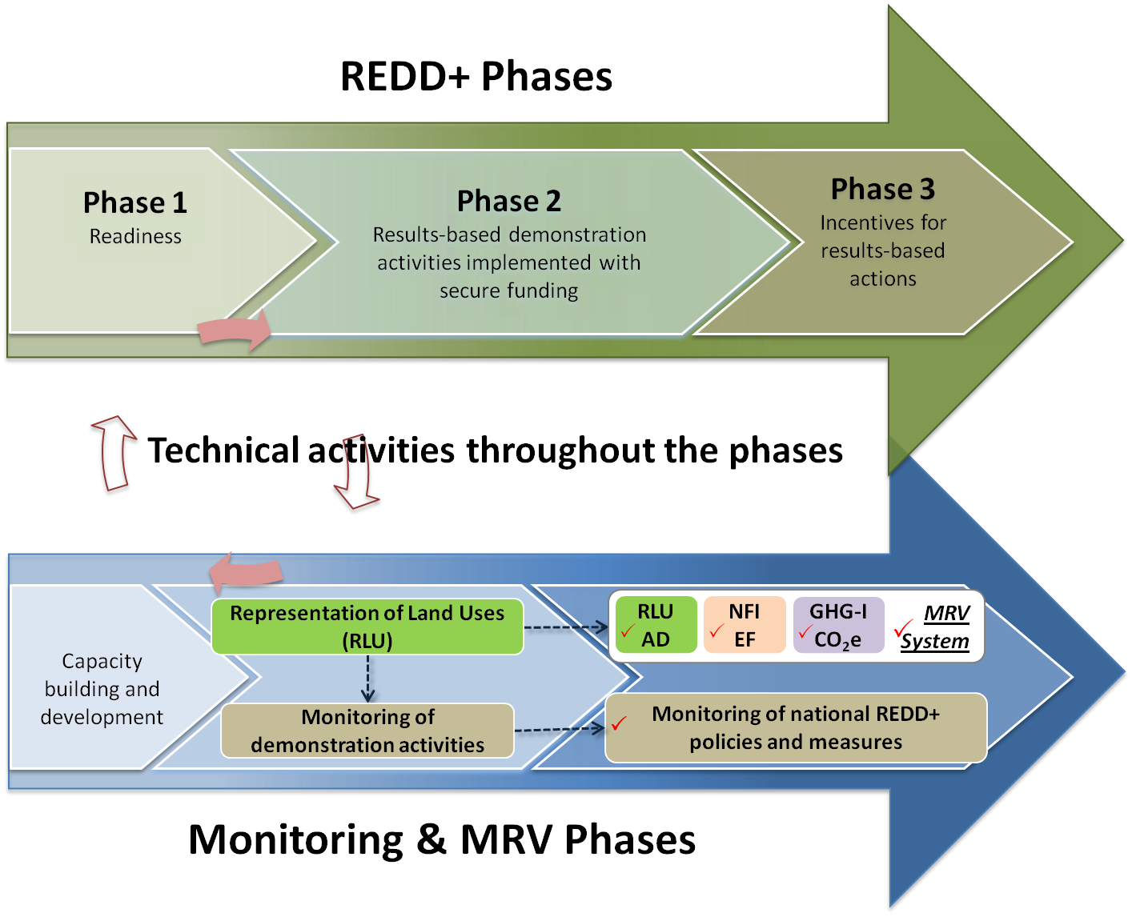
The Monitoring Function & REDD+ Phases
Notes:
KEY MESSAGES:
Monitoring function intends to assess REDD+ performance throughout its 3 phases (e.g Performance of REDD+ Demonstration Activities in Phase 2 & REDD+ PAMs in Phase 3)
In addition to Remote Sensing, ground-based monitoring approaches can be utilized, including community monitoring.
References:
UNEP. 2014. Forests in a Changing Climate: A Sourcebook for Integrating REDD+ into Academic Programmes. United Nations Environment Programme. Nairobi, Kenya.
http://www.unep.org/Training/docs/Forest_in_a_Changing_Climate.pdf
UNEP. 2015. REDD+ Academy Learning Journal. Edition 1.
www.un-redd.org/REDDAcademy

Slide 13
Monitoring Tools
Satellite Remote Sensing | Cost-effective method to monitor deforestation and to some extent degradation?
Web-based Portals | Transparent means to monitor outcomes of PAMs implementation, allows users to provide feedbacks and user-interactions
Community monitoring | Bottom-up means to incorporate local knowledge into monitoring. Means to ensure effective engagement of IPs in monitoring & Reporting
Other forest monitoring systems | Builds linkages with existing monitoring systems
Notes:
References:
UNEP. 2014. Forests in a Changing Climate: A Sourcebook for Integrating REDD+ into Academic Programmes. United Nations Environment Programme. Nairobi, Kenya.
http://www.unep.org/Training/docs/Forest_in_a_Changing_Climate.pdf
UNEP. 2015. REDD+ Academy Learning Journal. Edition 1.
www.un-redd.org/REDDAcademy

Slide 14
Summary of Important COP decisions
Agreement |  | Summary
The UNFCCC: Text of the Convention (1992), Article 4: Commitments: | 1992 | Parties will publish and make available national inventories of anthropogenic sources and removals by sinks, using similar methods.
The Bali Action Plan (2007) | 2007 | All parties are encouraged to reduce their GHG emissions in ways that are Measurable, Reportable and Verifiable (MRV) Capacity building should be supported and reporting using the latest IPCC guidelines encouraged.
Copenhagen (2009) | 2009 | Emissions from forests should be reduced according to the latest IPCC guidelines and national forest monitoring systems should be established according to using consistent methodologies.
Cancun (2010) | 2010 | A National forest monitoring system is one of the four key elements of REDD+ and it should be developed through a phased approach.
Warsaw (2013) | 2013 | Formalises earlier guidance into decisions, describes the quality of national forest monitoring systems required for measurement of REDD+ results, and the methods of reporting and verification.
Notes:
References:
UNEP. 2014. Forests in a Changing Climate: A Sourcebook for Integrating REDD+ into Academic Programmes. United Nations Environment Programme. Nairobi, Kenya.
http://www.unep.org/Training/docs/Forest_in_a_Changing_Climate.pdf
UNEP. 2015. REDD+ Academy Learning Journal. Edition 1.
www.un-redd.org/REDDAcademy

Slide 15
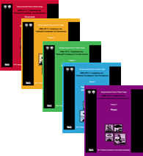
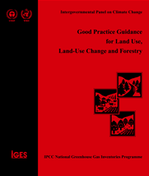
Implementing NFMS: IPCC Guidelines
IPCC Methodological Guidance are useful in the implementation of NFMS:
    Revised 1996 IPCC Guidelines
    Good Practice Guidance (GPG) 2000
    GPG 2003 (LULUCF)
    2006 IPCC Guidelines
Using Software Tools to support the Guidelines (e.x. Emission Factor Database: EFDB)
IPCC Guidelines/Guidance help to demonstrate the Good Practices to be used by all countries in reporting to UNFCCC (TACCC: Transparency, Accuracy, Consistency, Completeness & Comparability).
TACCC
Notes:
References:
UNEP. 2014. Forests in a Changing Climate: A Sourcebook for Integrating REDD+ into Academic Programmes. United Nations Environment Programme. Nairobi, Kenya.
http://www.unep.org/Training/docs/Forest_in_a_Changing_Climate.pdf
UNEP. 2015. REDD+ Academy Learning Journal. Edition 1.
www.un-redd.org/REDDAcademy

Slide 16
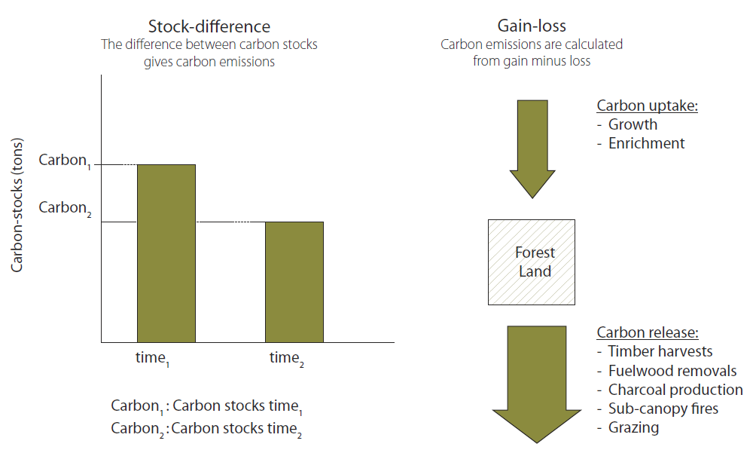
Measuring forest carbon stock changes
Stock difference & Gain-Loss Methods
Notes:
References:
UNEP. 2014. Forests in a Changing Climate: A Sourcebook for Integrating REDD+ into Academic Programmes. United Nations Environment Programme. Nairobi, Kenya.
http://www.unep.org/Training/docs/Forest_in_a_Changing_Climate.pdf
UNEP. 2015. REDD+ Academy Learning Journal. Edition 1.
www.un-redd.org/REDDAcademy

Slide 17
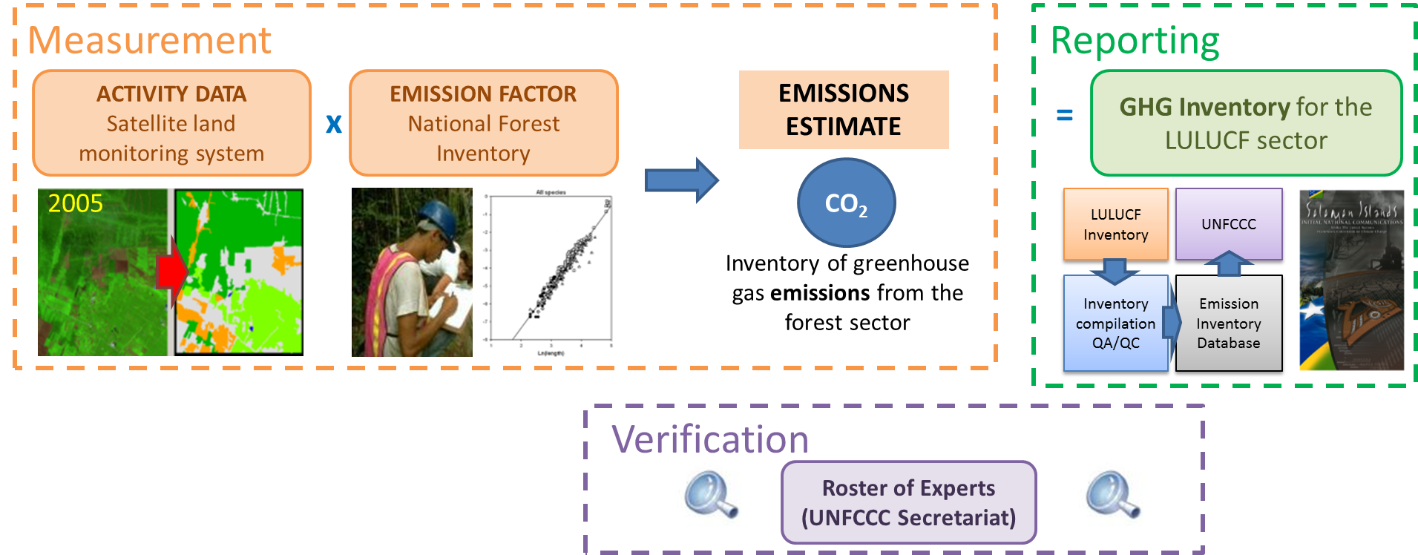
MRV for REDD+
Notes:
References:
UNEP. 2014. Forests in a Changing Climate: A Sourcebook for Integrating REDD+ into Academic Programmes. United Nations Environment Programme. Nairobi, Kenya.
http://www.unep.org/Training/docs/Forest_in_a_Changing_Climate.pdf
UNEP. 2015. REDD+ Academy Learning Journal. Edition 1.
www.un-redd.org/REDDAcademy

Slide 18
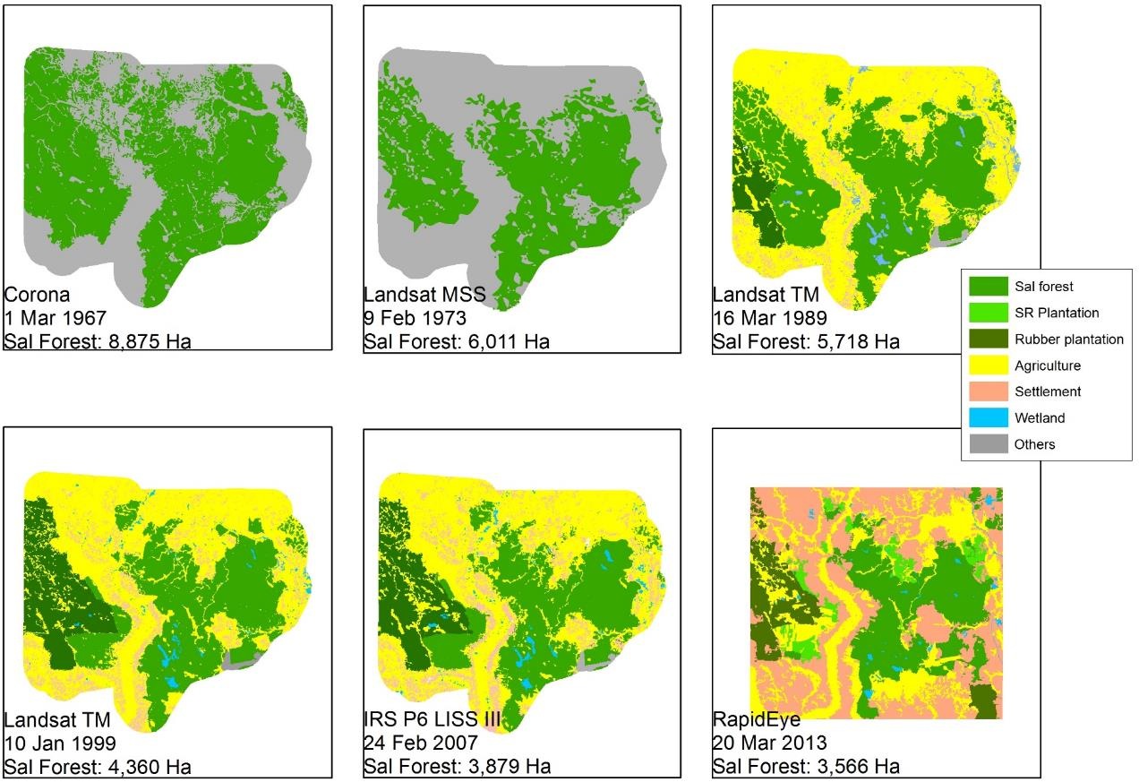
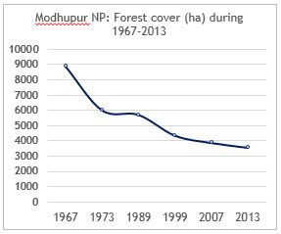
Example of Activity data: Modhupur National Park
Modhupur National Park (1967-2013)
Notes:
Modhupur National Park: forest land reduced over 1967 - 2013

Slide 19
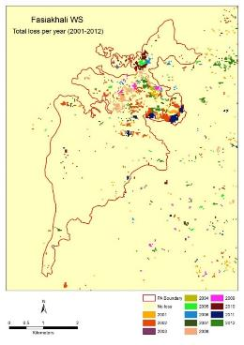
Example of Activity data: Fasiakhali Wildlife sanctuary
Notes:
Using Global data; Matt Hansen et. al. 2013

Slide 20
Example of Emission factor, CO₂ Mg/ha
 |  | Converted to . . . .
 |  | Hill Forest | Sal Forest | Plantation | Rubber | Degraded forest | Tea Garden | Agriculture | Bare land
Converted from . . . . | Hill Forest | N/A | N/A | 93.4 | 114.4 | 257.9 | 288 | 319.1 | 324.8
 | Sal Forest | N/A | N/A | 15.6 | 36.6 | 180.1 | 210.2 | 241.3 | 247.1
 | Plantation | N/A | N/A | N/A | 21 | 164.6 | 194.6 | 225.7 | 231.5
 | Rubber | N/A | N/A | N/A | N/A | 143.5 | 173.6 | 204.7 | 210.4
 | Degraded forest | -257.9 | -180.1 | -164.6 | -143.5 | N/A | 30 | 61.1 | 66.9
 | Tea Garden | N/A | N/A | N/A | N/A | N/A | N/A | 31.1 | 36.9
 | Agriculture | -319.1 | -241.3 | -225.7 | -204.7 | N/A | -31.1 | N/A | 5.8

Slide 21
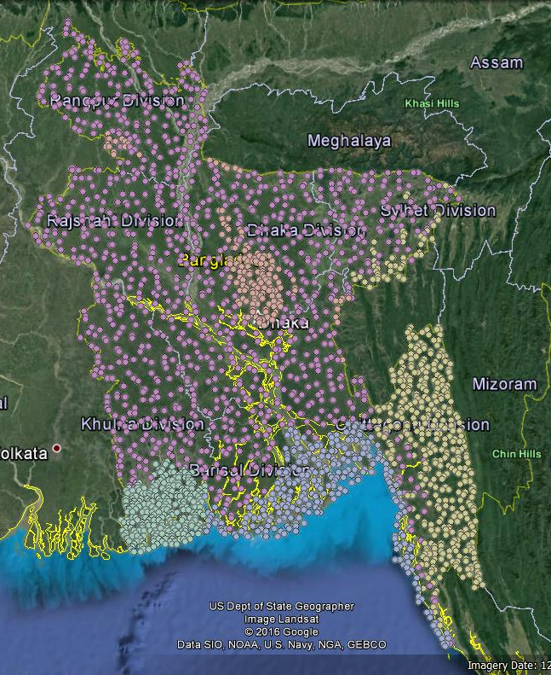
Bangladesh Forest Inventory 2016-2018: No. of Plots
Zone | Number of plots
 | On land | On water | Total
Coastal | 113 | 178 | 291
Hill | 429 | 14 | 443
Sal | 145 | 5 | 150
Sundarbans | 173 | 105 | 278
Villages | 998 | 85 | 1083
Total | 1858 | 387 | 2245

Slide 22
Sampling Design: intensity and average distance between plots
Forest zone | Total Area (1000 ha) | Number of plots | Total area of plots (ha) | Sampling intensity (%) | Average distance between plots (km)
 |  |  |  |  | Straight line distance | Travel distance along roads
Hill forest | 1714 | 429 | 243.27 | 0.014 | 4.34 | 10.59
Sal forest | 534.8 | 145 | 82.22 | 0.015 | 4.61 | 5.91
Sundarban | 609.2 | 173 | 98.10 | 0.016 | 3.51 | 7.79
Coastal | 1209 | 113 | 64.08 | 0.005 | 6.02 | 11.08
Villages | 10890 | 998 | 565.92 | 0.005 | 6.70 | 13.40

Slide 23
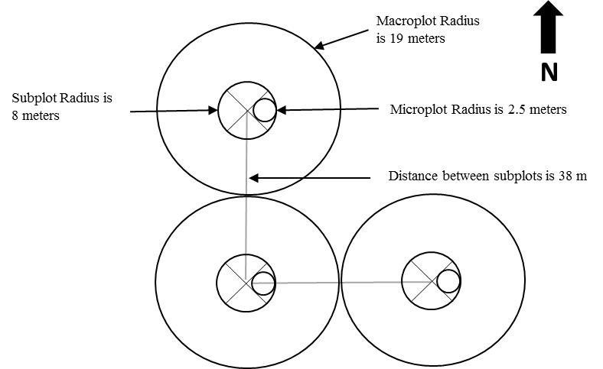
Technical Design: Circular Plots
Cluster of Five sub plots
Cluster of 3 sub plots
(For Hill, Sal, Village & Coastal Plantation)
For Sundarbans
L plot Radius
is 19 meters
N
M plot Radius is
8 meters
S plot Radius is 2.5 meters
Distance between subplots is 38 m

Slide 24
Technical Design: Circular Plots
Cluster of Five sub plots
Cluster of 3 sub plots
(For Hill, Sal, Village & Coastal Plantation)
For Sundarbans
Distance between subplots centres is 38 m
Subplot
Subplot
N

Slide 25
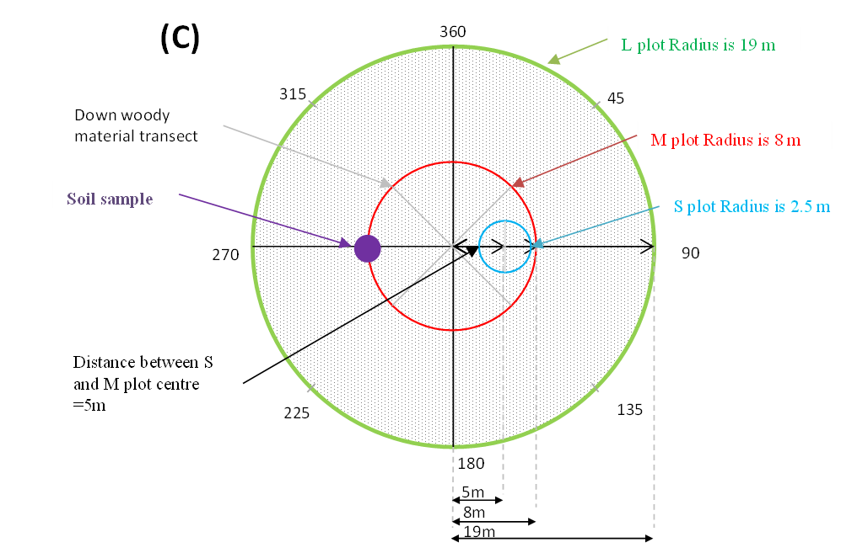
Technical Design: Circular Plot Details

Slide 26
Technical Design: Measurements in each sub plot
Trees ≥ 10cm
Bamboo
8 m
19 m
2.5m
Seedlings, Nypa palm, Ceriops, phoenix, shrubs etc.
Trees ≥ 30 cm
Dead Wood

Slide 27
BFI 2016-2018
Sustainability of the BFI
Building on existing capacities and needs
Avoiding creating a parallel process
Proposed institutionalization
One NFI unit in BFD
5 Supervisors in 5 locations (Dhaka, Chittagong, Khulna, Sylhet & Bogra)
12 Field teams led by nominated ACF
5 QA/QC teams
Assumptions
One plot in one day
Field campaign during 5 months per year
Complete Hill, Sundarbans and Coastal plantation first
Future
10 Teams, 5 cycle inventory, 20% plots per year

Slide 28
TAKE HOME MESSAGES
Main components of a NFMS for REDD+ include the satellite Land Monitoring System and the National Forest Inventory
Key principles of IPCC’s guidance for MRV for REDD+ are: TACCC: Transparent, Documented, consistent over time, Complete, Comparable, assessed for Uncertainty
MRV for REDD+ involves
  Measurement: AD x EF=Emissions
  Reporting through NC and BUR on GHG Emissions
  Verification through 3rd Party (external) Reviewers

Slide 29
References
UNEP. 2014. Forests in a Changing Climate: A Sourcebook for Integrating REDD+ into Academic Programmes. United Nations Environment Programme. Nairobi, Kenya.
http://www.unep.org/Training/docs/Forest_in_a_Changing_Climate.pdf
UNEP. 2015. REDD+ Academy Learning Journal. Edition 1.
www.un-redd.org/REDDAcademy

Slide 30
References and Resources
The curriculum of USAID’s Climate-Resilient Ecosystems and Livelihoods (CREL) in Bangladesh is a free resource of teaching materials for university professors, teachers and climate change training experts.
Reproduction of CREL’s curriculum materials for educational or other non-commercial purposes is authorized without prior written permission from the copyright holder, provided the source is fully acknowledged.
Suggested citation: Winrock International. 2016. USAID‘s Climate-Resilient Ecosystems and Livelihoods (CREL). Winrock International. Dhaka, Bangladesh.
Disclaimer: The CREL’s curriculum is made possible by the support of the American People through the United States Agency for International Development (USAID). The contents of the curriculum do not necessarily reflect the views of USAID or the US Government.

Slide 31
USAID's Climate-Resilient Ecosystems and Livelihoods (CREL) Project
Winrock International Headquarters
2101 Riverfront Drive, Little Rock
Arkansas 72202-1748 USA
Tel: 1-501-280-3000
Web: www.winrock.org

