Slide 1
Bangladesh Climate-Resilient Ecosystem Curriculum (BACUM)
Module 2: REDD+ in Climate Change Context

Slide 2
Module 2: REDD+ in Climate Change Context
SECTION II: ASSESSING CURRENT CONDITIONS OF REDD+
2.1. Drivers of Deforestation and Forest Degradation

Slide 3
REDD+ in Climate Change Context (REDD+)
ENABLING ENVIRONMENT OF REDD+
1.1. Forests, Forest Carbon and Climate Change
1.2. Fundamentals of REDD+ and the UNFCCC
1.3. Stakeholder Engagement
ASSESSING CURRENT CONDITIONS OF REDD+
2.1. Drivers of Deforestation and Forest Degradation
2.2. Fundamentals of Forest (Emission) Reference Levels
2.3. National Forest Monitoring Systems (NFMS) for REDD+
ANALYZING FUTURE OPTIONS FOR REDD+
3.1. Policies and Measures for REDD+ Implementation
3.2. REDD+ Safeguards under the UNFCCC
3.3. The Costs and Benefits of REDD+
DEVELOPING REDD+ STRATEGIES AND ACTION PLANS
4.1. Negotiation in REDD+
4.2. National Strategies and Action Plans
4.3. Approaches for Incentive Allocation System
MONITORING, EVALUATION AND ADAPTATION
5.1. Establish M&E Framework for REDD+ Action Plan
5.2. Monitor and Measure Implementation Progress
5.3. Evaluate, Report and Adapt

Slide 4
Acknowledgements
EXPERT CONTRIBUTORS | SPECIFIC INPUTS
Prof. (Dr.) Manzoor Rashid | Curriculum Development for all topics
Prof. (Dr.) Md. Danesh Miah | REDD+, Forest Carbon
Prof. (Dr.) Md. Jakariya | Community NR Management, Climate Change, Natural Resources Management
UNIVERSITIES
Bangladesh Agricultural University
University of Chittagong
Dhaka University
Independent University, Bangladesh
Khulna University
Noakhali University of Science and Technology
Shahjalal University of Science and Technology
Sher-e-Bangla Agriculture University
North South University
CREL STAFF | CREL STAFF
John A Dorr | Utpal Dutta
Abu Mostafa Kamal Uddin | Ruhul Mohaiman Chowdhury
Kevin T. Kamp | Rahima Khatun
Paul Thompson | Sultana Razia Zummi
Abdul Wahab | Shams Uddin
Shahzia Mohsin Khan
DESIGN, LAYOUT AND CONTENT DEVELOPMENT: Ms. Chi Pham, Curriculum Development Expert, Bangkok, Thailand

Slide 5
Learning Objectives
By the end of this session, students be able to:
Describe Forest Reference (Emission) Levels (FRELs/FRLs)
Explain the importance of developing FRELs/FRLs
Describe the process of constructing and submitting FRELs/FRLs
Explain why and how national circumstances can be taken into consideration

Slide 6
What are Forest Reference (Emission) Levels?
REL - for the “reducing emissions” activities i.e., deforestation & degradation
RL - is for Conservation, Enhancement & Sustainable management activities (+ activities)
To serves as benchmarks for assessing country’s performance in implementing 5 REDD+ activities
FERL/RL has to be consistent with time
FERL/RL has to be consistent with country’s GHG inventory estimates
FERL/RL has to be transparent taking into account historical data and be flexible to accommodate national circumstances and capabilities
Notes:
FREL/RL is one of the elements to be developed by developing country Parties implementing REDD+ activities.
Reference levels are expressed as tonnes of CO2 equivalent per year for a reference period against which the emissions and removals from a results period will be compared.
Thus, reference levels serve as benchmarks for assessing each country’s performance in implementing REDD+ activities.
Reference levels need to maintain consistency with the country’s greenhouse gas inventory estimates.
The Reference level needs to be submitted the (UNFCCC) secretariat for subsequent technical assessment. The information contained in the submission should be transparent, complete, consistent with guidance agreed by the COP and accurate. The information provided should be guided by the most recent IPCC guidance and guidelines, as adopted or encouraged by the COP.
Having an assessed national reference level in place is one of the requirements in order to be eligible for results-based payments in accordance with decision 9/CP.19. A link to the final technical assessment report should also be provided in the Lima REDD+ Information Hub.

Slide 7
What are Forest Reference (Emission) Levels?
“ Benchmarks for assessing each country’s performance in implementing REDD+ activities” (UNFCCC (Decision 12/CP.17))
Forest Reference Emission Level (FREL)
Gross emissions from deforestation or degradation
Forest Reference Level (FRL)
Net emissions and removals
Solely for activities that “reduce emissions”
Reducing emissions from deforestation
Reducing emissions from forest degradation
Also includes activities from the “+” that can “enhance forest carbon stocks”
Notes:
KEY MESSAGE:
The technical part of REL is further explained in Forest Carbon Measurement and Monitoring (FCMM) Module

Slide 8
Why develop a FREL/FRL
Countries may choose to express their contribution to international mitigation through REDD+ actions under the UNFCCC;
Countries may choose to assess progress on the outcomes of policies and measures taken to mitigate climate change in the forestry sector for domestic reasons; and
Countries may choose to access results-based payments (RBP). According to UNFCCC decisions, eligibility for results-based payments requires an assessed Forest Reference Level.

Slide 9
Illustration of FREL and Consistency with MRV
Notes:
References:
UNEP. 2014. Forests in a Changing Climate: A Sourcebook for Integrating REDD+ into Academic Programmes. United Nations Environment Programme. Nairobi, Kenya. http://www.unep.org/Training/docs/Forest_in_a_Changing_Climate.pdf
UNEP. 2015. REDD+ Academy Learning Journal. Edition 1. www.un-redd.org/REDDAcademy

Slide 10
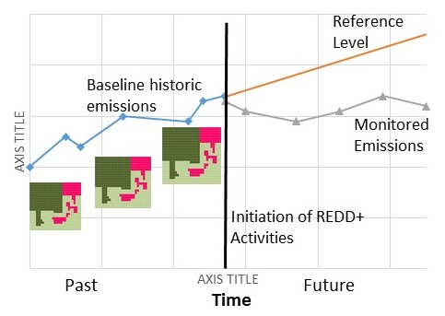
REL in REDD+?
Stratum | AG tree |  | BG tree |  | Soil | Total
 |  | t CO₂-e / ha
Mangrove forest | 110 |  | 23 | 100 |  | 233
Upland forest | 91 |  | 17 | 20 |  | 128
Wetland | 0 |  | 0 | 70 |  | 70
Grassland | 10 |  | 5 | 10 |  | 25
Agriculture | 5 |  | 2 | 5 |  | 13
Reference Emission Level (REL/RL)
RL = Baseline
Map historic land cover 3 points in time
Historic land cover change
Benchmark map
Quantify Carbon stock
Emission factors = C stocks per land cover
Develop Emission look-up tables
Project future emissions and removals of CO₂e the absence of REDD+

Slide 11
Emission factor, CO₂ Mg/ha
 |  | Converted to . . . .
 |  | Hill Forest | Sal Forest | Plantation | Rubber | Degraded forest | Tea Garden | Agriculture | Bare land
Converted from . . . . | Hill Forest | N/A | N/A | 93.4 | 114.4 | 257.9 | 288 | 319.1 | 324.8
 | Sal Forest | N/A | N/A | 15.6 | 36.6 | 180.1 | 210.2 | 241.3 | 247.1
 | Plantation | N/A | N/A | N/A | 21 | 164.6 | 194.6 | 225.7 | 231.5
 | Rubber | N/A | N/A | N/A | N/A | 143.5 | 173.6 | 204.7 | 210.4
 | Degraded forest | -257.9 | -180.1 | -164.6 | -143.5 | N/A | 30 | 61.1 | 66.9
 | Tea Garden | N/A | N/A | N/A | N/A | N/A | N/A | 31.1 | 36.9
 | Agriculture | -319.1 | -241.3 | -225.7 | -204.7 | N/A | -31.1 | N/A | 5.8
Notes:
A generalized scenario for Emission factors in Bangladesh forests
For example
If one ha of “Hill Forest” becomes “Degraded Land”, it causes emission worth 257.9 tons of CO₂ from the forests

Slide 12
Considerations in development of FREL/FRL
Forest Definition | Forest definition must be consistent with that used in international reporting (e.g. NC) Uses 3 minimum threshold: tree crown cover (10 to 30%), min. land area (bet. 0.05 and 1 ha); min height (bet. 2 and 5m)
Historical Data | Activity data and Emission Factors
Scope (Activities) | Refers to the 5 REDD+ Activities: Select Priority Activities for your country
Scope (carbon pools | Refers to the carbon pools (major carbon pools)
Scale | National or sub-national
Method of Construction | Historical Average; Adjusted or projected methods
Adjustment for national Circumstances | Those relevant to REDD+ include DD, state of forest transition, population changes, development policies
Notes:
References:
UNEP. 2014. Forests in a Changing Climate: A Sourcebook for Integrating REDD+ into Academic Programmes. United Nations Environment Programme. Nairobi, Kenya. http://www.unep.org/Training/docs/Forest_in_a_Changing_Climate.pdf
UNEP. 2015. REDD+ Academy Learning Journal. Edition 1. www.un-redd.org/REDDAcademy

Slide 13
How to develop FRELs/FRLs
National Forest Monitoring System
National Strategy or Action Plan
Forest definition
Data selection Activity Data & Emission Factor
Scope activities, pools, gases included
Choice of Scale
Analysis of historical data
The UNFCCC requires that FREL/FRLs take into account historical data
Choice of construction approach for FREL/FRL
Analysis of national circumstances
Does the country want to adjust for national circumstances?
FREL/FRL
Notes:
KEY MESSAGE:
This is just a simplied process overview
More detailed on technical measurement is taught in FCMM Module

Slide 14
Approaches for Constructing FREL/FRL
Historical Average Approach
This method uses only historicla averages of deforestation rates (generally for a 10 year period)
Adjusted Historical Approach
The historical average constitues the starting point, but other important factors are included to imporve on the forecasts or prediction
Simulation Model
Future deforestation and resulting emissions can be estimated using a simulation model which takes various forms
Source: Huertner et al. 2009
Notes:
References:
UNEP. 2014. Forests in a Changing Climate: A Sourcebook for Integrating REDD+ into Academic Programmes. United Nations Environment Programme. Nairobi, Kenya. http://www.unep.org/Training/docs/Forest_in_a_Changing_Climate.pdf
UNEP. 2015. REDD+ Academy Learning Journal. Edition 1. www.un-redd.org/REDDAcademy

Slide 15
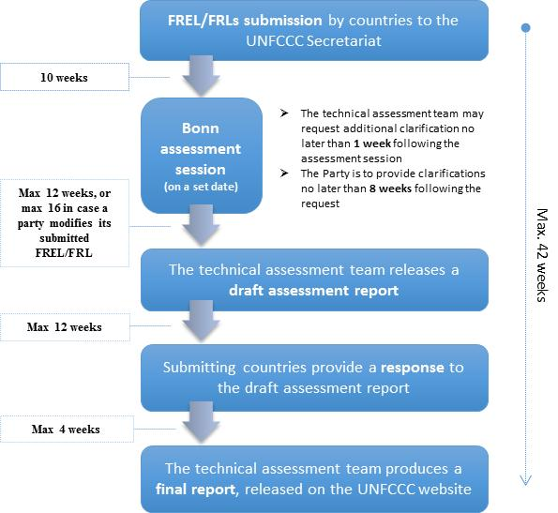
Submitting a FREL/FRL
Notes:
Key Messages:
FREL can be submitted anytime for assessment by Assessment Team (AT) of UNFCCC
AT conducts a comprehensive assessment of the submitted FREL following set timelines for assessment session in Bonn
AT makes clarifications, request revisions, and make compilation of experts report on the FREL, published on UNFCCCC website
References:
UNEP. 2014. Forests in a Changing Climate: A Sourcebook for Integrating REDD+ into Academic Programmes. United Nations Environment Programme. Nairobi, Kenya. http://www.unep.org/Training/docs/Forest_in_a_Changing_Climate.pdf
UNEP. 2015. REDD+ Academy Learning Journal. Edition 1. www.un-redd.org/REDDAcademy

Slide 16
TAKE HOME MESSAGES
Forest Reference (Emission) Levels provide a reference point for measuring changes in emissions due to REDD+ implementation
Defining a forest appropriately is crucial
REDD+ can be implemented at different levels, but ultimately should be at a national level
National circumstances must be taken into consideration when determining FRELs/FRLs

Slide 17
References
UNEP. 2014. Forests in a Changing Climate: A Sourcebook for Integrating REDD+ into Academic Programmes. United Nations Environment Programme. Nairobi, Kenya. http://www.unep.org/Training/docs/Forest_in_a_Changing_Climate.pdf
UNEP. 2015. REDD+ Academy Learning Journal. Edition 1. www.un-redd.org/REDDAcademy

Slide 18
References and Resources
The curriculum of USAID’s Climate-Resilient Ecosystems and Livelihoods (CREL) in Bangladesh is a free resource of teaching materials for university professors, teachers and climate change training experts.
Reproduction of CREL’s curriculum materials for educational or other non-commercial purposes is authorized without prior written permission from the copyright holder, provided the source is fully acknowledged.
Suggested citation: Winrock International. 2016. USAID‘s Climate-Resilient Ecosystems and Livelihoods (CREL). Winrock International. Dhaka, Bangladesh.
Disclaimer: The CREL’s curriculum is made possible by the support of the American People through the United States Agency for International Development (USAID). The contents of the curriculum do not necessarily reflect the views of USAID or the US Government.

Slide 19
USAID's Climate-Resilient Ecosystems and Livelihoods (CREL) Project Winrock International Headquarters 2101 Riverfront Drive, Little Rock Arkansas 72202-1748 USA Tel: 1-501-280-3000 Web: www.winrock.org

