Slide 1
Bangladesh Climate-Resilient Ecosystem Curriculum (BACUM)
Module 3: Forest Carbon Measurement and Monitoring

Slide 2
Module 3: Forest Carbon Measurement and Monitoring
SECTION III: FOREST CARBON MEASUREMENT AND MONITORING METHODS
3.2. Quality Assurance and Quality Control (QA/QC)

Slide 3
Forest Carbon Measurement and Monitoring (FCMM)
FUNDAMENTALS OF FOREST CARBON IN REDD+ CONTEXT
1.1. Forests, the Global Carbon Cycle and Climate Change
1.2. The Roles of Forests and Forest Carbon in Global Climate Negotiations
1.3. Challenges for Forest-based Climate Change Mitigation
FOREST CARBON STOCKS AND IPCC GUIDELINES
2.1. Overview of Forest Carbon Pools (Stocks)
2.2. Land Use, Land Use Change, and Forestry (LULUCF)
2.3. IPCC Guidelines for Forest Carbon Measurement and Monitoring
2.4. Reference Levels – Monitoring against a Baseline
FOREST CARBON MEASUREMENT AND MONITORING METHODS
3.1. Overview of Forest Carbon Measurement and Monitoring
3.2. Quality Assurance and Quality Control (QA/QC)
3.3. Field Sampling Design Methods
3.4. Forest Carbon Field Measurement Methods
3.5. Carbon Stock Calculation and Available Tools
3.6. Creating Activity Data and Emissions Factors
3.7. Considerations in Developing a Monitoring System

Slide 4
Acknowledgements
EXPERT CONTRIBUTORS | SPECIFIC INPUTS
Prof. (Dr.) Manzoor Rashid | Curriculum Development for all topics
Prof. (Dr.) Md. Danesh Miah | REDD+, Forest Carbon
Prof. (Dr.) Md. Jakariya | Community NR Management, Climate Change, Natural Resources Management
UNIVERSITIES
Bangladesh Agricultural University
University of Chittagong
Dhaka University
Independent University, Bangladesh
Khulna University
Noakhali University of Science and Technology
Shahjalal University of Science and Technology
Sher-e-Bangla Agriculture University
North South University
CREL STAFF | CREL STAFF
John A Dorr | Utpal Dutta
Abu Mostafa Kamal Uddin | Ruhul Mohaiman Chowdhury
Kevin T. Kamp | Rahima Khatun
Paul Thompson | Sultana Razia Zummi
Abdul Wahab | Shams Uddin
Shahzia Mohsin Khan
DESIGN, LAYOUT AND CONTENT DEVELOPMENT: Ms. Chi Pham, Curriculum Development Expert, Bangkok, Thailand

Slide 5
Learning Objectives
At the end of the training session, students will be able to:
Explain the value of QA/QC in forest carbon measurement and monitoring
Identify key strategies on QA/QC that could be applied for the field measurement
Apply the Standard Operating Procedures in implementing QA/QC plan

Slide 6
Quality Assurance/Quality Control plans
Plans need to be made to monitor for:
Quality Assurance (QA)
Quality Control (QC)
The QA/QC plan should become part of project documentation and cover the following procedures:
Field measurements
Laboratory measurements
Data entry
Data analysis
Data maintenance and archiving

Slide 7
Accuracy vs Precision
Accuracy:
agreement between the true value and repeated measured observations or estimations
Precision:
illustrates the level of agreement among repeated measurements of the same quantity
Accurate
but not precise
Precise
but not accurate
Accurate and Precise

Slide 8
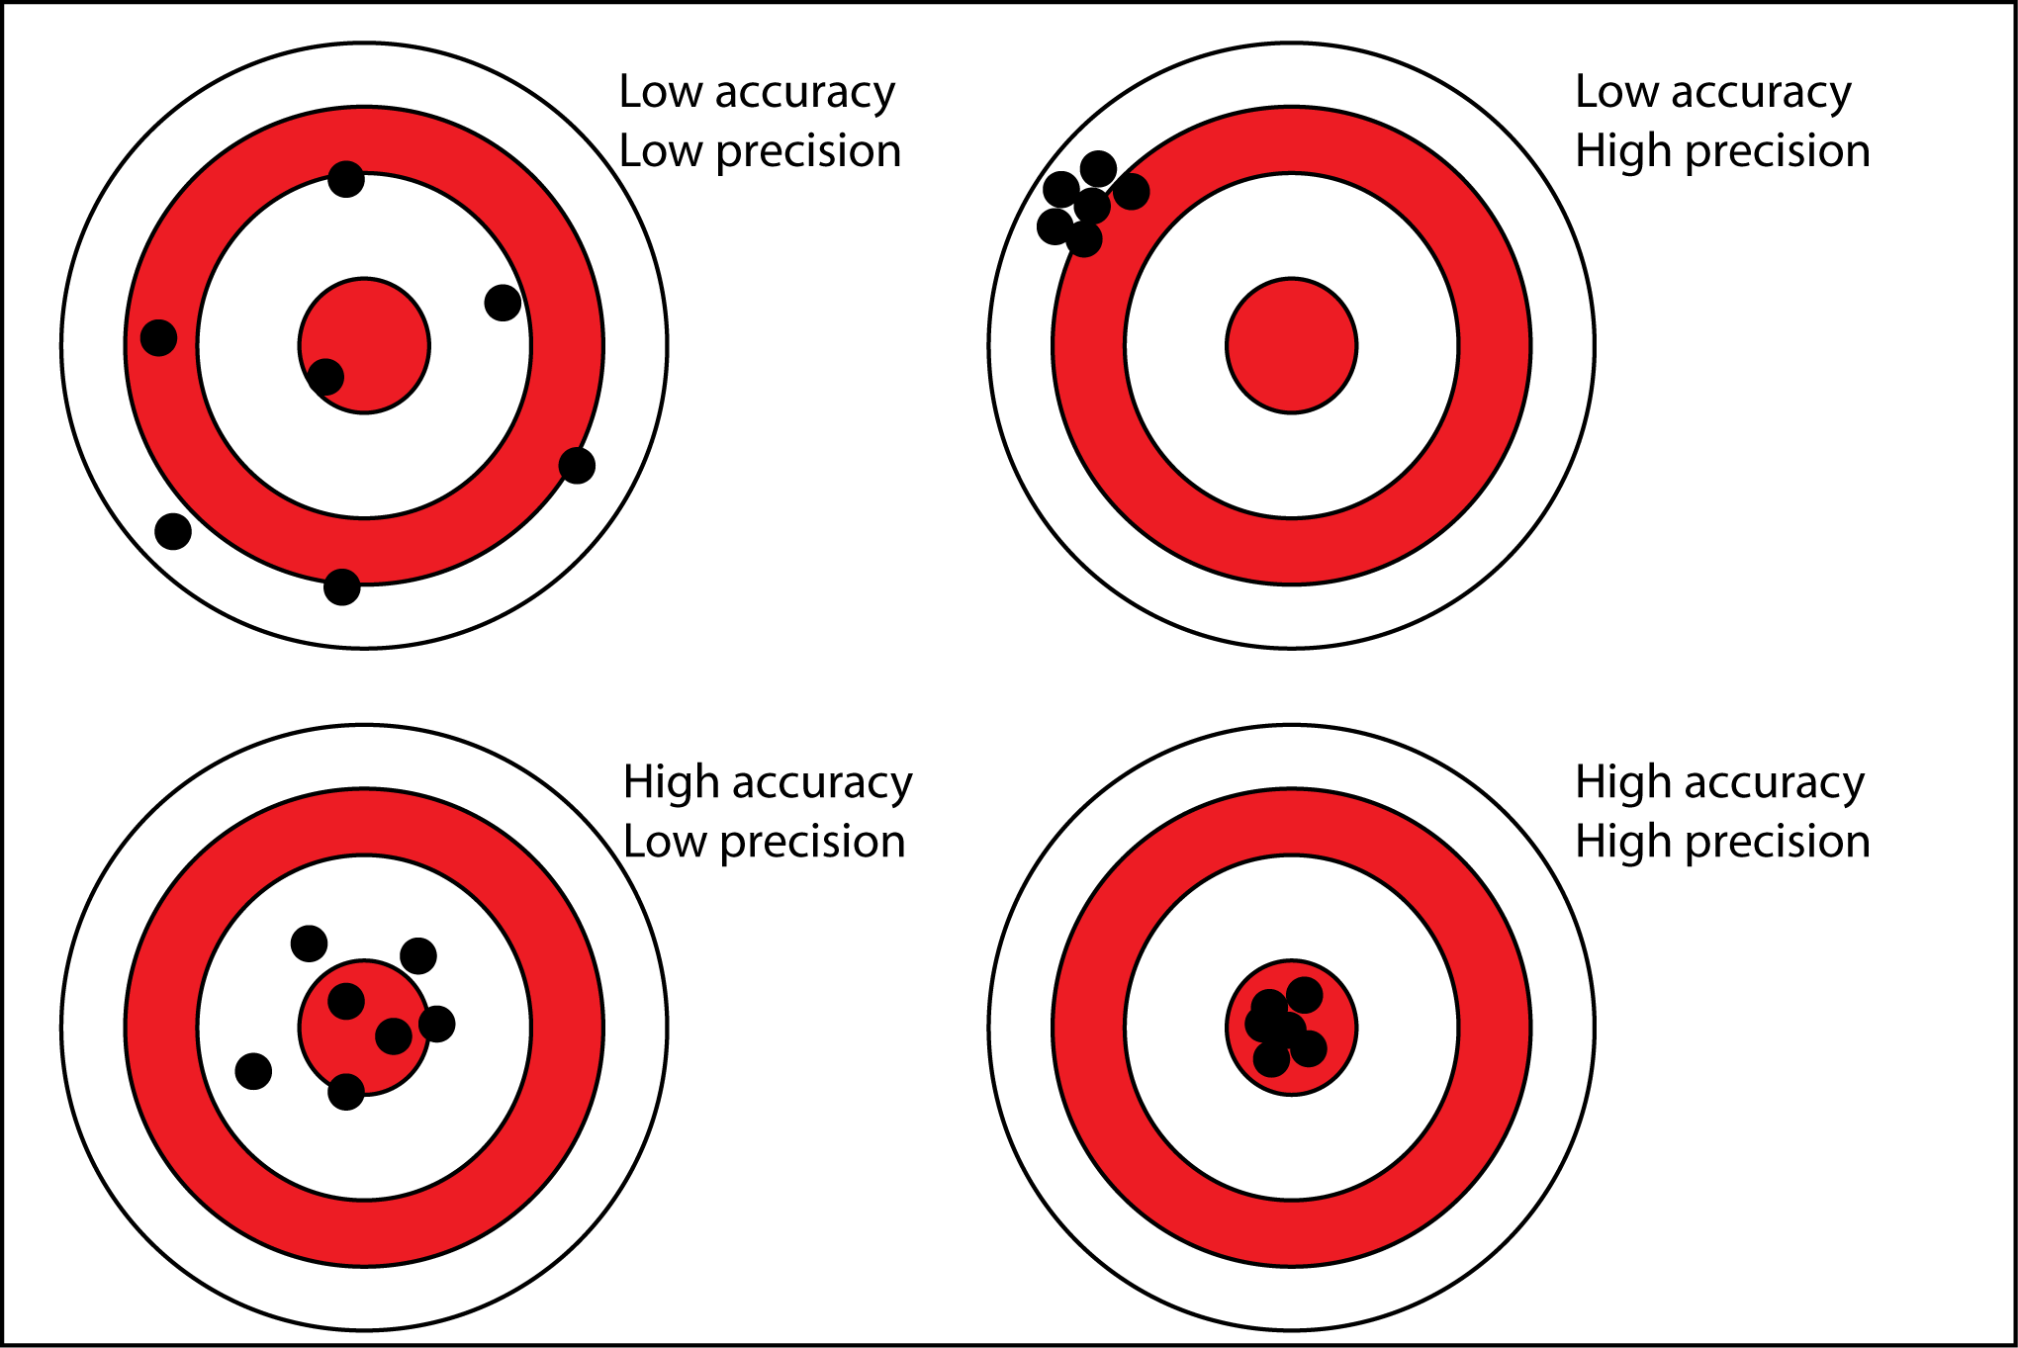
Exercise
Task: Recognize characteristics of the images and label them accoridingly
High accuracy
High precision
Low accuracy
Low Precision
Notes:
KEY MESSAGES:
Accurate measurements fall in the bulls eye. Precise measurements are tightly clustered. Accurate and precise measurements are tightly clustered in the bulls eye!
Image source: http://www.antarcticglaciers.org/glacial-geology/dating-glacial-sediments-2/precision-and-accuracy-glacial-geology/

Slide 9
Exercise: Answers
Notes:
KEY MESSAGES:
Accurate measurements fall in the bulls eye. Precise measurements are tightly clustered. Accurate and precise measurements are tightly clustered in the bulls eye!
Image source: http://www.antarcticglaciers.org/glacial-geology/dating-glacial-sediments-2/precision-and-accuracy-glacial-geology/

Slide 10
Exercise: Answers
Notes:
KEY MESSAGES:
Accurate measurements fall in the bulls eye. Precise measurements are tightly clustered. Accurate and precise measurements are tightly clustered in the bulls eye!
Image source: http://www.antarcticglaciers.org/glacial-geology/dating-glacial-sediments-2/precision-and-accuracy-glacial-geology/

Slide 11
QA/QC for Field Measurements
Standard Operating Procedures should be created
Ensure Accuracy of measurements (consistency of methods)
Thorough training of all field crews in procedures
Followed by:
Hot Checks - supervisor visits crew in field and verifies measurements
Cold Checks - supervisor revisits plots after the departure of crew and reviews recorded measurements
Blind Checks - supervisor re-measures a proportion of plots with no knowledge of data recorded by crew

Slide 12
QA/QC for Field Measurements
Blind Checks
Used to access the amount of error
Re-measure 10-20% of plots
This error level should be reported

Slide 13
QA/QC for Laboratory Measurements
Standard Operating Procedures should be formed for laboratory analysis
Blind Checks:
Used to access the amount of error
Re-measure 10-20% of samples
This error level should be reported

Slide 14
QA/QC for Data Entry
Standard Operating Procedures should be formed
Data should be examined for numbers that are outside range of most numbers as this may be caused by data entry mistakes
If problems exist in data entry that cannot be resolved, this plot should be removed

Slide 15
QA/QC for Data Storage
Standard Operating Procedures should be formed to update and backup all data
Copies of all data should be stored in a secure location separate from location of original data
Update all electronic data to new types of data storage as technology changes

Slide 16
Take Home Message
A QA/QC plan provides confidence to all stakeholders that the reported carbon credits are reliable and meet minimum measurement standards.
The plan should become part of project documentation and cover procedures for:
Collecting reliable field measurements
Verifying laboratory procedures
Verifying data entry and analysis techniques
Data maintenance and archiving
To ensure these procedures are carried out in a repeatable manner, a set of Standard Operating Procedures should be prepared for each step.

Slide 17
References and Resources
Walker, S.M., Pearson, TRH, Casarim, N, Harris, N, Petrova,S, Grais, A, Swails, E, Netzer, M, Goslee, KM and Brown, S. 2014. Standard Operating Procedures for Terrestrial Carbon Measurement: Version 2014. Winrock International.

Slide 18
References and Resources
The curriculum of USAID’s Climate-Resilient Ecosystems and Livelihoods (CREL) in Bangladesh is a free resource of teaching materials for university professors, teachers and climate change training experts.
Reproduction of CREL’s curriculum materials for educational or other non-commercial purposes is authorized without prior written permission from the copyright holder, provided the source is fully acknowledged.
Suggested citation: Winrock International. 2016. USAID‘s Climate-Resilient Ecosystems and Livelihoods (CREL). Winrock International. Dhaka, Bangladesh.
Disclaimer: The CREL’s curriculum is made possible by the support of the American People through the United States Agency for International Development (USAID). The contents of the curriculum do not necessarily reflect the views of USAID or the US Government.

Slide 19
USAID's Climate-Resilient Ecosystems and Livelihoods (CREL) Project Winrock International Headquarters 2101 Riverfront Drive, Little Rock Arkansas 72202-1748 USA Tel: 1-501-280-3000 Web: www.winrock.org

