Slide 1
Bangladesh Climate-Resilient Ecosystem Curriculum (BACUM)
Module 3: Forest Carbon Measurement and Monitoring

Slide 2
Module 3: Forest Carbon Measurement and Monitoring
SECTION II: FOREST CARBON STOCKS AND IPCC GUIDELINES
2.4. Reference Levels – Monitoring against a Baseline

Slide 3
Forest Carbon Measurement and Monitoring (FCMM)
FUNDAMENTALS OF FOREST CARBON IN REDD+ CONTEXT
  1.1. Forests, the Global Carbon Cycle and Climate Change
  1.2. The Roles of Forests and Forest Carbon in Global Climate Negotiations
  1.3. Challenges for Forest-based Climate Change Mitigation
FOREST CARBON STOCKS AND IPCC GUIDELINES
  2.1. Overview of Forest Carbon Pools (Stocks)
  2.2. Land Use, Land Use Change, and Forestry (LULUCF)
  2.3. IPCC Guidelines for Forest Carbon Measurement and Monitoring
  2.4. Reference Levels – Monitoring against a Baseline
FOREST CARBON MEASUREMENT AND MONITORING METHODS
  3.1. Overview of Forest Carbon Measurement and Monitoring
  3.2. Quality Assurance and Quality Control (QA/QC)
  3.3. Field Sampling Design Methods
  3.4. Forest Carbon Field Measurement Methods
  3.5. Carbon Stock Calculation and Available Tools
  3.6. Creating Activity Data and Emissions Factors
  3.7. Considerations in Developing a Monitoring System

Slide 4
Acknowledgements
EXPERT CONTRIBUTORS | SPECIFIC INPUTS
Prof. (Dr.) Manzoor Rashid | Curriculum Development for all topics
Prof. (Dr.) Md. Danesh Miah | REDD+, Forest Carbon
Prof. (Dr.) Md. Jakariya | Community NR Management, Climate Change, Natural Resources Management
UNIVERSITIES
Bangladesh Agricultural University
University of Chittagong
Dhaka University
Independent University, Bangladesh
Khulna University
Noakhali University of Science and Technology
Shahjalal University of Science and Technology
Sher-e-Bangla Agriculture University
North South University
CREL STAFF | CREL STAFF
John A Dorr | Utpal Dutta
Abu Mostafa Kamal Uddin | Ruhul Mohaiman Chowdhury
Kevin T. Kamp | Rahima Khatun
Paul Thompson | Sultana Razia Zummi
Abdul Wahab | Shams Uddin
Shahzia Mohsin Khan
DESIGN, LAYOUT AND CONTENT DEVELOPMENT: Ms. Chi Pham, Curriculum Development Expert, Bangkok, Thailand

Slide 5
Learning Objectives
By the end of this session, students will be able to:
Explain how reference levels are formulated
Determine what they are used for
Explain why reference levels are important to meet IPCC guidelines
Notes:
Key Message: The purpose of this slide is to convey the class objectives with a focus on what, why and how.

Slide 6
Session Plan
Introduction to Reference levels under UNFCCC – 10 minutes
Key component for reference level development – 30 minutes
Class Exercise on ‘Reference levels’ – 5 minutes
Notes:
KEY MESSAGES:
The purpose of this slide is to convey how the time of the session will be allocated to each topic. These are just suggestions.
Reference Level is a very complicated topic and it is a constantly evolving field. Students will need to understand the UNFCCC guidance, key components of RL, differences between REL and RL, and a short class exercise on activity data and emission factors.

Slide 7
What are Reference Levels?
Additionality
Notes:
KEY MESSAGES:
Reference Levels are the projected quantity of GHG emissions and removals against which actual emissions will be monitored and performance assessed. RLs are based on historic emissions and removals.
Additionality is the reduction in emissions, relative to the reference level, resulting from the intervention or activity.
Reference levels refer to a Business As Usual scenario- what would happen if there were no REDD+ actions taken.
In this slide, we want to introduce the concept of additionality. That being, the difference of business as usual projection with the actual emissions under a project scenario or with REDD+ interventions. The additional benefits of implementing the project or REDD+ Activities can be at the subnational level, the project scale (for a voluntary project) or even at the National Scale of REDD+. The initiation of REDD+ Activities at Time 0 is when the project is considered against the reference level. This is the premise of additionality against what would have happened without the project (as known as Business as Usual).
Graph source:
Walker et al. 2013. Technical Guidance on Development of a REDD+ Reference Level. May 2013 version. Winrock International, Ecosystems Services Unit.

Slide 8
What are Reference Levels?
Additionality
Notes:
KEY MESSAGES:
Reference Levels are the projected quantity of GHG emissions and removals against which actual emissions will be monitored and performance assessed. RLs are based on historic emissions and removals.
Additionality is the reduction in emissions, relative to the reference level, resulting from the intervention or activity.
Reference levels refer to a Business As Usual scenario- what would happen if there were no REDD+ actions taken.
In this slide, we want to introduce the concept of additionality. That being, the difference of business as usual projection with the actual emissions under a project scenario or with REDD+ interventions. The additional benefits of implementing the project or REDD+ Activities can be at the subnational level, the project scale (for a voluntary project) or even at the National Scale of REDD+. The initiation of REDD+ Activities at Time 0 is when the project is considered against the reference level. This is the premise of additionality against what would have happened without the project (as known as Business as Usual).
Graph source:
Walker et al. 2013. Technical Guidance on Development of a REDD+ Reference Level. May 2013 version. Winrock International, Ecosystems Services Unit.

Slide 9
What are Reference Levels?
Reference Emissions Levels (REL) or Reference Levels (RL)?
  RELs: gross emissions in a given time period from deforestation and forest degradation
  RLs: emissions and removals from all REDD+ activities
Notes:
KEY MESSAGES:
The terms reference emission level and reference level are both used and it is important to distinguish between the two as they refer to gross and net emissions respectively.
REL is for deforestation and forest degradation – Just REDD with both Ds but without the “+””.
REL is only looking at GROSS emissions while RL is focused on net emissions.
The term RL was supported to ensure the inclusion of afforestation/reforestation that may play an important role in determining the impact of forestry related activities on greenhouse gas emissions. Another reason that RL was supported was related to concerns regarding capacity issues. Countries might be able to measure forest cover but not estimate emissions, and therefore forest cover was an attractive proxy for emissions. The term RL implies forest cover as an acceptable proxy for emissions. However, RLs were less attractive to NGOs and other groups because they “reduce forests to sticks” where emissions gives a more holistic view of the role of forests in climate change.

Slide 10
Why Reference Levels Matter
Historical emissions of GHGs and reference levels derived from the historical data:
Provide information on the magnitude, location, and causes of emissions/removals
Identify strategies that have the most impact on reducing deforestation and forest degradation as well as enhancement of forest carbon stocks (“big bang for bucks”)
Contribute to the development of low emission development strategies by providing improved knowledge on the role of forests in national GHG inventory and potential REDD+ interventions to reduce net GHG emissions
Notes:
KEY MESSAGES:
Establishing historic emissions provide opportunities for “learning by doing”
Historical emissions of GHGs provide information on the magnitude, location, and causes of emissions/removals, helping to identify strategies that have the most impact on reducing deforestation and forest degradation as well as enhancement of forest carbon stocks. RLs also contribute to the development of low emission development strategies by providing improved knowledge on the role of forests in national GHG inventory and potential REDD+ interventions to reduce net GHG emissions. Establishing historical emissions provides opportunities to “learn by doing” and design the forest measurement and monitoring system in the process of developing the RL.

Slide 11
UNFCCC COP Decisions and Guidelines on REL/RL and MRV
COP18 (Durban): The outcomes were not revolutionary, but a way forward - decision on the 8-year second commitment period for Kyoto ; financing was main focus (Green Climate Fund); financial support for REDD+
2012
COP17 (Durban): Guidance on RELs/RLs (include historical data, step-wise approach, activities, pools and gases, forest definition); Parties are encouraged to submit information and rational on the development of RELs/RLs; subnational RLs/RELs may be elaborates as an interim measure
2011
COP16 (Cancun): Guidance on implementation of REDD+ activities; MRV ; calls for development of national (subnational) action plan; mandates SBSTA to develop modalities for RELs/RLS
2010
2009
COP15 (Copenhagen): Methodological guidance on REDD+ activities and drivers, NFMS; developing country Parties to take into account historical data for development of RELs/RLs
2008
COP14 (Poznan): Pave the way for COP 15
COP13 (Bali): Utilizes the GPG for LULUCF and encourage it’s use; subnational approaches should constitute a step toward the development of nat. approaches, RL and estimates
2007
Notes:
KEY MESSAGES:
RL/REL guidance has been developed since 2007 and continue to be revised by the UNFCCC
Prior to 2007, reference emission levels were related to reducing emissions from deforestation only. Forest degradation, conservation, and enhancement were not mentioned in relation to reference levels until the 2007 COP in Bali. The term was then divided into RL and REL at the UNFCCC Climate Change Conference at Poznan in 2008. Another level of complexity was added to the terms RL and REL by introducing “and/or” into text at the 2010 COP in Cancun. At COP 16 the UNFCCC adopted a decision encouraging developing countries to establish “a national forest reference emission level and/or forest reference level, or if appropriate, as an interim measure, subnational forest reference emission levels and/or forest reference levels, in accordance with national circumstances.” Thus this new text implies that a country can have multiple subnational RLs.
Acronyms:
GPG = IPCC good practice guidance
Reference:
http://unfccc.int/2860.php

Slide 12
Exercise: Home Work
Task: Students continue their own research and update this COP timeline from 2013-2015 on the evolution of REL/RL
COP18 (Durban): The outcomes were not revolutionary, but a way forward - decision on the 8-year second commitment period for Kyoto ; financing was main focus (Green Climate Fund); financial support for REDD+
2012
COP17 (Durban): Guidance on RELs/RLs (include historical data, step-wise approach, activities, pools and gases, forest definition); Parties are encouraged to submit information and rational on the development of RELs/RLs; subnational RLs/RELs may be elaborates as an interim measure
2011
2010
COP16 (Cancun): Guidance on implementation of REDD+ activities; MRV ; calls for development of national (subnational) action plan; mandates SBSTA to develop modalities for RELs/RLS
2009
COP15 (Copenhagen): Methodological guidance on REDD+ activities and drivers, NFMS; developing country Parties to take into account historical data for development of RELs/RLs
2008
COP14 (Poznan): Pave the way for COP 15
COP13 (Bali): Utilizes the GPG for LULUCF and encourage it’s use; subnational approaches should constitute a step toward the development of nat. approaches, RL and estimates
2007
Notes:
KEY MESSAGES:
RL/REL guidance has been developed since 2007 and continue to be revised by the UNFCCC
Prior to 2007, reference emission levels were related to reducing emissions from deforestation only. Forest degradation, conservation, and enhancement were not mentioned in relation to reference levels until the 2007 COP in Bali. The term was then divided into RL and REL at the UNFCCC Climate Change Conference at Poznan in 2008. Another level of complexity was added to the terms RL and REL by introducing “and/or” into text at the 2010 COP in Cancun. At COP 16 the UNFCCC adopted a decision encouraging developing countries to establish “a national forest reference emission level and/or forest reference level, or if appropriate, as an interim measure, subnational forest reference emission levels and/or forest reference levels, in accordance with national circumstances.” Thus this new text implies that a country can have multiple subnational RLs.
Acronyms:
GPG = IPCC good practice guidance
Reference:
http://unfccc.int/2860.php

Slide 13
REDD+ RLs – Benchmark for Assessing Performance in Reducing Emissions
Creation of forest RELs/RLs is guided by modalities contained in the UNFCCC COP decisions:
  Historical data and adjusting for national circumstances should be done transparently
  A step-wise approach is allowed in order to improve the forest RELs/RL by incorporating better data, improved methodology and where appropriate additional pools
  Forest RELs/RLs are expressed in units of tons of CO₂ equivalent per year ( t CO₂e yr-1) and must be consistent with the country’s GHG inventory
  Subnational RELs/RLs should be developed according to the rules and principles of the national RELs/RLs
Notes:
KEY MESSAGES:
UNFCCC decisions have set some standards for the development of RELs and RLs with respect to REDD+ at both national and subnational scales
All the steps taken in the development of a reference level including the historical reference period chosen, the collection of and calculations associated with historical data and any adjustments for national circumstances need to be transparent and consistent with good practice guidelines
Reference levels can be developed in a step-wise process allowing the incorporation of improved data and increased capacity etc as appropriate ( ie learn by doing)
For clarity and consistency with national greenhouse gas inventories RLs and RELs should all be expressed in t CO2e/year ( metric tons of CO2 equivalents per year)
Subnational RELs/RLs should be developed according to the rules and principles of the national RELs/RLs
Subnational RELs/RLs should follow a common set of criteria allowing for reconciliation at national level (Harmonized national criteria)
National government should ensure coherence between national and existing subnational RELs/RLs, when national RELs/RLs are adopted

Slide 14
UNFCCC & IPCC Guidance Principles
Transparency - assumption and methods used to develop RLs are clearly and fully described
Accuracy - bias must be avoided and uncertainty must be reduced
Completeness - with respect to relevant pools and activities
Consistency - with accepted standards for carbon accounting
Comparability - allow for comparison among countries/ provinces
Conservativeness - should be applied to address large uncertainties in emission and removal estimates
Notes:
KEY MESSAGES:
There are set of principles need to be followed when establishing reference level. The IPCC principles (TACCC ) are the first five listed which you have seen in earlier lectures.
The UNFCCC adds the concept of conservativeness- when in doubt use the most conservative estimates

Slide 15
Key Reference Level Decisions
1. Determine Scope of Activities
2. Finalize Forest Definition
3. Determine Scale (National or Summed Subnational)
4. Determine Which Pools/Gases to Include
5. Link REDD+ to a National Forest Inventory?
7. Should a Location Analysis Be Included?
6. Adjust for National Circumstances?
Notes:
KEY MESSAGES:
When establishing a reference level, there are seven key decisions to make. This is the Decision Tool for RL development developed by Winrock International.
Go through the decisions listed and discuss with the students what is involved in each and what information might be needed to make each decision. These decisions are as valid for a project as for a national scale referece level but clearly the information needed in each case would be different.
Image source:
Harris et al. Decision Support Tool for Developing Reference Levels for REDD+. Winrock International for World Bank Forest Carbon Partnership Facility.

Slide 16
REDD+ Carbon Accounting Framework
Reference Level
MRV System
KEY
Final Outcome
Future Projection of Emissions
Policy decision
Sum Emissions
Intermediate outcome
Technical input
Emissions from Deforestation
Emissions from Forest Degradation
Emission Reduction from Forest Enhancement
Deforestation Activity Data
Deforestation Emission Factors
Forest Degradation Activity Data
Forest Degradation Emission Factors
Forest Enhancement Activity Data
Forest Enhancement Emission Factors
Stratification
Driver Analysis
Notes:
KEY MESSAGES:
The framework for reference level establishment shows required technical inputs and policy decisions.
This flowchart shows the process by which reference levels are developed and will be used as a reference as we discuss the process in the rest of this talk.
Chart source:
Walker et al. 2013 Technical Guidance on Development of a REDD+ Reference Level May 2013 version. Winrock International Ecosystems Services Unit

Slide 17
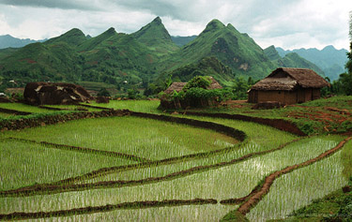
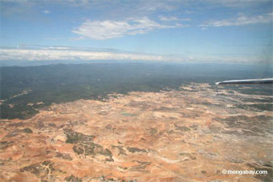
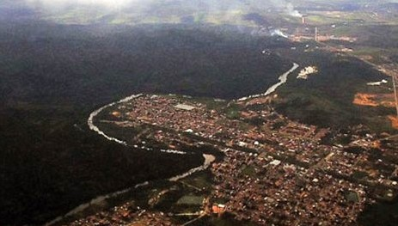
Drivers of Deforestation and Forest Degradation
AGRICULTURE
EXPANSION
DESERTIFICATION
URBAN EXPANSION
Notes:
KEY MESSAGES:
There are direct and indirect; planned and unplanned drivers of both deforestation and forest degradation identified by various approaches including analysis of historical data with participation of stakeholders
Each country or subnational region will have deforestation and degradation drivers specific to that region as was discussed in earlier lectures.
Image sources
https://www.wageningenur.nl/en/show/Agriculture-is-the-direct-driver-for-worldwide-deforestation.htm
http://news.mongabay.com/2005/1115-forests.html
http://curitibainenglish.com.br/current-affairs/environment/amazon-urbanization/

Slide 18
Stratification
Reference Level
MRV System
KEY
Final Outcome
Future Projection of Emissions
Policy decision
Sum Emissions
Intermediate outcome
Technical input
Emissions from Deforestation
Emissions from Forest Degradation
Emission Reduction from Forest Enhancement
Deforestation Activity Data
Deforestation Emission Factors
Forest Degradation Activity Data
Forest Degradation Emission Factors
Forest Enhancement Activity Data
Forest Enhancement Emission Factors
Stratification
Driver Analysis
Notes:
KEY MESSAGES:
After drivers are identified, stratification is the next step.
Chart source:
Walker et al. 2013 Technical Guidance on Development of a REDD+ Reference Level May 2013 version. Winrock International Ecosystems Services Unit

Slide 19
What is Forest Carbon Stratification?
Forest carbon stratification refers to the division of heterogeneous unit (FOREST) into distinct homogeneous groups (STRATA) with respect to CARBON
Forest carbon stratification is a critical decision for national/ sub-national REDD+ initiative.
ONCE A STRATIFICATION SCHEME IS DETERMINED, IT CANNOT BE CHANGED DURING MONITORING PERIODS!!
Notes:
KEY MESSAGES:
During stratification, forest area is divided into sub units each of which have similar sized carbon pools. Forest strata are often defined by species composition, soil quality and forest age.
Forest carbon stratification is critical to optimize sampling efforts and improve the accuracy of the national forest inventory.

Slide 20
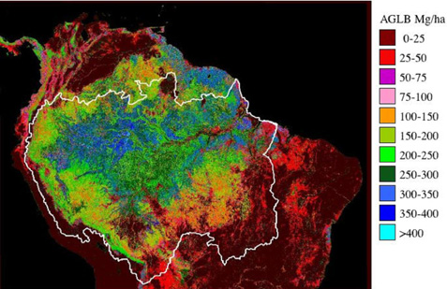
Forest Carbon Strata Map
This is one example of a map of forest stratification.
In this case the forests of the Amazon Basin is divided by estimated above-ground biomass
Notes:
KEY MESSAGES:
Here is an example of a forest stratification map from South America. In this image the Amazon Basin is divided into 11 strata based on aboveground biomass
Image source:
http://www-radar.jpl.nasa.gov/carbon/ab/fbc.htm

Slide 21
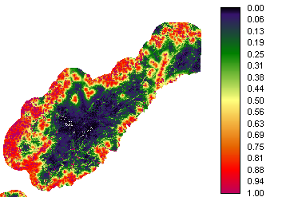
Forest Threat Stratification
Use spatial model to project deforestation threat based on past patterns and rates
Generate a potential land use change map for a 10-yr period
Rescale “threat” into three classes
Notes:
KEY MESSAGES:
This is another example – here forests are stratified by the threat they face based on factors such as proximity to roads and population centers, slope and protection status
Stratification can have a great influence on the costs of collecting ground data. We will talk much more about stratification later – the important thing to remember about stratification is that it increases the accuracy and precision of measurements and estimation because it divides the sampled area into “strata” that form relatively homogenous units. In general, stratification also decreases the costs of monitoring because it typically diminishes the sampling efforts necessary while maintaining the same level of confidence (it does so because there is a smaller variation in carbon stocks in each stratum than in the whole area).
Chart source:
Walker et al. 2013 Technical Guidance on Development of a REDD+ Reference Level May 2013 version. Winrock International Ecosystems Services Unit

Slide 22
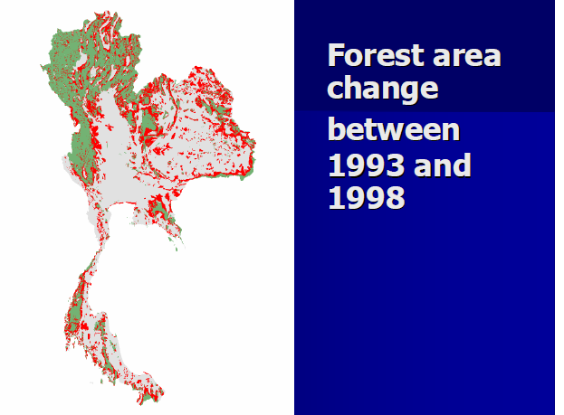
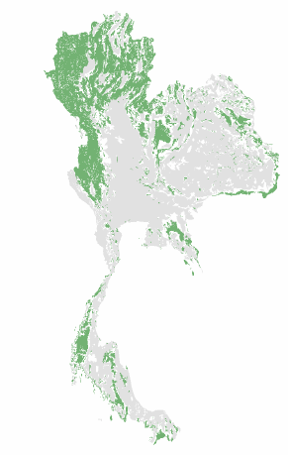
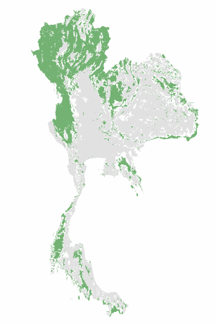
Activity Data
Definition of forest is important to determine the main type activities causing deforestation, degradation, and forest enhancement
Activity data for RLs should be developed using spatial data and expertise along with non-spatial data
1998
1993
-
–
=
ACTIVITY DATA
Notes:
KEY MESSAGES:
Activity data (AD) – measure of extent of activity Here is an example where remote sensing maps show forest area from 1998 in the left hand map and 1993 in the middle map
The difference in forest area is indicated in red in the right hand map and the sum of that area is the activity data for deforestation over that time period
Image source:
The Forest Cover Assessment by Omsomwang and Rattanasuwan presented at the 2nd GEO Forest Monitoring Symposium, Chiang Mai Thailand 2009.
https://www.earthobservations.org/documents/cop/ag_forest/20090701_thailand/15%20Forest%20Cover%20Assessment%20in%20Thailand.pdf

Slide 23
Emission Factors
Reference Level
MRV System
KEY
Final Outcome
Future Projection of Emissions
Policy decision
Sum Emissions
Intermediate outcome
Technical input
Emissions from Deforestation
Emissions from Forest Degradation
Emission Reduction from Forest Enhancement
Deforestation Activity Data
Deforestation Emission Factors
Forest Degradation Activity Data
Forest Degradation Emission Factors
Forest Enhancement Activity Data
Forest Enhancement Emission Factors
Stratification
Driver Analysis
Notes:
KEY MESSAGES:
Identifying emission factors for each activity data is the next step.
Emissions factors are the calculated amount of CO2 released (emitted) or taken up by a specific land use change
Chart source:
Walker et al. 2013 Technical Guidance on Development of a REDD+ Reference Level May 2013 version. Winrock International Ecosystems Services Unit

Slide 24
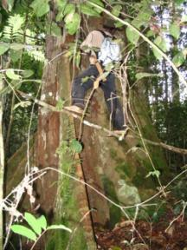
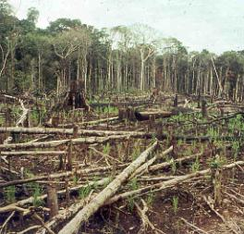
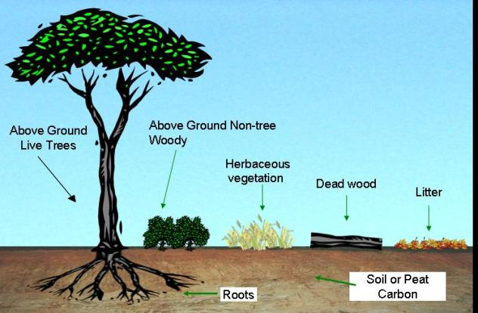
Emission Factors
The carbon stocks for each forest stratum undergoing change is determined to define emission factors
Notes:
KEY MESSAGES:
This slide provides an illustration of an emission factor for the conversion of a forest to cropland.
The emission factor is determined by estimating the change in carbon stocks in all pools impacted by the change in land use: live trees and their roots, shrubs and their roots, herbaceous vegetation, down dead material, and soil carbon. The changes are summed to calculate the emission factor.
Carbon stock image source:
Walker et al. 2013 Technical Guidance on Development of a REDD+ Reference Level May 2013 version. Winrock International Ecosystems Services Unit

Slide 25
Class Exercise
Calculate Emission Factors for the conversion of forest to pasture and oil palm plantation using the following data
Land use | AGBM (tC/ ha) | BGBM (tC/ha) | Soil C (tC/ha) | Dead wood (tC/ha)
Forest | 300 | 80 | 175 | 15
Pasture | 50 | 40 | 220 | 0
Oil Palm | 100 | 27 | 150 | 0
Notes:
KEY MESSAGES:
AGBM=ABOVE GROUND BIOMAS; BGBM=BELOW GROUND BIOMASS.
Have students working in groups or individually determine the emission factors for two land use conversion scenarios- they could include forest to pasture, forest to oil palm or oil palm to forest, pasture to oil palm.
Have students share their results and if they have different results for the same land use change pattern determine why they differ.

Slide 26
Emissions
Reference Level
MRV System
KEY
Future Projection of Emissions
Final Outcome
Policy decision
Sum Emissions
Intermediate outcome
Technical input
Emissions from Deforestation
Emissions from Forest Degradation
Emission Reduction from Forest Enhancement
Deforestation Activity Data
Deforestation Emission Factors
Forest Degradation Activity Data
Forest Degradation Emission Factors
Forest Enhancement Activity Data
Forest Enhancement Emission Factors
Stratification
Driver Analysis
Notes:
KEY MESSAGES:
Combining activity data and emission factors provides an estimate of historical emissions
Graph source:
Walker et al. 2013 Technical Guidance on Development of a REDD+ Reference Level May 2013 version. Winrock International Ecosystems Services Unit

Slide 27
Emission Factors
Reference Level
MRV System
KEY
Final Outcome
Future Projection of Emissions
Policy decision
Sum Emissions
Intermediate outcome
Technical input
Emissions from Deforestation
Emissions from Forest Degradation
Emission Reduction from Forest Enhancement
Deforestation Activity Data
Deforestation Emission Factors
Forest Degradation Activity Data
Forest Degradation Emission Factors
Forest Enhancement Activity Data
Forest Enhancement Emission Factors
Stratification
Driver Analysis
Notes:
KEY MESSAGES:
Identifying emission factors for each activity data is the next step.
Emissions factors are the calculated amount of CO2 released (emitted) or taken up by a specific land use change
Chart source:
Walker et al. 2013 Technical Guidance on Development of a REDD+ Reference Level May 2013 version. Winrock International Ecosystems Services Unit

Slide 28
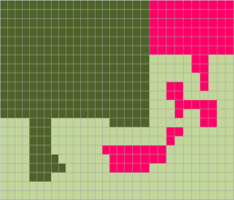

Emissions from Deforestation
Activity data | * | Emission factor | = | Emissions from Deforestation
1000 ha | * | 495 t CO₂/ha | = | 495,000 t CO₂e
Notes:
KEY MESSAGES:
This slide illustrates an example of an emissions calculation; activity data and emission factor. Important to again highlight that the units are tons of CO2 equivalent.
Reference:
USAID LEAF's Training. 2013

Slide 29
Establishing the Reference Level
Reference Level
MRV System
KEY
Final Outcome
Future Projection of Emissions
Policy decision
Sum Emissions
Intermediate outcome
Technical input
Emissions from Deforestation
Emissions from Forest Degradation
Emission Reduction from Forest Enhancement
Deforestation Activity Data
Deforestation Emission Factors
Forest Degradation Activity Data
Forest Degradation Emission Factors
Forest Enhancement Activity Data
Forest Enhancement Emission Factors
Stratification
Driver Analysis
Notes:
KEY MESSAGES:
Projecting future emissions based on historical levels can be done using various approaches.
Chart source:
Walker et al. 2013 Technical Guidance on Development of a REDD+ Reference Level May 2013 version. Winrock International Ecosystems Services Unit

Slide 30
Projection of Historical Emissions
Future conditions similar to the past
Notes:
KEY MESSAGES:
Future emissions can be predicted to be very similar to or different from historical emissions based on current data collection and policy decisions.
If conditions in the future are predicted to be similar to those in the past than predicting future emissions from past emissions using a linear projection for historical emissions with a significant trend or average emissions for historical patterns with no clear trend are preferred
Graph source:
Walker et al. 2013 Technical Guidance on Development of a REDD+ Reference Level May 2013 version. Winrock International Ecosystems Services Unit

Slide 31
Projection of Historical Emissions
Future conditions different from the past
Notes:
KEY MESSAGES:
Future emissions can be predicted to be very similar to or different from historical emissions based on current data collection and policy decisions.
If conditions in the future are predicted to change then future emission projections will need to reflect those changes and modelling projections is likely the best approach. The dashed line in the figure above represents only an example of one possible modelled future emission pattern with a change in conditions
Graph source:
Walker et al. 2013 Technical Guidance on Development of a REDD+ Reference Level May 2013 version. Winrock International Ecosystems Services Unit

Slide 32
Future Conditions Expected to Change
Pending further guidance from the UNFCCC, and based on existing guidance, the assessment of national circumstances could consider the following information:
  Geographic characteristics (climate, forest area, land use, other environmental characteristics);
  Population (growth rates, distribution, density, etc.);
  Economic (energy, transport, industry, mining, tourism, agriculture, fisheries, waste, health, services)
  Regulatory (land tenure/permitting and land use designation, land use planning, regulatory changes)
Notes:
KEY MESSAGES:
In case where future conditions are expected to change, reference levels can be adjusted based on national or provincial circumstances.
For example if population size or economic status are thought to influence the major drivers of deforestation and they are projected to change those changes need to be considered when projecting future emissions rates

Slide 33
Why Adjust for National Circumstances?
The Business as Usual (BAU) RL can be adjusted for national circumstances:
  to improve the accuracy of the BAU projection based on only historical emissions by taking into account relevant circumstances and future events that will affect forest emissions
  to reflect political considerations that are most relevant for defining financial support and linking RL to REDD+ results-based finance
Notes:
KEY MESSAGES:
Adjusting for national circumstances is a key policy decision and the justification needs to be transparent

Slide 34
Take Home Message
Emissions data are calculated from activity data and emissions factors
Reference levels are based on historical emissions data
Reference levels are essential to the determination of additionality or the impact of mitigation activities

Slide 35
References and Resources
USAID. 2015. USAID LEAF‘s Climate Change Curriculum. USAID Lowering Emissions in Asia Forests Program (USAID LEAF). Winrock International and US Forest Service. Bangkok, Thailand.
Harris et al. 2012. Decision Support Tool for Developing Reference Levels for REDD+. Winrock International for World Bank Forest Carbon Partnership Facility.
Walker et al. 2013 Technical Guidance on Development of a REDD+ Reference Level May 2013 version. Winrock International Ecosystems Services Unit
Harris et al. 2013. Draft Methodological Framework for Developing RL/RELs for REDD+. Winrock International for World Bank Forest Carbon Partnership Facility.

Slide 36
References and Resources
The curriculum of USAID’s Climate-Resilient Ecosystems and Livelihoods (CREL) in Bangladesh is a free resource of teaching materials for university professors, teachers and climate change training experts.
Reproduction of CREL’s curriculum materials for educational or other non-commercial purposes is authorized without prior written permission from the copyright holder, provided the source is fully acknowledged.
Suggested citation: Winrock International. 2016. USAID‘s Climate-Resilient Ecosystems and Livelihoods (CREL). Winrock International. Dhaka, Bangladesh.
Disclaimer: The CREL’s curriculum is made possible by the support of the American People through the United States Agency for International Development (USAID). The contents of the curriculum do not necessarily reflect the views of USAID or the US Government.

Slide 37
USAID's Climate-Resilient Ecosystems and Livelihoods (CREL) Project
Winrock International Headquarters
2101 Riverfront Drive, Little Rock
Arkansas 72202-1748 USA
Tel: 1-501-280-3000
Web: www.winrock.org

