Slide 1
Bangladesh Climate-Resilient Ecosystem Curriculum (BACUM)
Module 3: Forest Carbon Measurement and Monitoring

Slide 2
Module 3: Forest Carbon Measurement and Monitoring
SECTION I: FUNDAMENTALS OF FOREST CARBON IN REDD+ CONTEXT
1.2. The Roles of Forests and Forest Carbon in Global Climate Negotiation

Slide 3
Forest Carbon Measurement and Monitoring (FCMM)
FUNDAMENTALS OF FOREST CARBON IN REDD+ CONTEXT
  1.1. Forests, the Global Carbon Cycle and Climate Change
  1.2. The Roles of Forests and Forest Carbon in Global Climate Negotiations
  1.3. Challenges for Forest-based Climate Change Mitigation
FOREST CARBON STOCKS AND IPCC GUIDELINES
  2.1. Overview of Forest Carbon Pools (Stocks)
  2.2. Land Use, Land Use Change, and Forestry (LULUCF)
  2.3. IPCC Guidelines for Forest Carbon Measurement and Monitoring
  2.4. Reference Levels – Monitoring against a Baseline
FOREST CARBON MEASUREMENT AND MONITORING METHODS
  3.1. Overview of Forest Carbon Measurement and Monitoring
  3.2. Quality Assurance and Quality Control (QA/QC)
  3.3. Field Sampling Design Methods
  3.4. Forest Carbon Field Measurement Methods
  3.5. Carbon Stock Calculation and Available Tools
  3.6. Creating Activity Data and Emissions Factors
  3.7. Considerations in Developing a Monitoring System

Slide 4
Acknowledgements
EXPERT CONTRIBUTORS | SPECIFIC INPUTS
Prof. (Dr.) Manzoor Rashid | Curriculum Development for all topics
Prof. (Dr.) Md. Danesh Miah | REDD+, Forest Carbon
Prof. (Dr.) Md. Jakariya | Community NR Management, Climate Change, Natural Resources Management
UNIVERSITIES
Bangladesh Agricultural University
University of Chittagong
Dhaka University
Independent University, Bangladesh
Khulna University
Noakhali University of Science and Technology
Shahjalal University of Science and Technology
Sher-e-Bangla Agriculture University
North South University
CREL STAFF | CREL STAFF
John A Dorr | Utpal Dutta
Abu Mostafa Kamal Uddin | Ruhul Mohaiman Chowdhury
Kevin T. Kamp | Rahima Khatun
Paul Thompson | Sultana Razia Zummi
Abdul Wahab | Shams Uddin
Shahzia Mohsin Khan
DESIGN, LAYOUT AND CONTENT DEVELOPMENT: Ms. Chi Pham, Curriculum Development Expert, Bangkok, Thailand

Slide 5
Learning Objectives
At the end of this session, students will be able to:
Identify the essential steps for including forests in the international climate negotiations
Describe how afforestation/reforestation (A/R) evolved into RED and then REDD+
Analyze the current issues in REDD+ negotiations
Notes:
Key message: Just read these 4 major learning objectives.
Reminder: This is an ever evolving topic so reviewing associated websites for the latest updates is highly recommended.

Slide 6
Pre-lecture Assignment: Discussion Option
Divide the class into groups of seven students
Each student will be assigned one of the seven texts to present to their group
Before class, or in class, break into groups and have each student present
  Date
  Major decision taken
  Which countries are affected
  How is forest/land use change treated
Notes:
KEY MESSAGES:
Options: pre-homework assignment, use newspaper and showcase background negotiations. Bring in a negotiator to breathe some life into this topic.

Slide 7
Today’s Class
How has forest carbon been incorporated into action on global climate? What were the major steps?
How did afforestation/reforestation (A/R) become RED and then REDD+?
What is the current status of REDD+?
Why is forest-based mitigation promising—environmentally, socially, and politically?
Notes:
KEY MESSAGES:
These are the topics we will discuss today
A/R is afforestation/reforestation RED the reduction of emissions from deforestation
REDD+ reduction of emissions from deforestation and forest degradation (plus forest management, conservation and carbon stock enhancement etc.)

Slide 8
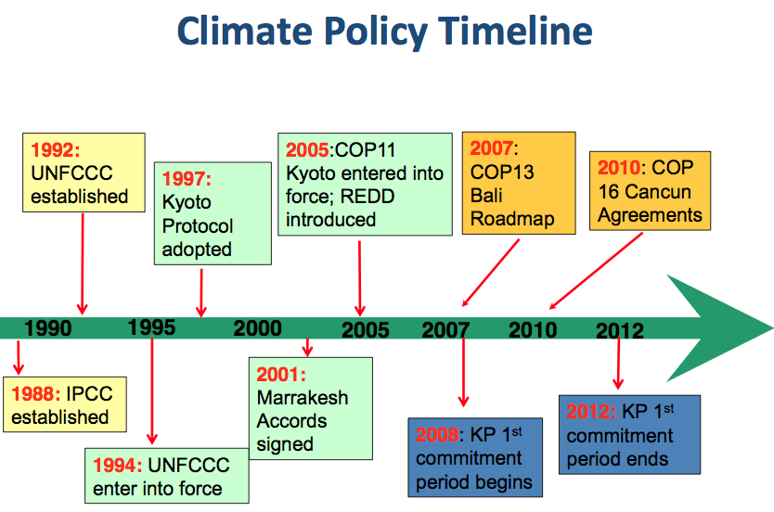
Climate Policy Timeline
History of UNFCCC
Including forests
Mitigation and other benefits
Notes:
KEY MESSAGES:
This is a brief timeline of major UN activities on climate change – we will discuss what important decisions or actions came out of each event
Acronym notes:
IPCC = Intergovernmental Panel on Climate Change
UNFCCC = United Nations Framework Convention on Climate Change
KP= Kyoto Protocol
COP = Conference of the Parties ( those nations that have signed up to the UNFCCC as of 2014 192 countries are “parties” to the UNFCCC)
Alternative: This timeline can be omitted in the lecture or instructors can show timeline but not what is written in the boxes until after activity. We can ask students to create it as an activity
Reference:
Paz- Rivera 2011. REDD+ negotiations and key milestones from Cancun to Durban

Slide 9
Paris Roadmap
Notes:
KEY MESSAGES:
Roadmap to a successful Climate Agreement 2015
Warsaw has to lay the foundation for a fair, ambitious and legally-binding agreement in 2015 which transforms how people in all countries use energy. Governments must also commit to doing more to reduce emissions prior to 2020. This is in order to ensure that the world can still stay as far below 2°C as possible.
Governments must:
- Chart the road to Paris
- Table post-2020 targets in 2014, not 2015
- Launch the development of an Equity Reference Framework
- Don't shelve climate protection until 2015, increase climate action now
- Establish a mechanism to address loss and damage of homes and livelihoods
- Respond to the latest science: review the long-term temperature warming limit
- Fill the climate fund and ensure that climate finance works for the poor
- Make REDD+ finance about stopping deforestation and protecting forests
Reference & Image Source:
http://www.greenpeace.org/international/Global/international/briefings/climate/COP19/Roadmap-to-Paris-Infographic.pdf

Slide 10
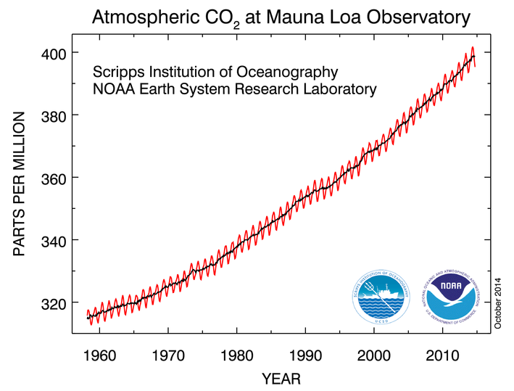
1992: Beginning to Address Climate Change
Notes:
KEY MESSAGES:
This is the Keeling curve – a record of atmospheric CO2 concentration in ppm measured at the Mauna Loa Observatory in Hawaii you have seen it in earlier lectures. It is helpful to look at the baselines set in each agreement in terms of what the atmospheric CO2 concentration is.
The carbon dioxide data (red curve), measured as the mole fraction in dry air, on Mauna Loa constitute the longest record of direct measurements of CO₂ in the atmosphere. They were started by C. David Keeling of the Scripps Institution of Oceanography in March of 1958 at a facility of the National Oceanic and Atmospheric Administration [Keeling, 1976]. NOAA started its own CO₂ measurements in May of 1974, and they have run in parallel with those made by Scripps since then [Thoning, 1989].
The black curve represents the seasonally corrected data.
Image source:
National Oceanic and Atmospheric Administration (NOAA)/Earth System Research Laboratory (ESRL) at http://www.esrl.noaa.gov/gmd/ccgg/trends/

Slide 11
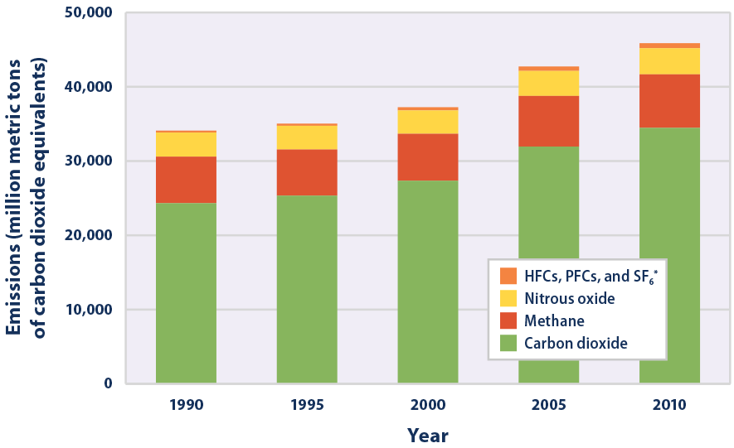
Global GHG Emissions by Gas,
1990-2010
Notes:
KEY MESSAGES:
This figure shows worldwide emissions of carbon dioxide, methane, nitrous oxide, and several fluorinated gases from 1990 to 2010.
For consistency, emissions are expressed in million metric tons of carbon dioxide equivalents.
These totals include emissions and sinks due to land-use change and forestry.
Please note that the UNFCCC was initiated in 1992.
Reference and Image Source:
US Environmental Protection Agency (EPA)
Link: https://www.epa.gov/climate-indicators/climate-change-indicators-global-greenhouse-gas-emissions

Slide 12
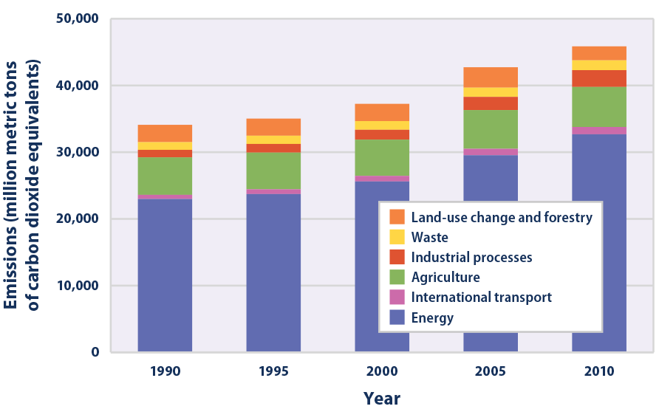
Global GHG Emissions by Setor,
1990-2010
Notes:
KEY MESSAGES:
This figure shows worldwide greenhouse gas emissions by sector from 1990 to 2010. For consistency, emissions are expressed in million metric tons of carbon dioxide equivalents. These totals include emissions and sinks due to land-use change and forestry.
Note that the sectors shown here are different from the economic sectors used in U.S. emissions accounting (see the U.S. Greenhouse Gas Emissions indicator). Emissions from international transport (aviation and marine) are separate from the energy sector because they are not part of individual countries’ emissions inventories. The energy sector includes all other transportation activities.
By economic sector the biggest source of CO2 is energy generation (power plants) with agriculture ( which includes deforestation) the second largest source but much smaller-the red box indicates the time period influencing the creation of the UNFCCC.
Please note that the UNFCCC was initiated in 1992.
Question for Discusion :
What were the major drivers of GHG emissions?
Reference and Image Source:
US Environmental Protection Agency (EPA)
Link: https://www.epa.gov/climate-indicators/climate-change-indicators-global-greenhouse-gas-emissions

Slide 13
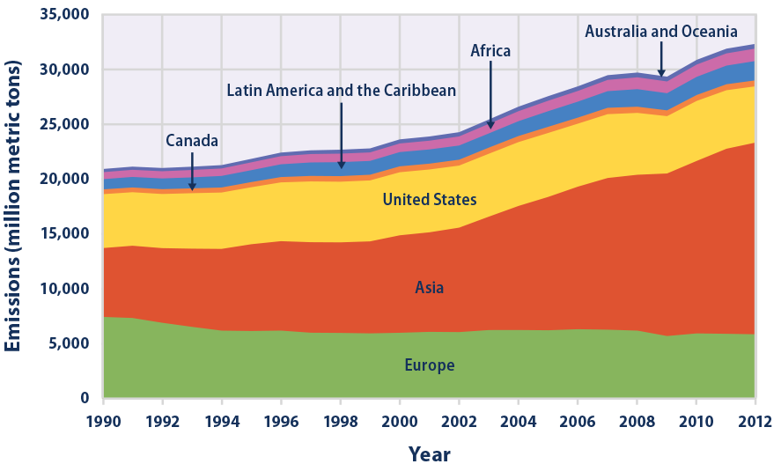
Global CO2 Emissions by Region,
1990–2012
Notes:
KEY MESSAGES:
This figure shows carbon dioxide emissions from 1990 to 2012 for different regions of the world.
These totals do not include emissions or sinks related to land-use change or forestry.
Inclusion of land-use change and forestry would increase the apparent emissions from some regions while decreasing the emissions from others.
In 1992 the UNFCCC was initiated. At the time the major CO2 emitters were Europe, Asia (primarily China) and the US.
Questions for Discussion:
Who were the big emitters?
Reference and Image Source:
US Environmental Protection Agency (EPA)
Link: https://www.epa.gov/climate-indicators/climate-change-indicators-global-greenhouse-gas-emissions
Reference and Graphic Source: US Environmental Protection Agency (EPA)
Link: https://www.epa.gov/climate-indicators/climate-change-indicators-global-greenhouse-gas-emissions

Slide 14
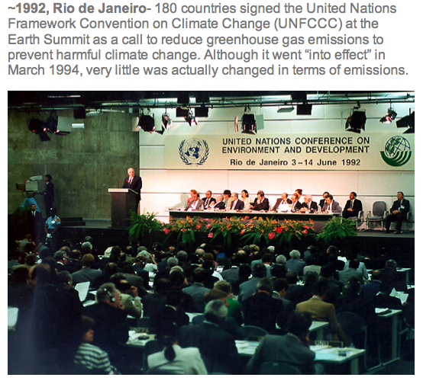
Earth Summit in 1992
Goal: “…stabilization of greenhouse gas concentrations in the atmosphere at a level that would prevent dangerous anthropogenic interference with the climate system.”
Notes:
KEY MESSAGES:
Earth Summit in 1992 some of the key text in the UNFCCC.
This is an important goal but note it is left somewhat vague in terms what GHG levels are considered dangerous
Reference:
UNFCCC
http://unfccc.int/essential_background/convention/items/6036.php
Image source:
http://www.mtholyoke.edu/~ljpothie/images/index.jpg

Slide 15
Earth Summit in 1992
Principle:
“…common but differentiated responsibilities”
Developed and developing nations have different obligations
Notes:
KEY MESSAGES:
All share the responsibility of reducing CO2 emissions but different obligations due to historical emission rates and state of economic development.
Question for discussion: Do countries have different obligations or just ways of achieving the global goal?
Reference:
UNFCCC
http://unfccc.int/essential_background/convention/items/6036.php
Image source:
http://www.mtholyoke.edu/~ljpothie/images/index.jpg

Slide 16
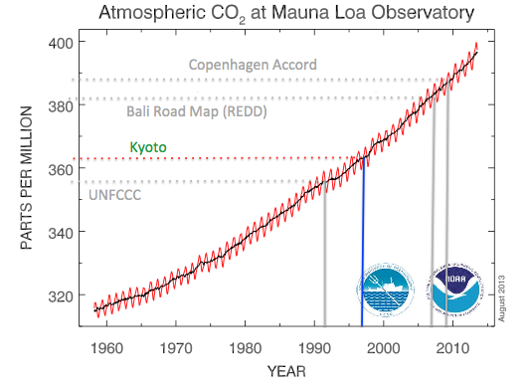
1997: Binding Commitments at Kyoto
Notes:
KEY MESSAGES:
Next point on the timeline is the meeting at Kyoto in 1997 where the Kyoto Protocol was finalized- 5 years after Rio atmospheric CO2 has already increased by about 5 ppm.
Despite issues addressed in the UNFCCC, atmospheric GHG concentrations continue to rise.
The graph shows at the time of the Kyoto Protocol the CO₂ concentration was over 360 ppm.
Reference:
National Oceanic and Atmospheric Administration (NOAA)/Earth System Research Laboratory (ESRL)
Link http://www.esrl.noaa.gov/gmd/ccgg/trends/

Slide 17
Kyoto Protocol (1997)
Context: global emissions growing
Fraction of global emissions due to tropical deforestation still high
Key points
  Formal agreement
  Annex I vs non-Annex I
Notes:
KEY MESSAGES:
Annex I vs non Annex I addresses the issue of different obligations between developed (Annex I) and developing (non Annex) countries.
Only Annex I countries have binding targets to meet in the KP
Reference:
UNFCCC. Link: http://unfccc.int/kyoto_protocol/items/2830.php

Slide 18
Kyoto Protocal and Its Mechanisms
Stimulate sustainable development through technology transfer and investment
Help countries with Kyoto commitments to meet their targets by reducing emissions or removing carbon from the atmosphere in other countries in a cost-effective way
Encourage the private sector and developing countries to contribute to emission reduction efforts
CDM
Kyoto
Mechanisms
ET
JT
Notes:
KEY MESSAGES:
The Kyoto mechanisms are:
Clean development mechanism (CDM)
Joint implementation (JI)
Emissions trading (ET)
The Kyoto mechanisms aim to:
Stimulate sustainable development through technology transfer and investment
Help countries with Kyoto commitments to meet their targets by reducing emissions or removing carbon from the atmosphere in other countries in a cost-effective way
Encourage the private sector and developing countries to contribute to emission reduction efforts
CDM and JI are the two project-based mechanisms which feed the carbon market. The CDM involves investment in emission reduction or removal enhancement projects in developing countries that contribute to their sustainable development, while JI enables developed countries to carry out emission reduction or removal enhancement projects in other developed countries.
The Kyoto Protocol set up some mechanisms to meet the binding targets for the Annex I countries.
Many of the mechanisms focused on trading carbon credits which encouraged participation by developing countries
Annex I countries with excess assigned amount units (who reduce emissions beyond their Kyoto commitments) can trade these AAUs (Assigned Amount Units) to other Annex I countries (ET). Each country has different allowed amount of carbon to be emitted (Assigned Amount Unit). If countries emit lower than AAUs, then they can trade the carbon credit.
Annex I Parties under the Convention must provide information in their national communications under the Kyoto Protocol to demonstrate that their use of the mechanisms is “supplemental to domestic action” to achieve their targets. This information is assessed by the facilitative branch of the Compliance Committee
Acronyms
ET= Emissions Trading
CDM= Clean Development Mechanism
JI= Joint Implementation
Reference:
UNFCCC. Link http://unfccc.int/kyoto_protocol/mechanisms/items/1673.php

Slide 19
Class Activity
Demonstrate the use of CAIT Climate Data Explorer at this web page: http:// cait.wri.org
Divide the class into groups (at least 4)
Have groups identify top 5 emitters (countries) at say 3 or 4 times by key events (e.g., pre- Kyoto, time of signing Kyoto, Bali Action Plan, and Copenhagen).
Have groups identify top emitters by total GHG emissions including LULUCF vs. excluding LULUCF; only CO2 vs. all GHG emissions; total emissions vs. on a per capita basis.
Have groups compare results and discuss.
Notes:
KEY MESSAGES:
Options: pre-homework assignment, use newspaper and showcase background negotiations. Bring in a negotiator to breathe some life into this topic.
Since the web tool has many variables to choose from, the instructor will need to guide students – e.g., some students can look at total GHG emissions including LULUCF while others look at top emitters excluding LULUCF. Others can look at only CO2 emissions. Others can look at a per capita basis. Others can look at trends in specific select countries.
Acronyms:
LULUCF. Land Use, Land Use Change and Forestry
CO2: Carbon Dioxide
GHG: Greenhouse Gas

Slide 20
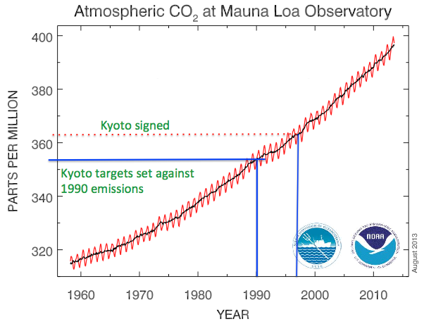
1997: Binding Commitments at Kyoto
Notes:
KEY MESSAGES:
In 1992, the CO₂ concentration was assumed to be dangerous so the goal was to reduce CO2 emissions to pre- UNFCCC level.
The Kyoto Protocol set 1990 as the baseline year for Annex I (developed) countries- trying to bring emissions levels back to pre-UNFCCC rates.
Ambitious goal to not only stop the increase in GHG concentrations but to actually reduce the atmospheric concentrations
Image source:
National Oceanic and Atmospheric Administration (NOAA)/Earth System Research Laboratory (ESRL) at http://www.esrl.noaa.gov/gmd/ccgg/trends/

Slide 21
Role of Forests in Kyoto
Annex I (developed) countries
Article 2 “shall: ….Implement and/or further elaborate policies and measures in accordance with its national circumstances, such as:
… (ii) Protection and enhancement of sinks and reservoirs of greenhouse gases … promotion of sustainable forest management practices, afforestation and reforestation
Article 3: Net emissions from deforestation shall be included in the calculation of the 1990 baseline emissions
Notes:
KEY MESSAGES:
The Kyoto Protocol specifically addresses the role of forests in mitigating climate change
Forest management and protection- as well as A/R (afforestation reforestation) explicit goals for Annex I countries
Clean Development Mechanisms only applied to reforestation from a practical perspective
Deforestation as a source of CO2 emissions will be counted in developed countries- moving from strictly considering afforestation/ reforestation towards a RED model. Remember from the previous lecture on the role of forests in climate by the 1990s temperate forests were a net sink rather than a source of CO2. Under Kyoto developing countries have no binding commitments so deforestation in tropical regions was not included
Reference:
UNFCCC. Link: http://unfccc.int/kyoto_protocol/items/2830.php

Slide 22
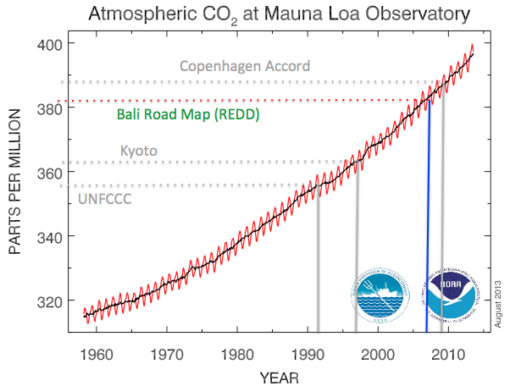
Bali Road Map
Notes:
KEY MESSAGES:
Here we can see that by the time the Bali meeting occurred (2007) atmospheric CO2 was above 380 ppm more than 20 ppm higher than when the UNFCCC was developed.
Image source:
National Oceanic and Atmospheric Administration (NOAA)/Earth System Research Laboratory (ESRL) at http://www.esrl.noaa.gov/gmd/ccgg/trends/

Slide 23
Role of Forests Under Bali Road Map
1. The Bali Action Plan Decision 1/CP13 Para 1 (b) (iii)
“Policy approaches and positive incentives on issues relating to reducing emissions from deforestation and forest degradation in developing countries; and the role of conservation, sustainable management of forests and enhancement of forest carbon stocks in developing countries”
Notes:
KEY MESSAGES:
REDD first developed as a concept- the emissions from deforestation and forest degradation in the tropical countries as a point of concern for all parties to the UNFCCC
References:
UNFCCC. Link: unfccc.int/resource/docs/2007/cop13/eng/06a01.pdf

Slide 24
Role of Forests Under Bali Road Map
There were five main issues, which remain contentious:
  1. Scope – what should be included in the definition of REDD
  2. Measurement, reporting and verification (MRV)
  3. The rights of indigenous people
  4. Financing options
  5. Institutional arrangements – whether REDD activities were considered National or project level activities.
Notes:
KEY MESSAGES:
The Bali Road Map opened debate on 5 key issues regarding the role of forests under the UNFCCC. These remain contentious.
Scope- extending beyond forestry and forest management to other LULUCF-biodiversity and social benefits beyond C accounting.
MRV- capacity building, technology transfer, baseline emissions still to be determined, leakage, permanence?
Indigenous peoples’ rights- still very much an issue- land tenure etc.
Financing options included funding from developed countries and the UN, market based approaches and financing options were connected to the question of institutional arrangements as some options are not available at different institutional scales ( regional vs national for example)
Many of these issues are still being resolved.
References:
UNFCCC
unfccc.int/resource/docs/2007/cop13/eng/06a01.pdf

Slide 25
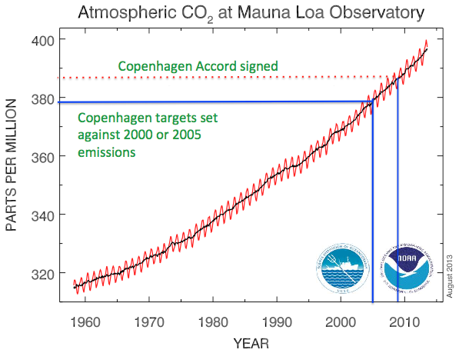
Copenhagen Accord
Notes:
KEY MESSAGES:
After Bali the next COP was in Copenhagen and a new target was established- to reduce emissions to the levels of 2000 or 2005.
The Copenhagen Accord was signed in 2009 and sets target at 2000 or 2005 emissions levels. Remember Kyoto originally set 1990 as the baseline
Discussion:
Ask question: Why do we have new target? Compare with Kyoto target?
Image source: National Oceanic and Atmospheric Administration (NOAA)/Earth System Research Laboratory (ESRL) at http://www.esrl.noaa.gov/gmd/ccgg/trends/

Slide 26
Copenhagen Accord
First time that developing countries made official commitments
Agree that the goal is to limit warming to < 2° C
Developed countries commit up to US$ 30 billion for adaptation and mitigation for the period 2010-2012
Copenhagen Green Climate Fund established to support mitigation projects in developing countries
Notes:
KEY MESSAGES:
There were four major results from the Copenhagen COP.
The best scientific knowledge suggested that limiting global warming to no more than 2 degrees C would meet the goal of avoiding significant impact.
Reference:
UNFCCC . Link unfccc.int/resource/docs/2009/cop15/eng/l07.pdf

Slide 27
Decision 4 CP15 Methods
1. Requests developing country Parties, …
  (a) To identify drivers of deforestation and forest degradation resulting in emissions and also the means to address these;
  (b) To identify activities within the country that result in reduced emissions and increased removals, and stabilization of forest carbon stocks;
  (c) To use the most recent IPCC guidance and guidelines, … as a basis for estimating anthropogenic forest-related greenhouse gas emissions by sources and removals by sinks, forest carbon stocks and forest area changes;
  (d) To establish, according to national circumstances and capabilities, robust and transparent national forest monitoring systems …
Notes:
KEY MESSAGES:
Developing (non Annex-I) countries to start identifying drivers of deforestation and degradation and start estimates of national carbon budgets and national forest monitoring systems.
All signatory members of the UNFCCC are now required to prepare National Greenhouse Gas Emission Inventories.
Reference:
UNFCCC. Link http://unfccc.int/land_use_and_climate_change/lulucf/items/6917.php

Slide 28
Role of Forests After Copenhagen
Annex I countries commit to emissions targets by 2020
Non Annex I countries will implement mitigation actions including national inventories
Included enhancing and maintaining carbon stocks (the “+” in REDD+)
Notes:
KEY MESSAGES:
Annex I countries commit to emissions targets (in all sectors) by 2020. Example: Australia: -5% up to -15% or -25%, Canada: 17%, Japan: 25%....
Instructors can mention that emissions from deforestation have been declining as a fraction of total since 2005. In 2013, only 10% of global emissions from deforestation
Reference:
UNFCC. http://redd.unfccc.int/uploads/2_181_redd_20100610_recoftc_after-copenhagen.pdf

Slide 29
Bali to Copenhagen and Beyond
Conversation evolved from ‘what is included’ to ‘methods’ to ‘safeguards’
Forest discussions often paved the way for discussions of the entire forum, for example on MRV, role of markets
Notes:
KEY MESSAGES:
While at times progress can seem slow, the conversation has actually been evolving not only in terms of moving from A/R to a more inclusive MRV but also moving from more theoretical questions to practical issues of how to measure and how to safeguard the actual carbon stocks as well as preventing leakage (moving the C emissions from one area to another)
Reference:
Jonathan Boston. 2008. Policy Quarterly. Vol 4, Number 1 2008. Institute of Policy Studies. Victoria University of Wellington, New Zealand.
http://ips.ac.nz/publications/files/87701057d45.pdf

Slide 30
Class Exercise
Concept map of developments, not just time but key issues:
  Scope – what should be included in the definition of REDD
  Measurement, reporting and verification (MRV)
  Safeguards
    The rights of indigenous people
    Biodiversity and natural forests
  Financing options
  Institutional arrangements – whether REDD activities were considered National or project level activities.
Notes:
KEY MESSAGES:
Potential in class activity to help build an understanding of the development of key ideas: how forest discussions have influenced the broader discussions.
The dates are not necessarily important but ensure that the students understand the order in which the key elements evolved.
There are more materials about the topics on Module 2: REDD+ in Climate Change Context

Slide 31
Limit Warming to 2° C
Already hit 400 in 2013
Notes:
KEY MESSAGES:
We are rapidly approaching the atmospheric concentrations scientists say will result in a 2 degree warming. Scientists say: Stay below 450 ppm
The original goal was to stabilize at a level that would “prevent dangerous anthropogenic interference with the climate system” now the goal is more specific- limit mean global warming to less than 2 degrees C.
Goal of the convention in 1992: Stabilization of CO2
Goal of COP in Cancun in 2010: Limit warming to 2° C (More specific target)
Image source:
NOAA. Link: http://www.esrl.noaa.gov/gmd/ccgg/trends/

Slide 32
Forests are One Possible Mitigation Strategy
Notes:
KEY MESSAGES:
One option suggested is to use a wide variety of current technologies each resulting in a reduction in emissions and summing to the necessary total reduction- stopping all deforestation and increasing area reforested/afforested is one of these “wedges” by Pacala and Socolow 2004.
Questions for discussion: How do forests mitigate climate change? How much carbon benefit do we get from REDD+?
Key message of discussion: Fraction of total CO2 emissions that come from Forest degradation and deforestation has been declining since 2005- there are still debates about the total amount but estimates for 2010 but the fraction at about 10%.
Reference and Image source:
Stabilization Wedges: Solving the Climate Problem for the Next 50 Years with Current Technologies. S. Pacala and R. Socolow in Science, Vol. 305, pages 968–972; August 13, 2004.

Slide 33
Carbon Benefits from 5 Components
Avoided deforestation
Avoided degradation
Conservation of forest carbon stocks
Enhancement of forest carbon stocks
Sustainable management of forests
Notes:
KEY MESSAGES:
The first two components are fairly self explanatory- avoiding carbon emissions by reducing rates of deforestation and forest degradation.
Conservation of forest carbon stocks is meant to address the value of maintaining forests that are NOT threatened with deforestation or degradation (thus, you cannot legitimately ‘avoid’ those emissions). They still act as an important carbon sink, just by being there. Think of parks. This was added to maintain incentives for existing protected areas and/or high forest/low deforestation countries, who could not legitimately claim that their forests were at risk of loss.
Enhancement of forest carbon stocks includes any management approaches that actually increase carbon storage in forests ( note this is different from afforestation or growing forests in areas that were deforested- this is increasing carbon storage in forests that stay in forest).
Finally sustainable management includes techniques such as reduced impact logging where forest resources can be extracted but that minimize the carbon emissions associated with the use of those forest resources.
There are more materials about the topics on Module 2: REDD+ in Climate Change Context

Slide 34
Forest Carbon is a Potential Win-win
Developing nations transition to low emission development without losing all forest
Developed nations obtain offsets to ease transition to new energy economy
Buy in from all parties to the whole process
Notes:
KEY MESSAGES:
Benefits to both developed and developing countries

Slide 35
Offsetting and Carbon Markets
Kyoto: JI and CDM
UNFCCC: REDD+
Voluntary Carbon Market (corporate social responsibility)
European Trading System
State-level actions in USA
Notes:
KEY MESSAGES:
REDD+ will need significant funds to function as intended and may require multiple funding streams including some or all of these.
Some of these are already functioning
Acronyms
ET= Emissions Trading
JI= Joint Implementation
CDM= Clean Development Mechanism. Emission-reduction projects in developing countries can earn certified emission reduction credits.

Slide 36
Co-benefits of REDD+
Are there extra benefits to forest mitigation?
Enforcement of current laws
New forest policy
Good governance
Transparency
Equity
Land tenure reform
These are co-benefits
Plus:
Biodiversity conservation
Water management
Human right
Notes:
KEY MESSAGES:
Other benefits include protection of biodiversity and water resources etc.
These developments are also benefits- improved governance and transparency etc.
Not just in questions of forest/ land management. Clarify that the ‘conditions’ for achieving forest mitigation also yield benefits or co-benefits.
This is a key place to refer to Module 2: REDD+ in Climate Change Context, which goes into governance, co-benefits, etc. Focus less on facts and more implications of decisions.
Reference:
The REDD Desk. Link: http://theredddesk.org/theme/safeguards-and-co-benefits

Slide 37
Take Home Message
Since Kyoto the discussion of the role of forests in tropical countries in GHG emissions has evolved from a focus on reforestation to preventing deforestation and forest degradation as well as improving forest C pools (REDD+)
Reducing emissions from LULUCF in the tropics alone will not resolve the problem of anthropogenic climate change but it is one part of the solution and the payment mechanisms set up allow both developed and developing countries to participate
The conditions necessary for REDD+ to succeed (Tranparency, Good governance, Equity etc) are all co-benefits as well

Slide 38
References and Resources
USAID. 2015. USAID LEAF‘s Climate Change Curriculum. USAID Lowering Emissions in Asia Forests Program (USAID LEAF). Winrock International and US Forest Service. Bangkok, Thailand.
Eliash Review. 2008. Climate Change: Financing Global Forests
Korhonen- Kuhki et al. 2012.Multiple levels and multiple challenges for REDD+ In Analyzing REDD+ Challenges and Choices .Angelsen, A., Brockhaus, M., Sunderlin, W.D. and Verchot, L.V. (eds) CIFOR Bogor Indonesia
Kholloway, V. and E. Giandomenico 2009. Carbon Planet White Paper. The History of REDD Policy. Carbon Planet Limited Adelaide SA
Dickson et al. UN-REDD Programme Policy Brief REDD+ Beyond Carbon: Supporting Decisions on Safeguards and Multiple Benefits
Pacala, S. and R. Sokolow. 2004. Stabilization Wedges: Solving the Climate Problem for the Next 50 Years with Current Technologies. Science, Vol. 305: 968–972.
Paz- Rivera 2011. REDD+ negotiations and key milestones from Cancun to Durban
Palmer , C. 2011. Property rights and liability for deforestation under REDD+: Implications for ‘permanence’ in policy design. Ecological Economics 70 : 571–576

Slide 39
References and Resources
The curriculum of USAID’s Climate-Resilient Ecosystems and Livelihoods (CREL) in Bangladesh is a free resource of teaching materials for university professors, teachers and climate change training experts.
Reproduction of CREL’s curriculum materials for educational or other non-commercial purposes is authorized without prior written permission from the copyright holder, provided the source is fully acknowledged.
Suggested citation: Winrock International. 2016. USAID‘s Climate-Resilient Ecosystems and Livelihoods (CREL). Winrock International. Dhaka, Bangladesh.
Disclaimer: The CREL’s curriculum is made possible by the support of the American People through the United States Agency for International Development (USAID). The contents of the curriculum do not necessarily reflect the views of USAID or the US Government.

Slide 40
USAID's Climate-Resilient Ecosystems and Livelihoods (CREL) Project
Winrock International Headquarters
2101 Riverfront Drive, Little Rock
Arkansas 72202-1748 USA
Tel: 1-501-280-3000
Web: www.winrock.org

